Slide 1
ihédate
Public interest versus private property in The Netherlands prof. mr. Jacques Sluysmans

Slide 2
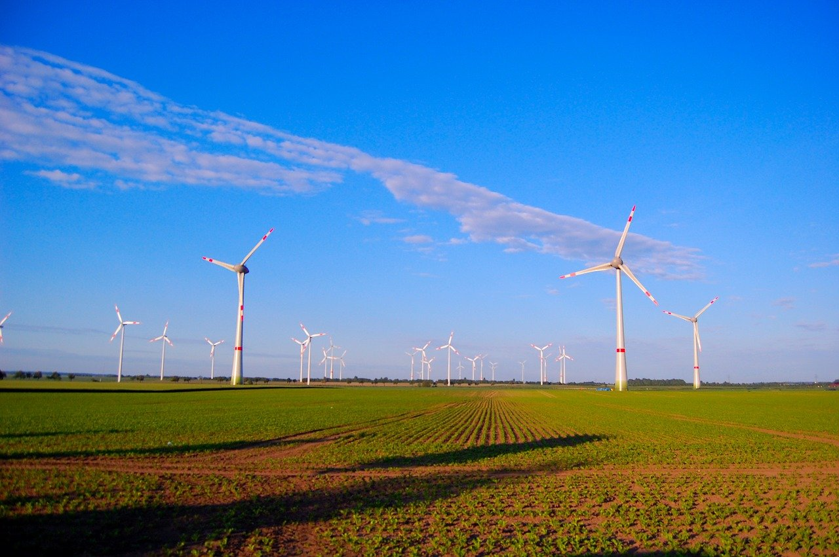
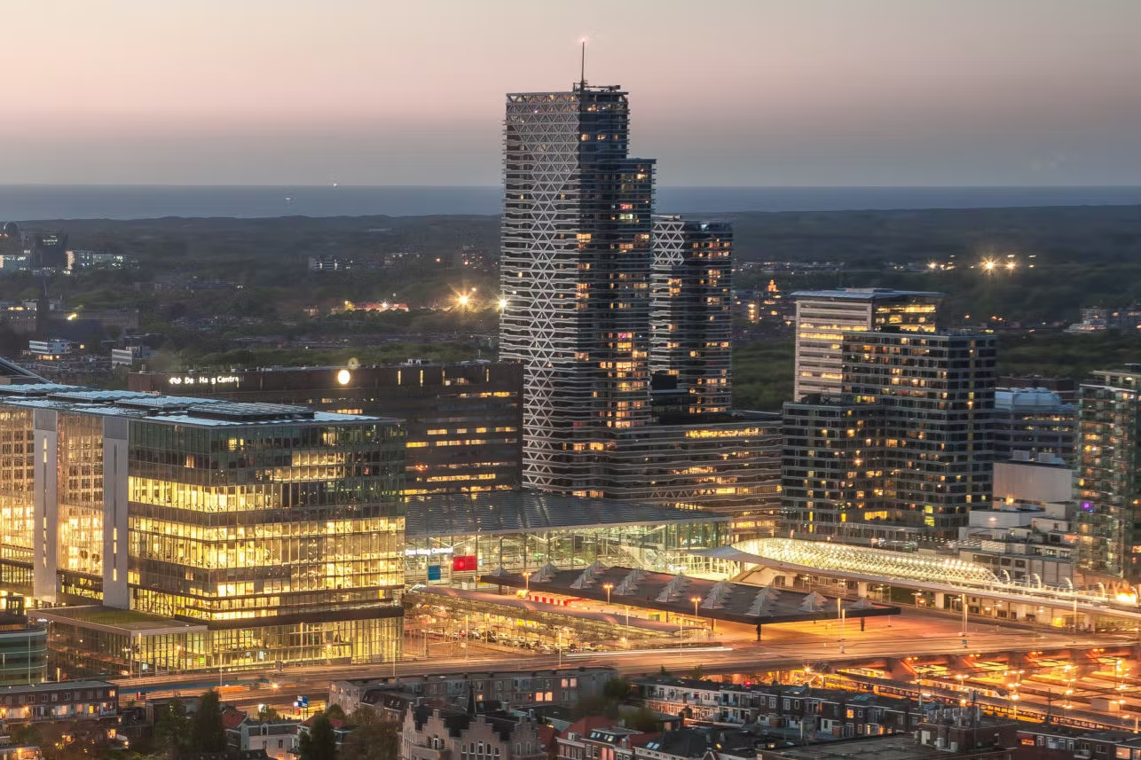
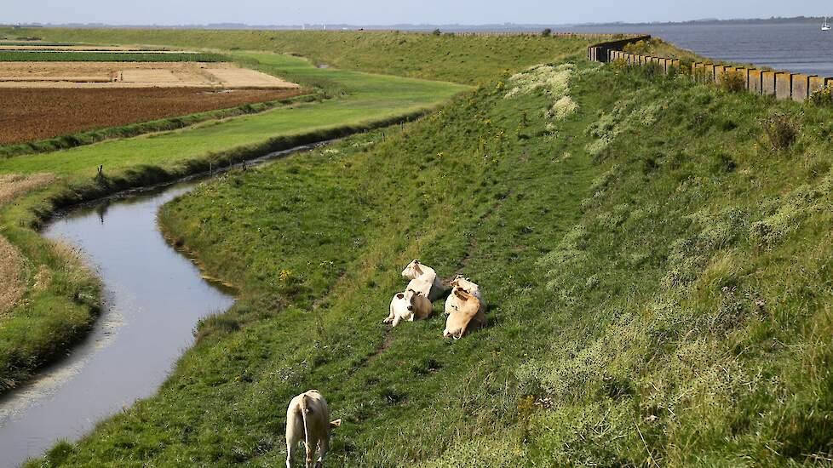

Slide 3
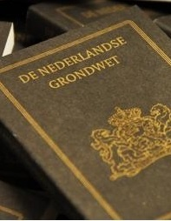
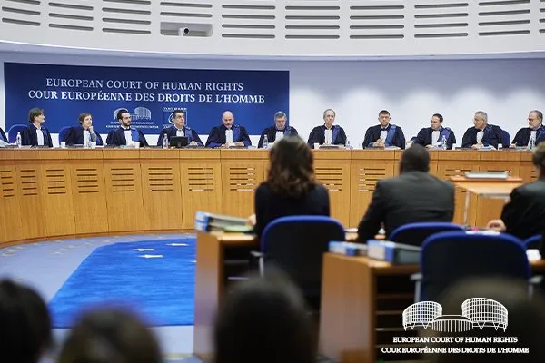
Property rights
Guaranteed by Constitution
But: no Constitutonal Court
Important: art. 1 FP ECHR

Slide 4
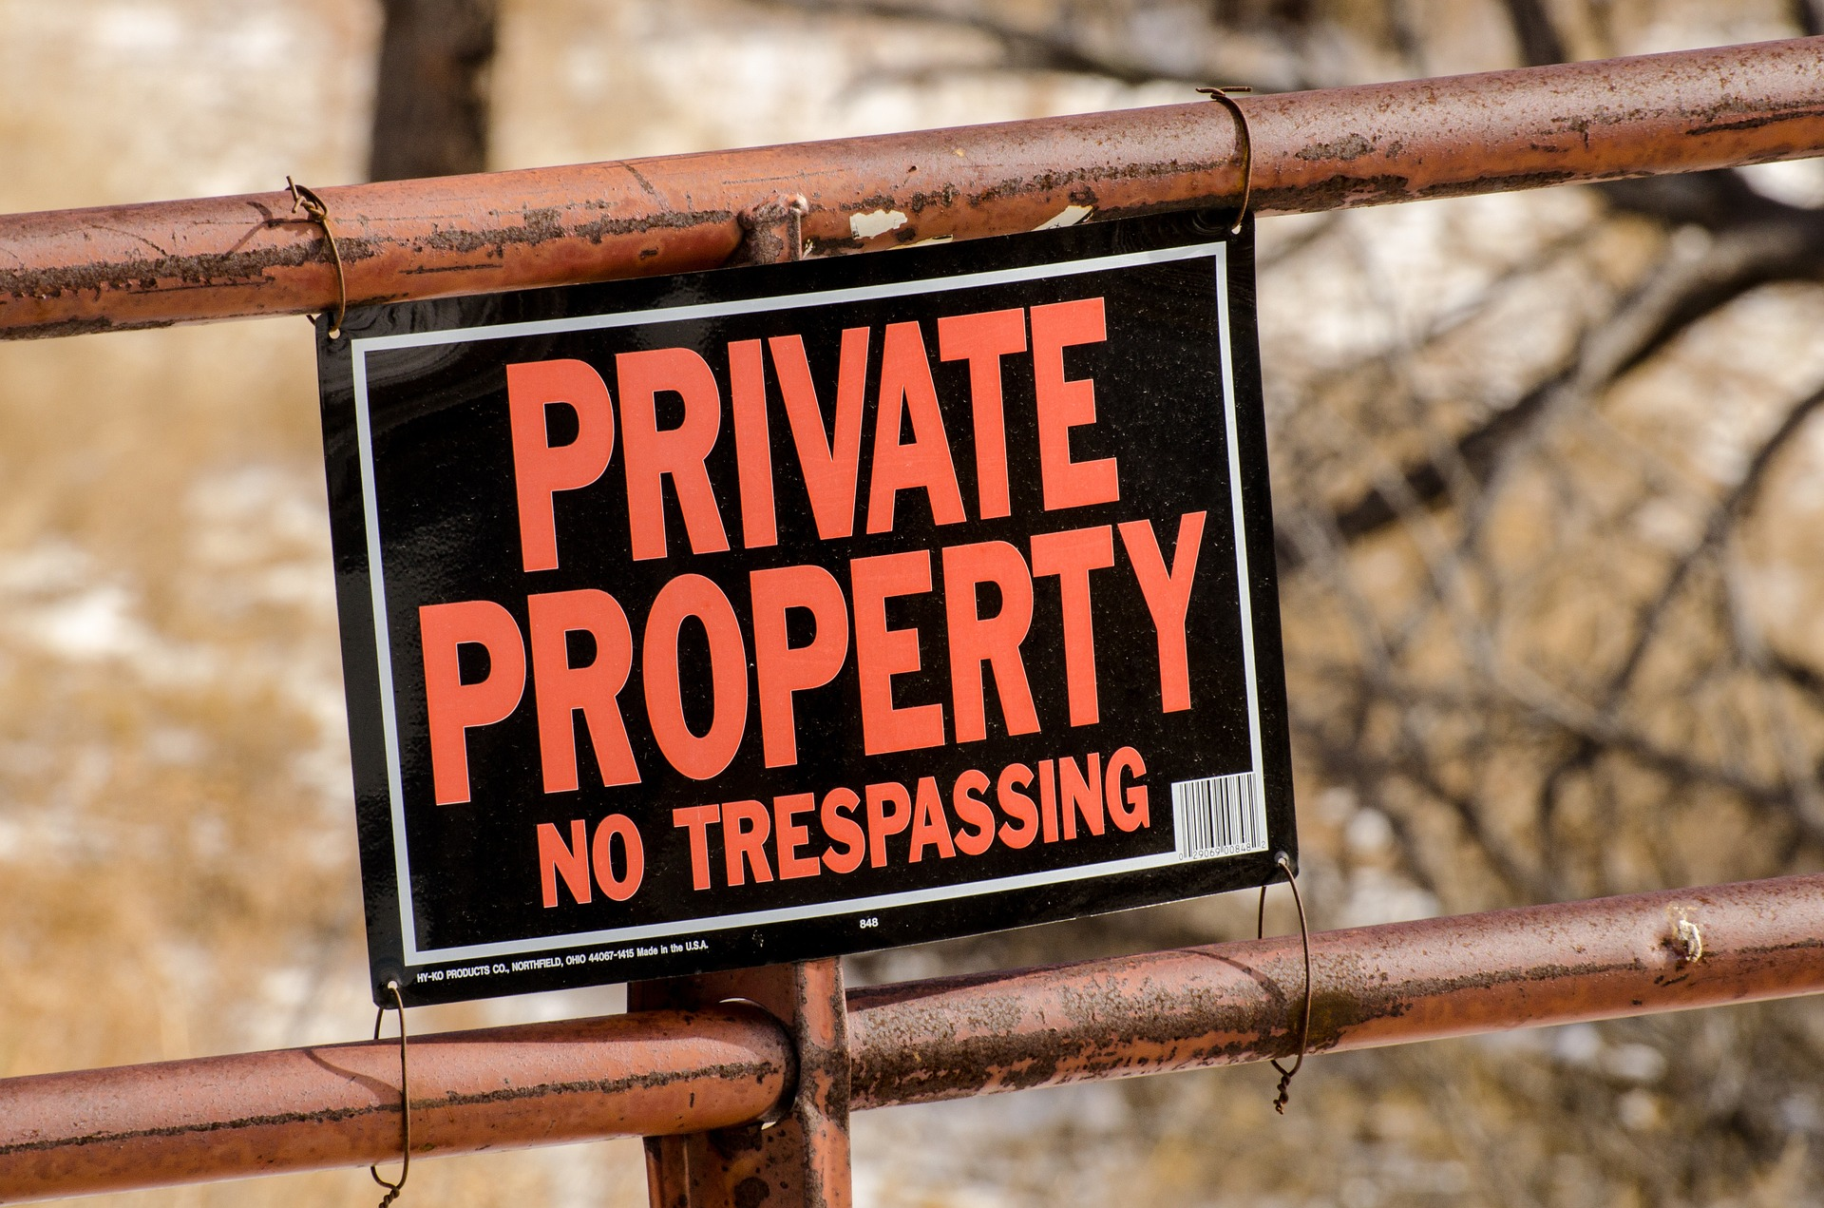
Infringement on property in public interest
Preferential rights
Expropriation
Public easements

Slide 5
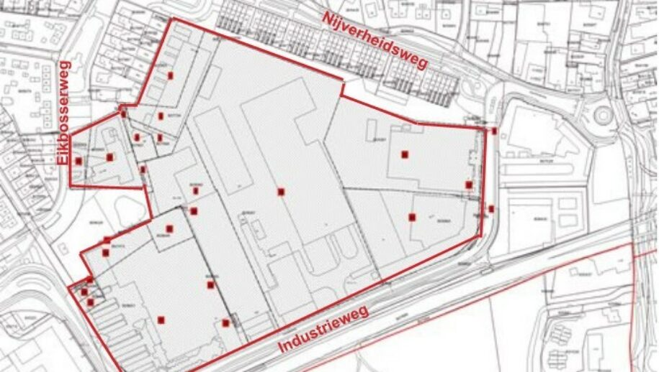
Preferential rights
Only for public authorities (muncipality, province, State)
Right of first refusal
Price fixing procedure (experts, court)
No obligation for property owner to sell at fixed price
If property is really needed: expropriation

Slide 6
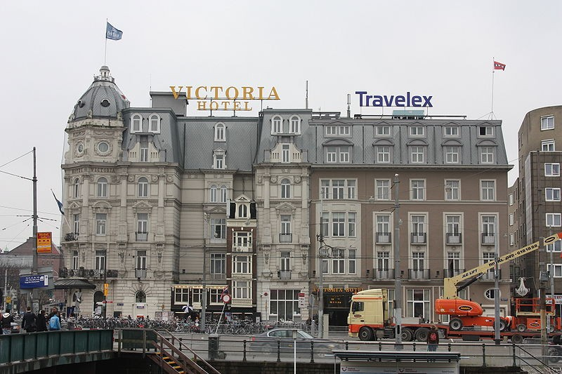

Slide 7
Expropriation
Most often: for the development of a zoning plan
Royal Decree
District Court: expropriation/compensation (experts)
Full compensation

Slide 8
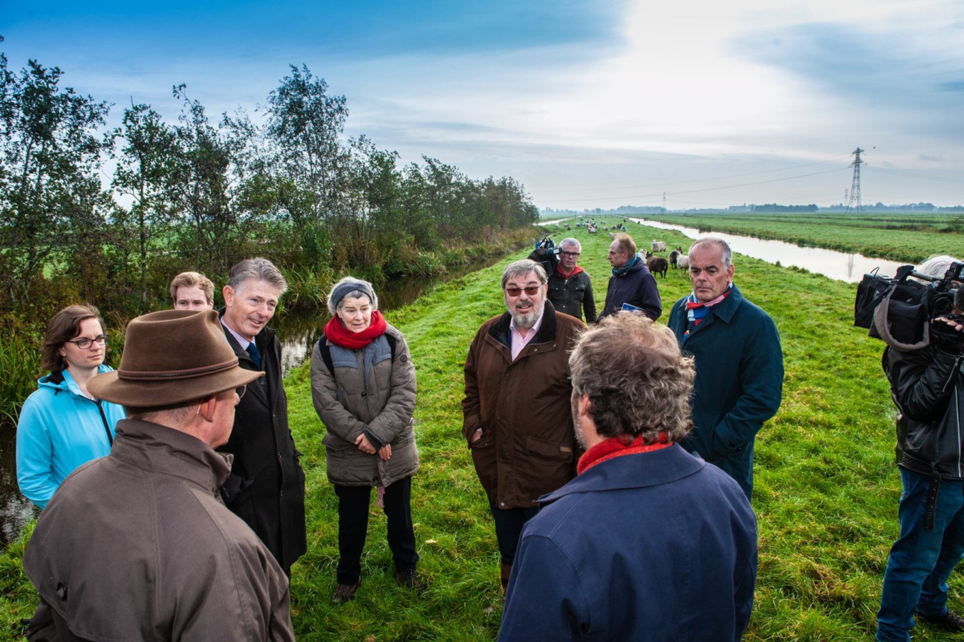

Slide 9
Full compensation
All the damages that are caused by the expropriation
  Value of the expropriated property
  Decrease in value of the remaining property (if applicable)
  All other damages (relocation costs, loss of income etc.)
Value is (generally) based on the zoning plan underlying expropriation
  Expropriation of farm land in order to develop a residential area causes a windfall profit for the property owner/farmer!

Slide 10
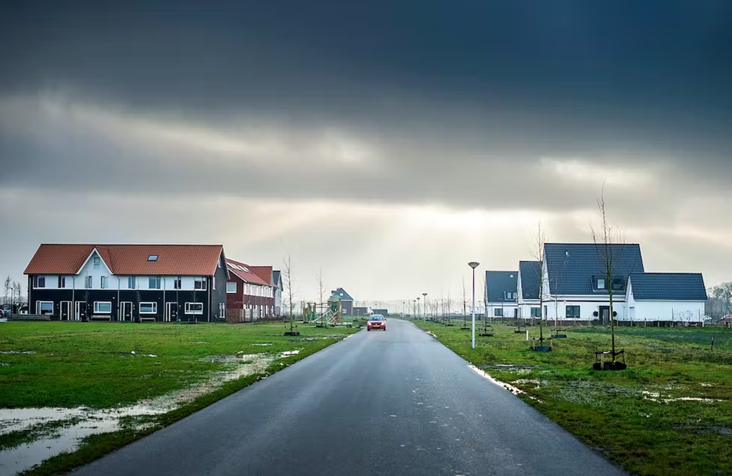

Slide 11
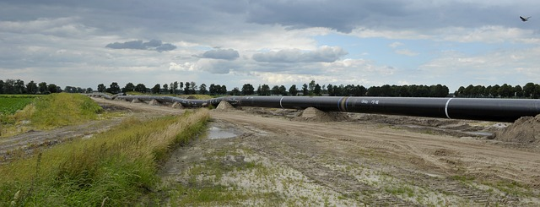
Public easement
Open for public authorities and private parties (usually for pipelines and cables)
Decision by minister, possibility of appeal in court
Also: entitlement to full compensation
Important tool for energy transition (expansion of the electricity grid, new pipeline corridors for hydrogen)

Slide 12
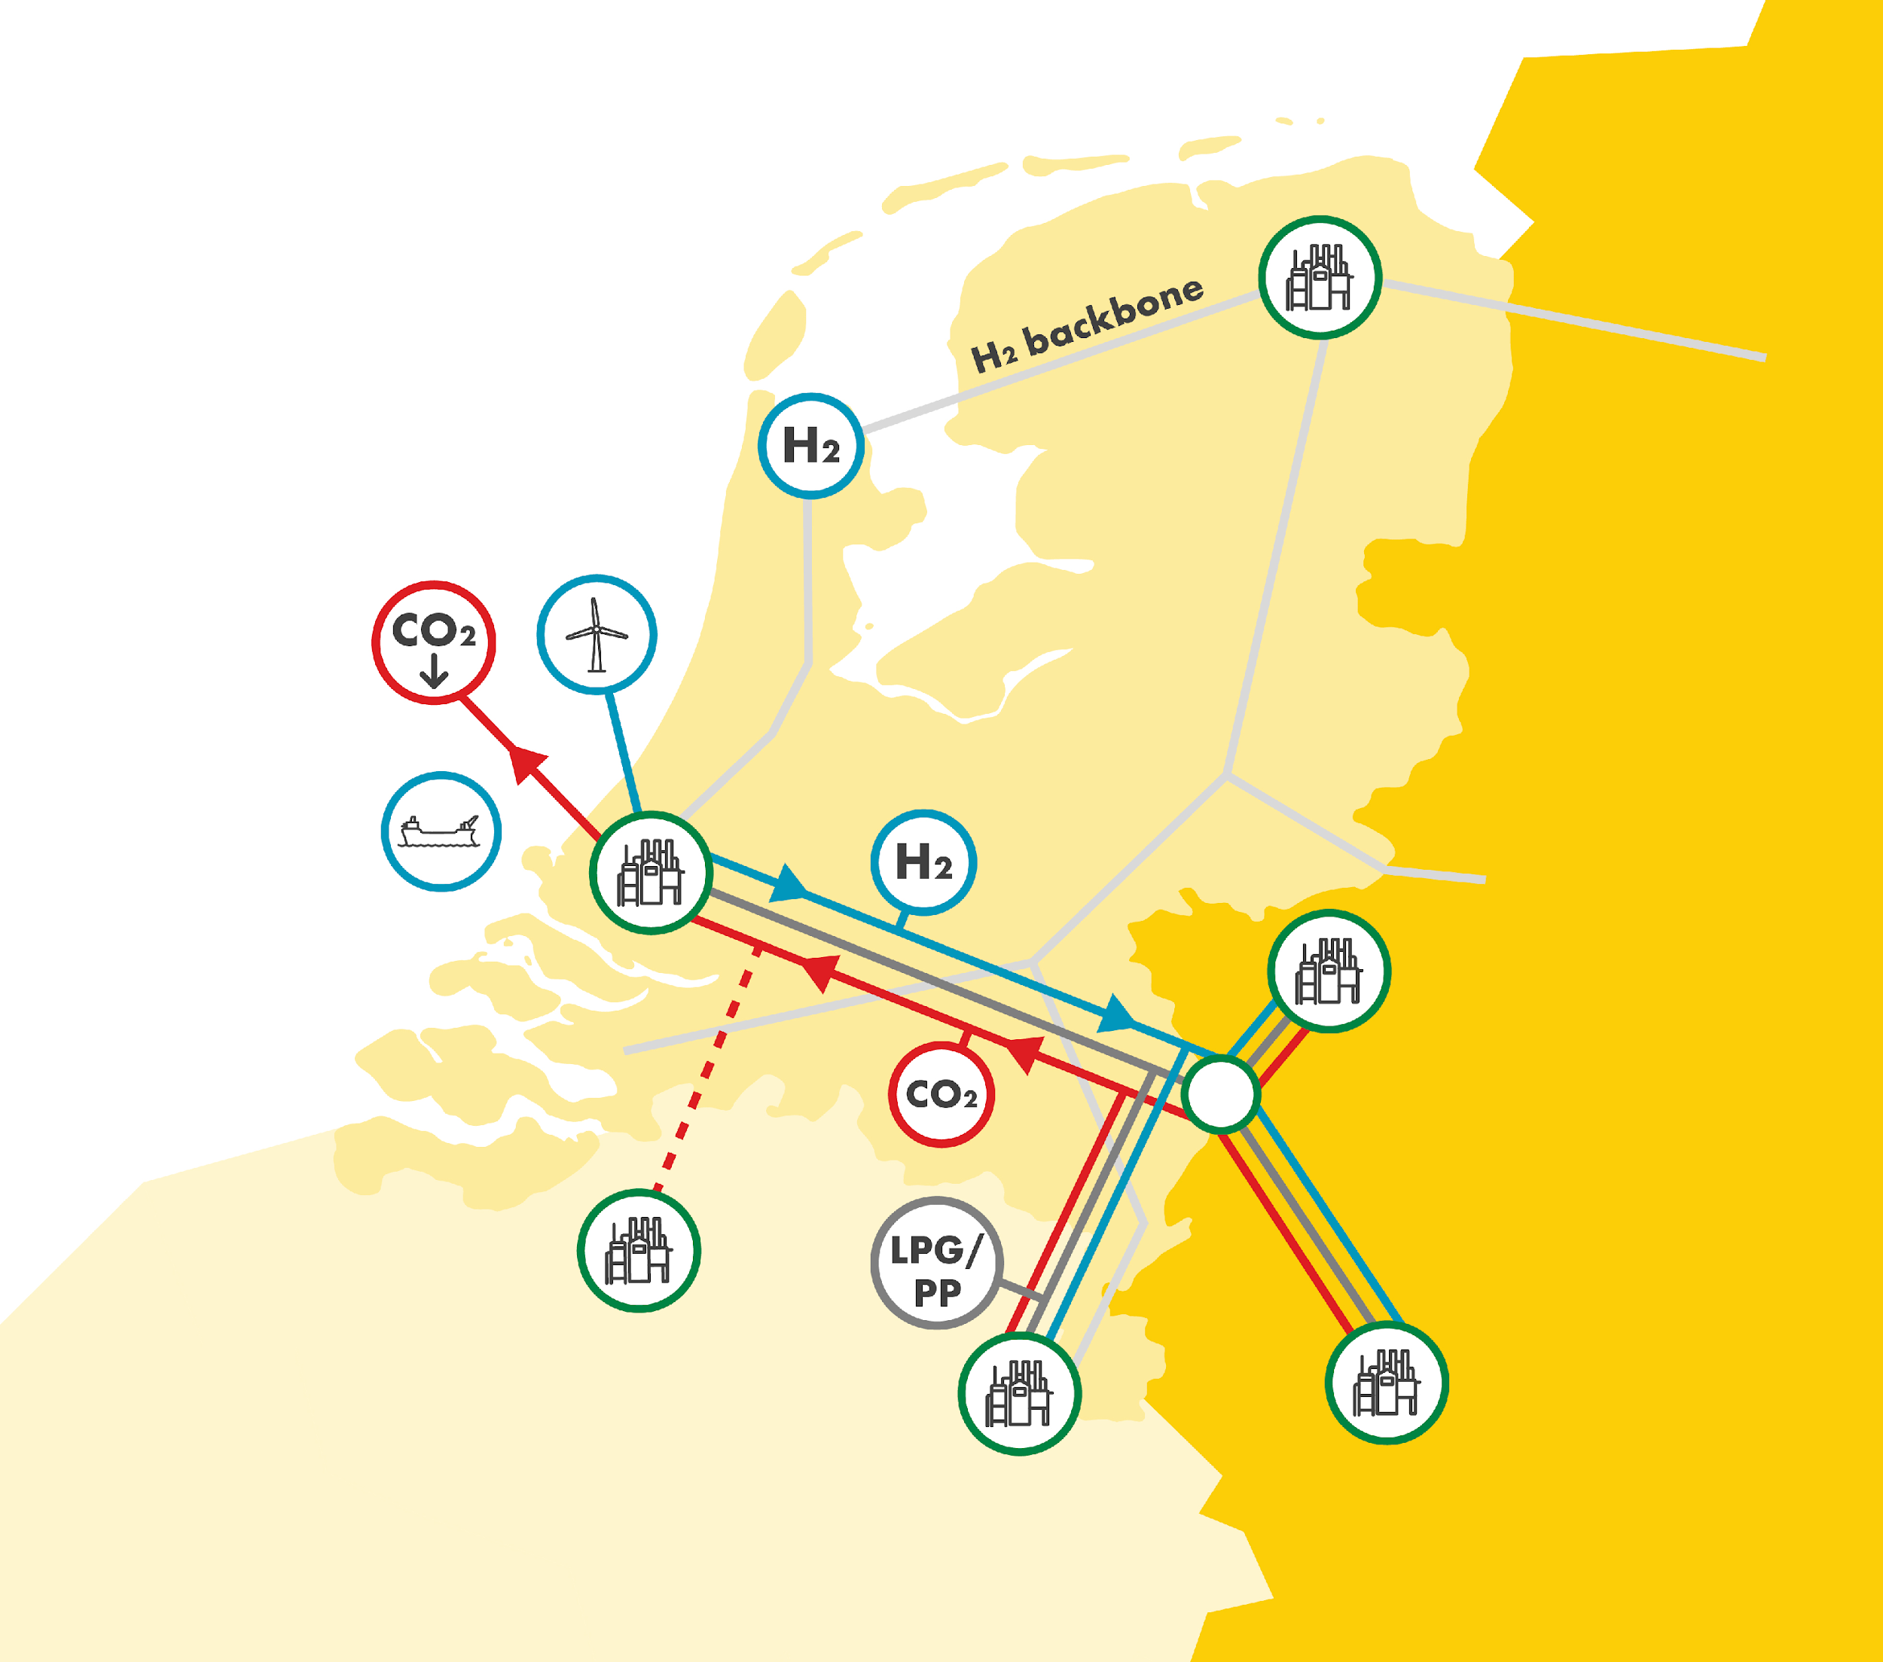
Energy crisis/transition
Expansion of electricity grid
New pipelines
  Delta Corridor
Re-use of pipelines
  Groningengas to hydrogen)
Public easements
  law is outdated and complicated (1927)

Slide 13
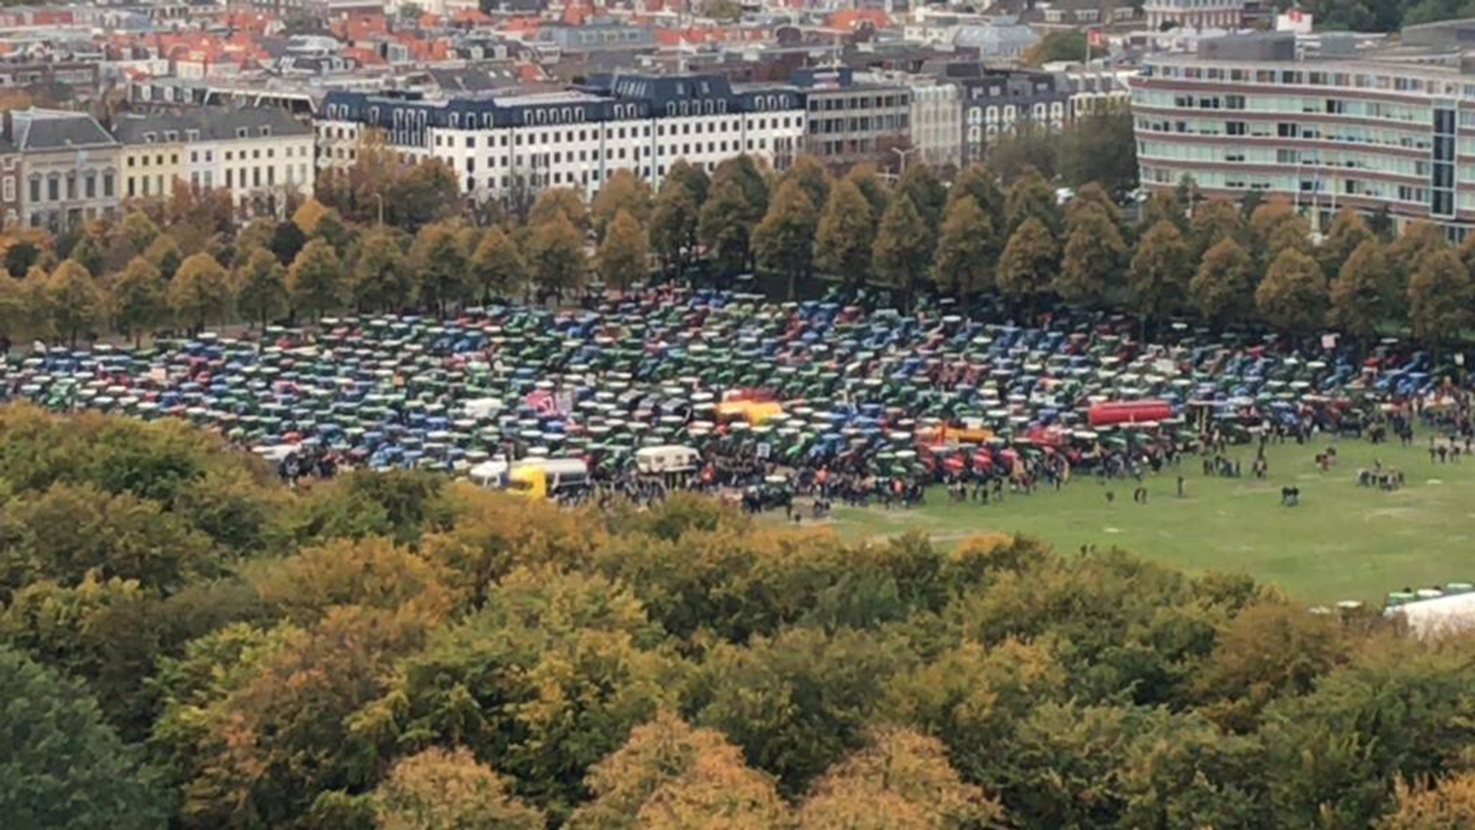
Farmers crisis
Too many farmers (livestock farming)
Problems with nitrogen and water quality
Thousands of farmers have to stop
  Buy out by State/province
  Change/withdrawal of environmental permits?
  Expropriation?

Slide 14
