Slide 1
Study Visit Presentation
Presented by: Claire Igoe, Associate Director of Sustainability, NHS Greater Manchester and Anoush Darabi, Senior Policy Manager, Transport for Greater Manchester
Date: 22nd May 2025

Slide 2
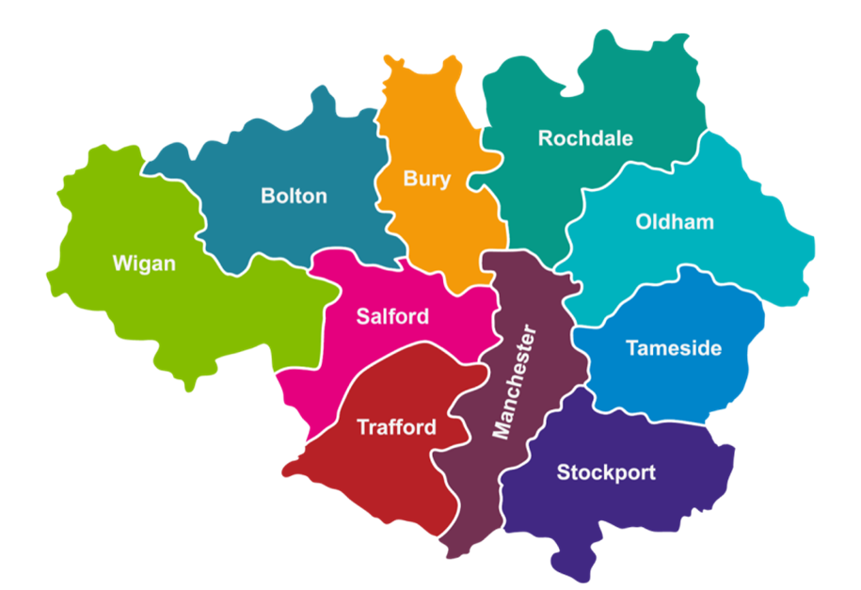







About Greater Manchester
Made up of 10 boroughs with a population of 2.8M
The Greater Manchester Combined Authority (GMCA) was established in 2011 and is run by the leaders of the 10 councils and the Mayor of Greater Manchester, Andy Burnham, with Caroline Simpson as the Chief Executive.
GM has had several devolution deals going back to 2009, covering transport, public services, employment, housing, low carbon, health and social care, post-16 education and training and other areas.
Known for being the birthplace of the Industrial Revolution and is now a major centre for services, media and digital industries.
Police & Crime
Transport
Health & Care
Environment & Low Carbon
Planning & Housing
Waste & Recycling
Investment and business support
Notes:
About Greater Manchester. The Greater Manchester Combined Authority (GMCA) was established in 2011 and is run by the leaders of the 10 councils and the Mayor of Greater Manchester, Andy Burnham, with Caroline Simpson as the Chief Executive.
Made up of 10 boroughs with a population of 2.8M. Greater Manchester is characterised by its dense urban and industrial developments, which include centres of commerce, finance, retail and administration, as well as commuter suburbs and housing, interspersed with transport infrastructure such as light rail, roads and motorway, and canals.
GM has had several devolution deals going back to 2009, covering police and crime, transport, public services, employment, housing, low carbon, health and social care, waste, post-16 education and training and investment and business support. With its long history on this agenda, Greater Manchester is known as the ‘poster child’ for devolution.
Greater Manchester was the birthplace of the Industrial Revolution and is now a major centre for services, media and digital industries. Manchester is renowned for its music and sporting legacy.

Slide 3




Greater Manchester is growing, but has challenges
2.8m people
Fastest growing city region outside of London
1.3m working in GM
+100,000 over next 10 years
Over 100,000 Higher Education Students
at 6 HE Institutions
124,000 businesses
Poverty: ~ 25% of GM residents living in the country’s most deprived neighbourhoods.​
Gross median weekly earnings: GM £567, compared to £767 in London, 25% lower.​
Life expectancy: ~two years below England average.​
Health inequalities: two-thirds of adults overweight or obese, ~third of population classed as “inactive”.
Notes:
Greater Manchester is growing, but has challenges
Greater Manchester is one of the UK’s fastest growing urban areas. Worth £74.8 billion, it is a larger economy than countries such as Wales, Croatia, Lithuania, and Slovenia.
Greater Manchester has persistent problems with poverty, health and inequality. 25% of residents live in the country’s most deprived neighbourhoods.
Earnings are 25% lower than in London, at £567 per week compared to £767 in London.
Greater Manchester has some of the lowest life expectancy in England, with differences between affluent suburbs and deprived neighbourhoods ranging from up to 9.5 years to as much as 17 years in some of the poorer communities. Two thirds of adults are classed as overweight or obese, and a third of the population is classed as inactive.
In Greater Manchester, 1,200 deaths every year are associated with poor air quality, much of which comes from domestic wood burning, industry, and internal combustion engine vehicles, and the city-region has set a target to become carbon neutral by 2038. Carbon emissions are falling, but not at the scale or pace required.
71% of Greater Manchester’s carbon emissions result from two areas: travel and transport; and domestic heating.

Slide 4
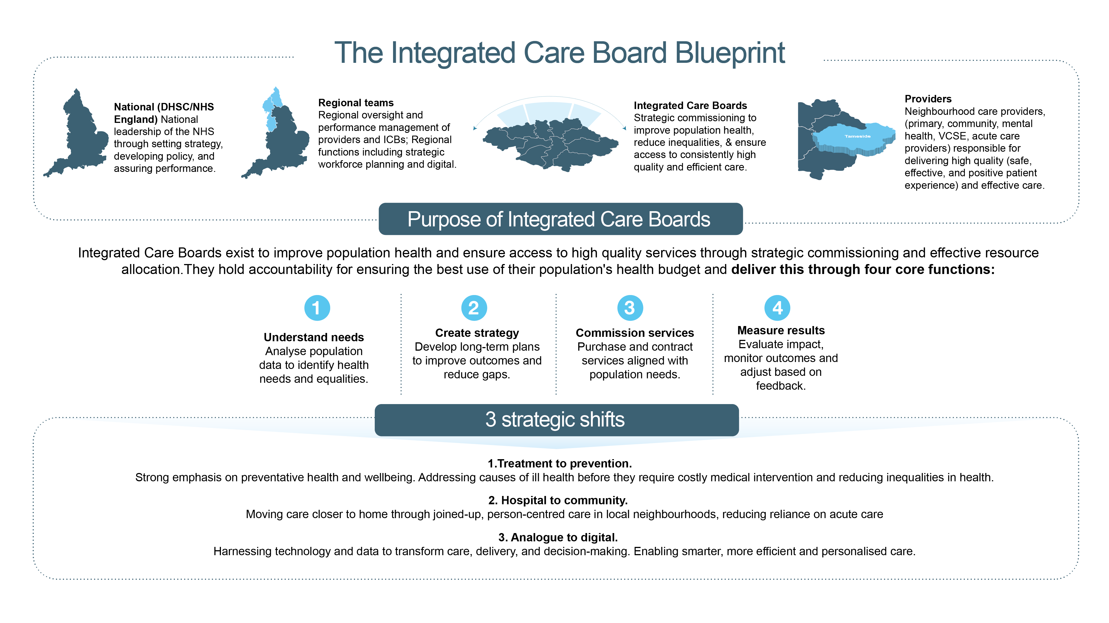
Notes:
About the Healthcare system.
The healthcare system in England is made up of four different layers. Nationally, the Department of Health and Social Care and NHSE provide leadership through setting strategy, policy and assuring performance. There are seven regional teams which provide regional functions such as workforce planning, as well as performance management of Integrated Care Boards.
Integrated Care Boards exist to improve population health and undertake the planning and strategic commissioning of services. Along with Integrated Care Partnerships, which bring together all health and social care partners, they make up Integrated Care Systems. And Neighbourhood Care Providers include primary care, community, mental health, voluntary and community organisations and acute care providers that are responsible for delivering services.
NHS Greater Manchester is the statutory body that makes decisions about healthcare services in the city-region. The Integrated Care Partnership Strategy sets out how we will work together with our communities to create the conditions for good lives, prevent poor health and provide consistent and high quality healthcare services.
There are four purposes of an Integrated Care Board:
Improve outcomes in population health and healthcare
Tackle inequalities in outcomes, experience and access
Enhance productivity and value for money
Help the NHS support broader social and economic development
And the government have set out three strategic shifts for the healthcare sector to ensure it is fit for the future: moving from an analogue to a digital system, shifting care from hospitals to communities, and transitioning from treating illness to preventing ill health.
There are significant changes underway in the healthcare system right now, NHSE is being abolished, with some of its functions being wrapped up into the Department of Health and Social Care. And there are also significant changes to Integrated Care Boards, with the number of these organisations nationally being reduced from 42 to between 23 and 28, along with changes to how some of the services are being delivered to reduce duplication between different layers of the healthcare system.

Slide 5
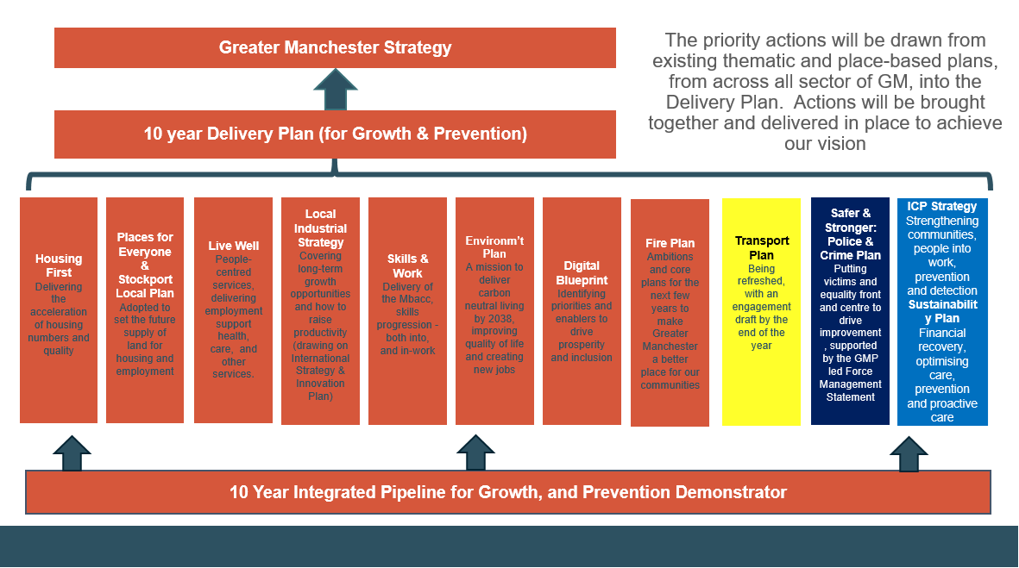
The Greater Manchester Strategy
Notes:
The Greater Manchester Strategy is the city region’s ‘North Star’, bringing all its organisations together behind a set of priorities for the next ten years. The current visions is for Greater Manchester to be a place where everyone can live a good life, growing up, getting on and growing old in a greener, fairer and more prosperous city region.
This diagram sets out how different organisations contribute to our overall progress against the key strategic themes – including housing, supply of land for housing and employment, supporting people to live well, making the city region carbon neutral, an integrated transport system and delivering the Integrated Care Partnership Strategy . Each part of the system is asked to set out how it will contribute to the overall goals of the city-region, and the actions and priorities are brought together into the delivery plan.
The Greater Manchester Strategy is currently being refreshed, and the updated version is expected to be published in July.

Slide 6
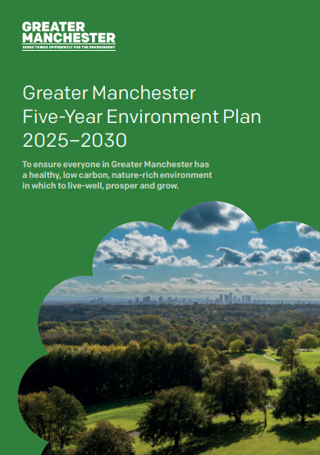


Context
Greater Manchester Combined Authority (GMCA)
Greater Manchester Strategy
Greener NHS (NHS England)
Greater Manchester Transport Strategy
NHS Greater Manchester Integrated Care Partnership Strategy
Hospital Trust Green Plans
Notes:
This slide shows how the various plans that support the Greater Manchester Strategy link into the areas of work that we are directly involved in, which are transport strategy and supporting the NHS in Greater Manchester towards reaching net zero carbon emissions.
NHS Greater Manchester’s Green Plan sets out the priority interventions to reduce the carbon footprint of the healthcare sector, and is informed by the city-region transport, environment and health strategies, whilst also being a stakeholder in the development refresh of those plans. Each of the NHS Trusts in Greater Manchester also has their own Green Plan.
And nationally, the NHS sets out the overall strategic direction for the NHS to reach net zero carbon emissions, and the priority interventions to get there.

Slide 7
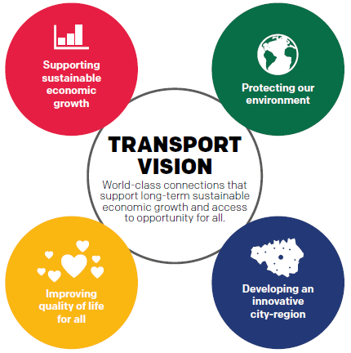
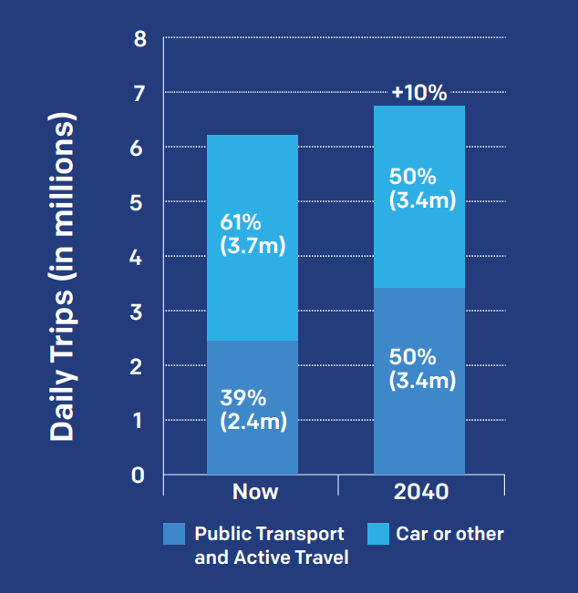
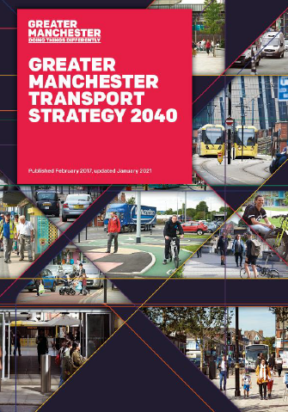
Greater Manchester Transport Strategy 2040
Notes:
The Greater Manchester Transport Strategy is TfGM’s long-term plan for transport in the city region.
It sets out how we hope to serve a growing population, transporting people sustainably around the city region, and opening up access to opportunities.
At the heart of this is the Right Mix Vision. By 2040, we want at least 50% of journeys to be made by walking, cycling and public transport by 2040, to avoid future growth in traffic. This was 40% in 2017.

Slide 8
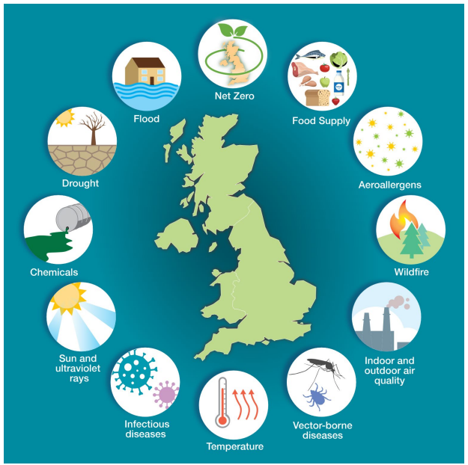
Climate Change and Health Inequalities
Climate change affects most health determinants either directly or indirectly.
The greatest opportunity for health benefits in the context of climate change comes from the potential to align health goals with the decarbonisation agenda.
There are win-win strategies including nature-based solutions, reducing existing health inequalities, supporting behavioural transitions, supporting vulnerable populations, embedding health in climate planning and embedding climate in public health practice.
There are also wider benefits to health of mitigation and adaptation actions, such as reduced air pollution, safer and healthier homes, shade protection from heat, greenspaces for mental health, healthy behaviour shifts and less pressure on health and care services.
Notes:
Why is the NHS concerned about climate change and environmental sustainability? Well, this is because climate change is a threat to human health, and affects most determinants of health either directly or indirectly.
The greatest opportunity for health benefits in the context of climate change comes from the potential to align health goals with the decarbonisation agenda.
There are win-win strategies including nature-based solutions, reducing existing health inequalities, supporting behavioural transitions, supporting vulnerable populations, embedding health in climate planning and embedding climate in public health practice.
There are also wider benefits to health of mitigation and adaptation actions, such as reduced air pollution, safer and healthier homes, shade protection from heat, greenspaces for mental health, healthy behaviour shifts and less pressure on health and care services.

Slide 9
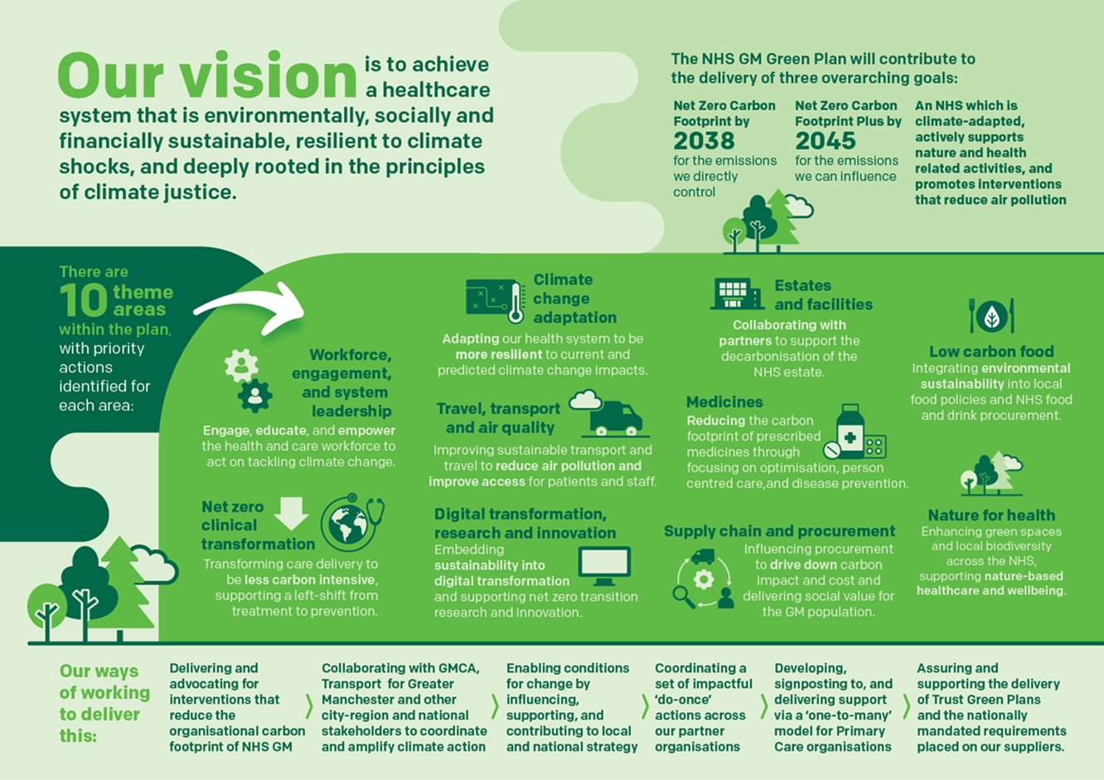
Notes:
NHS Greater Manchester Green Plan
This is our local response to the national Delivering a Net Zero NHS strategy as well as the Greater Manchester five-year environment plan. Its sets out our vision of achieving a healthcare system that is environmentally, socially and financially sustainable, resilient to climate shocks and deeply rooted in the principles of climate justice. It has recently been updated and is going to the Integrated Care Board for approval in July.
There are three overarching goals set out within the plan – Net Zero Carbon Footprint for the emissions we control by 2038 (which aligns with the Greater Manchester target, net zero carbon footprint plus (for the emissions we can influence) by 2045 which includes our supply chain, and aligns with the NHSE target, and finally a third goal of an NHS which is climate-adapted, actively support nature and health related activities, and promotes interventions that reduce air pollution.
The plan is structured around 10 themes, with each theme outlining priority actions. These themes replicate the NHSE and GMCA priorities, and includes areas such as medicines net zero clinical transformation and travel, transport and air quality.
And finally we have set out ways of working, which include a strong commitment to collaboration with our city-region partners such as Transport for Greater Manchester, and enabling the conditions for change.

Slide 10
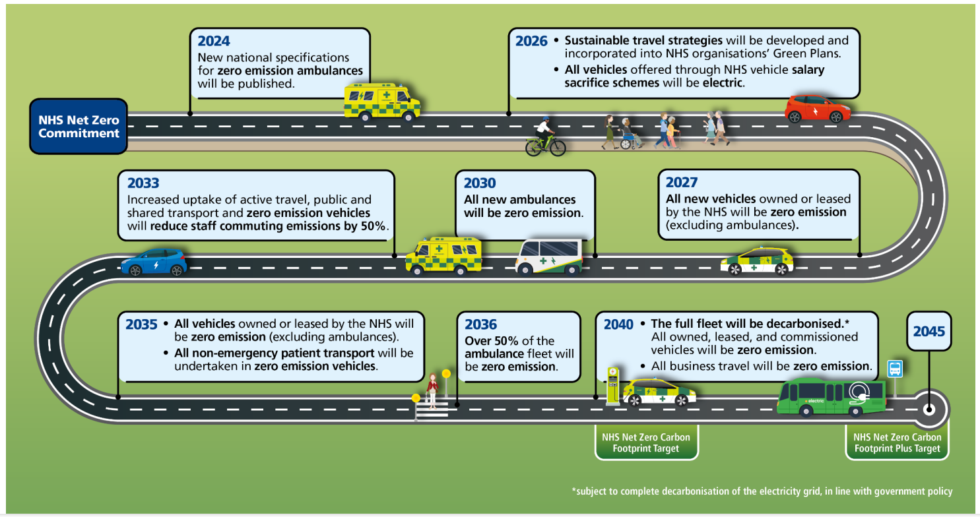
Notes:
This is the national NHSE Net Zero Travel and Transport Roadmap. Locally, we’ll be delivering this in alignment with the Greater Manchester Local Transport Strategy 2040.
It supports delivery of the overarching ‘Delivering a Net Zero NHS’ strategy, providing the detail of the interventions that deliver the national targets.
The NHS fleet is the second largest fleet in the country, consisting of over 20,000 vehicles travelling over 460 million miles every year. This fleet, combined with the impact of commissioned services and staff travel, directly contributes to the 36,000 deaths that occur every year from air pollution.
In addition, it is estimated that 3.5% of all traffic on the road is related to the NHS, including staff and patient travel, and delivery of goods and services.
NHSE engaged with the NHS workforce, and industry experts to develop a travel and transport strategy, outlining key interventions to support the transition to more sustainable travel.
This roadmap outlines key steps in the transition of NHS travel and transportation.
By 2026, sustainable travel strategies will be developed and incorporated into trust and integrated care board (ICB) green plans.
From 2027, all new vehicles owned and leased by the NHS will be zero emission vehicles (excluding ambulances).
From 2030, all new ambulances will be zero emission vehicles.
By 2033, staff travel emissions will be reduced by 50% through shifts to more sustainable forms of travel and the electrification of personal vehicles.
By 2035, all vehicles owned and leased by the NHS will be zero emission vehicles (excluding ambulances) and all non-emergency patient transport services (NEPTS) will be undertaken in zero emission vehicles.
In 2040, the full fleet will be decarbonised. All owned, leased, and commissioned vehicles will be zero emission.

Slide 11
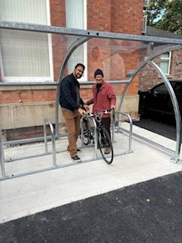
Case Study: Healthier Greener Travel Toolkit
Sustainable travel toolkit for Primary Care pilot project developed by NHS GM which launched in June 2023, featuring site audit, culture survey, patient and staff travel survey and travel plan template.
The NHS GM Healthier Greener Travel toolkit has now been published to our GM Primary Care Provider Board Sustainability webpages.
Financial incentives were available.
40 practices (32 GPs, 5 dentists, 2 pharmacies, 1 optometrist) participated in the travel surveys receiving a total of 204 staff responses and 2,057 patient responses.
8 practices submitted travel plans, and 5 submitted successful bids to support travel plan implementation.
Implementation projects included purchase of e-bikes for staff use, purchase of standard bikes and cycling equipment for staff use, installation of bike shelters, lockers and repair of shower facilities.
Notes:
Case Study: Healthier Greener Travel Toolkit.
A sustainable travel toolkit for Primary Care pilot project was developed by NHS GM and launched in June 2023. It features a site audit, culture survey, patient and staff travel survey and travel plan template. Some regional innovation funding was secured to develop this project. We worked with Transport for Greater Manchester to develop the toolkit, and it has been published.
Financial incentives were available including a small payment for completing and submitting a travel plan, and small grants to fund sustainable travel interventions.
40 practices (32 GPs, 5 dentists, 2 pharmacies, 1 optometrist) participated in the travel surveys receiving a total of 204 staff responses and 2,057 patient responses.
Of the 40 practices, 8 submitted travel plans, and 5 submitted successful bids to support travel plan implementation.
Implementation projects included purchase of e-bikes for staff use, purchase of standard bikes and cycling equipment for staff use, installation of bike shelters, lockers and repair of shower facilities.

Slide 12
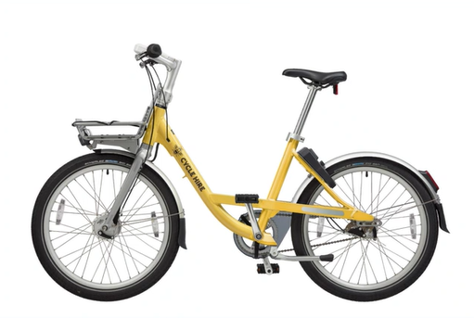
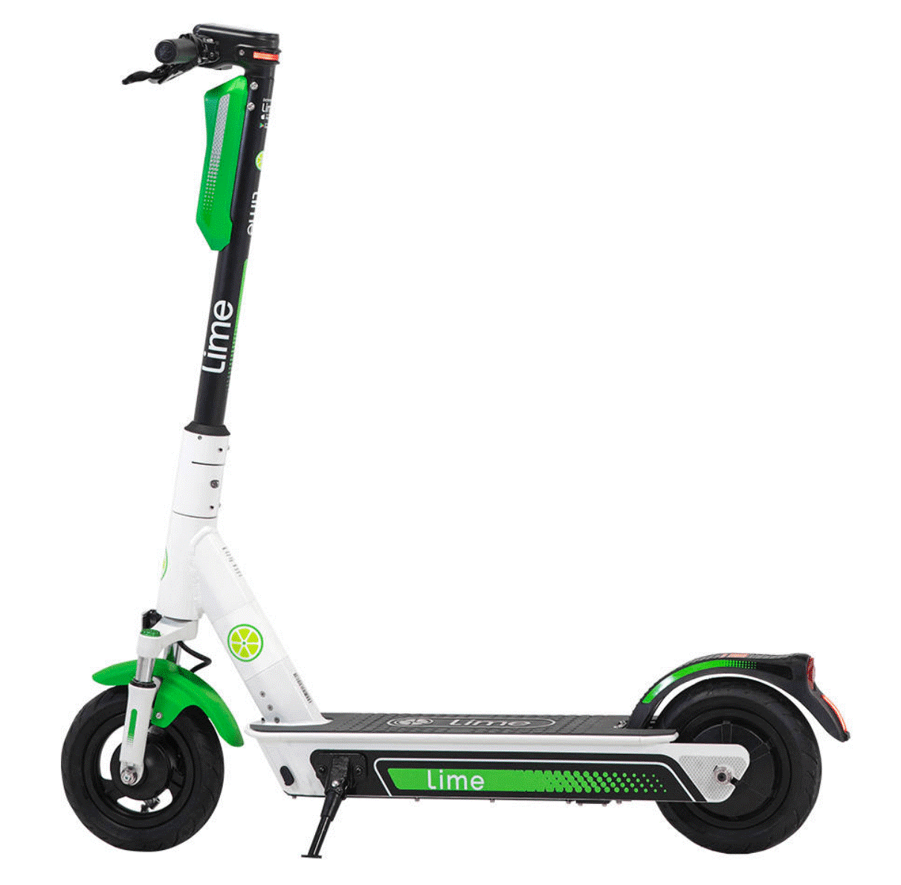
Case study: Bee Network Active Network
Greater Manchester is investing in its active travel infrastructure and transport options.
The aim is to connect all communities in GM with high quality active travel infrastructure.
Over 95% of Greater Manchester residents will live within 400m of a Bee Network route once the network is completed.
2734km, of which 1,170km is on busy roads, 932km on quiet roads and 631km off road.
130km since 2017, 160km in two years.
1,500 bikes
1 million rides
2,500,000 km ridden
800 vehicles
1.6 million rides
2,700,000 km ridden
Notes:
Case Study: Bee Network Active Network
We are building a walking, wheeling and cycling network that will connect every community across Greater Manchester. It will make walking and cycling a real alternative to the car.
When it’s complete in 2040, we will have an active travel network at Bee Network standard totalling 2,700km, up from 120km today.
As part of delivering the Bee Network, the launch of Starling Bank Bike Hire (Greater Manchester’s Cycle Hire Scheme) has given 200,000 residents access to bikes and has delivered over 1million active travel journeys since its launch in 2021.

Slide 13
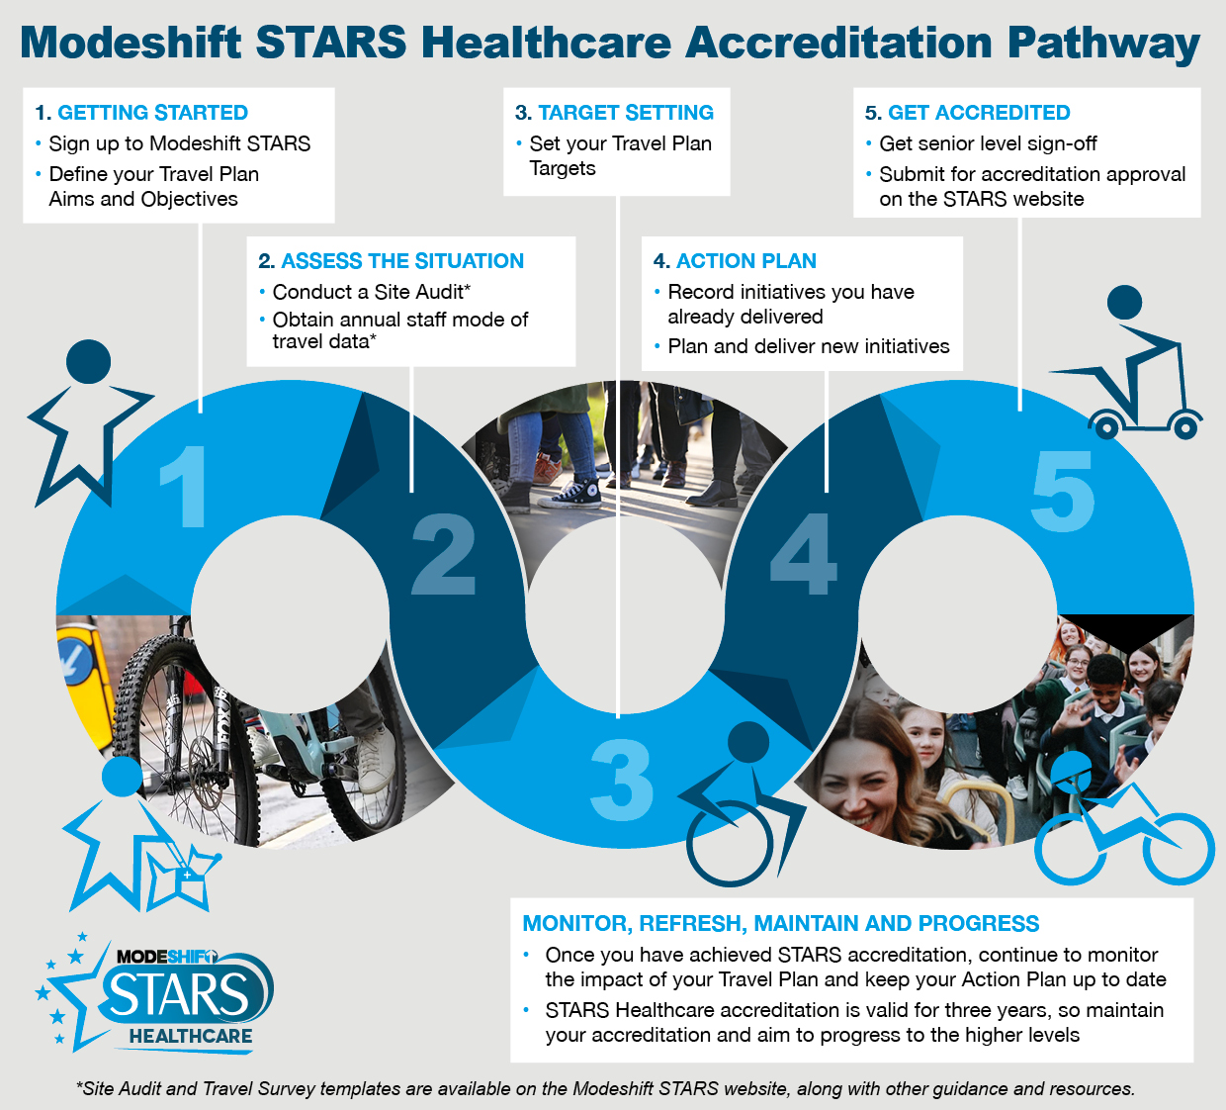
Modeshift STARS Healthcare supports organisations to create, deliver, and track the effectiveness of their travel plans.
Notes:
Case Study: Modeshift STARS
NHSE launched a two year programme called Step up a Gear Network to provide Trusts and ICBs with support to promote, develop and evaluate specific interventions to deliver modal shift.
As part of this programme, organisations were provided with a membership of the sustainable travel organisation ‘Modeshift’ which provided access to a range of supporting resources including the online Modeshift STARS platform.
Modeshift STARS Healthcare was developed in partnership with NHSE England and is one of four different schemes that Modeshift offer. This online platform supports participants to create and monitor their travel plans and travel surveys.
All GM Trusts and NHS Greater Manchester have uploaded their travel plans onto the site. Should organisations wish to do so, they have the option to get their travel plans accredited, there are 5 levels ranging from Approved to Outstanding.
Staff travel survey questionnaires have been aligned and made simpler through the platform
We can use the platform to provide us with a Greater Manchester-wide overview of performance and progress

Slide 14

Notes:
Thank you for listening. Would members of the audience like to ask us any questions?

