Slide 1
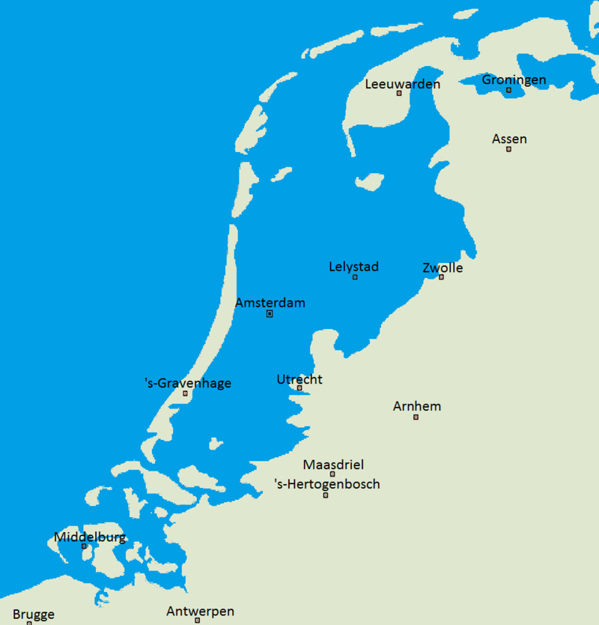

Land use in Holland
Hein A.M. Klemann
Klemann@eshcc.eur.nl
023 5310141

Slide 2
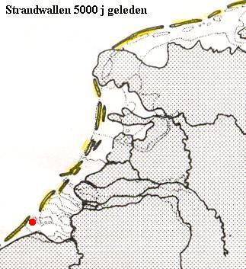
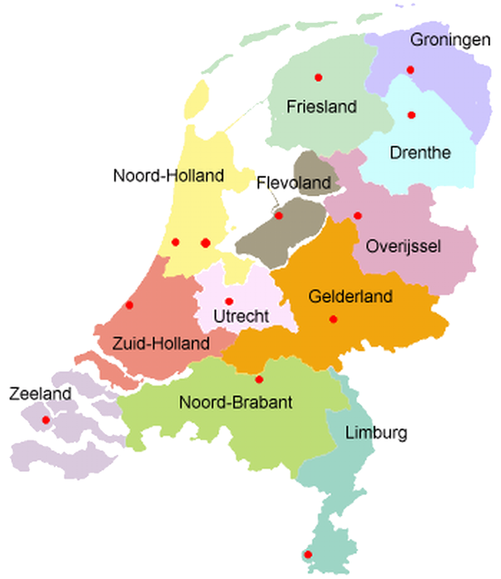
Land below sea level and beach ridges

Slide 3
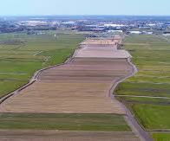
Beach ridges and land formation
When the tide comes in, the current to the land is stronger than the current to the sea at low tide
This resulted in hundreds of years in sandy strips of land
Beach ridges are hundreds of kilometres long, 100-200 metres wide and a few meters high strips of dry land, parallel to the coast
When the strip was closed, a new one developed further to the sea
Between such beach ridges, swaps and wet peatlands developed
Dangerous, wooded, wild and very wet land
There was no natural drainage as it was locked in between the beach ridges
The last beach ridge the base of the dunes

Slide 4
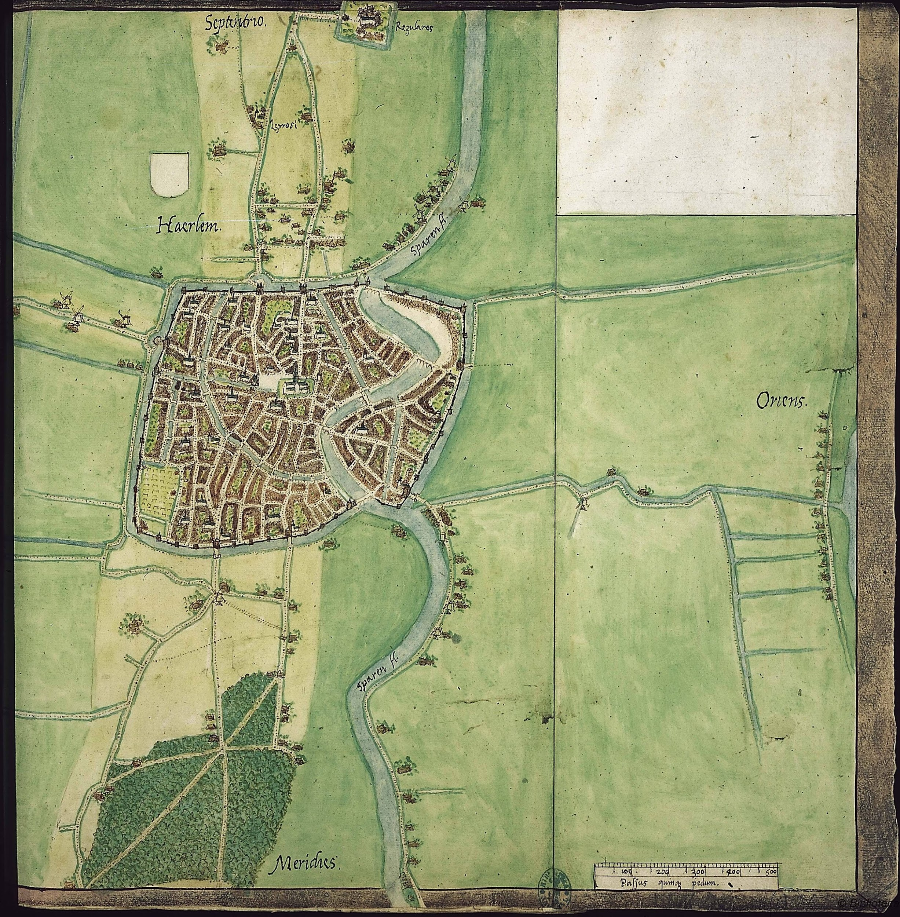
16th century map of Haarlem
You can see that the town was founded on a beach ridge, een strandwal
Stable, dry land
Not typical for Haarlem: numerous settlements on dry land
  Alkmaar, Heiloo, Heemstede, Leiden, The Hague all were built on a beach ridge
Beach ridges highly urbanized
  As a result, north-south connections are much better developed in Holland than east-west
  See the map
Yet, these beach ridges are only half the story
Larger swaths of land were the swamps that developed between these ridges

Slide 5
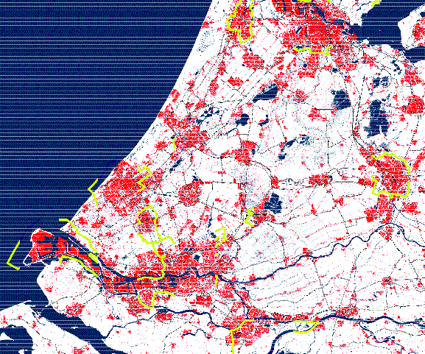
Building on dry land
Strip of towns and villages over the old beach ridge
Still to be seen on the map

Slide 6
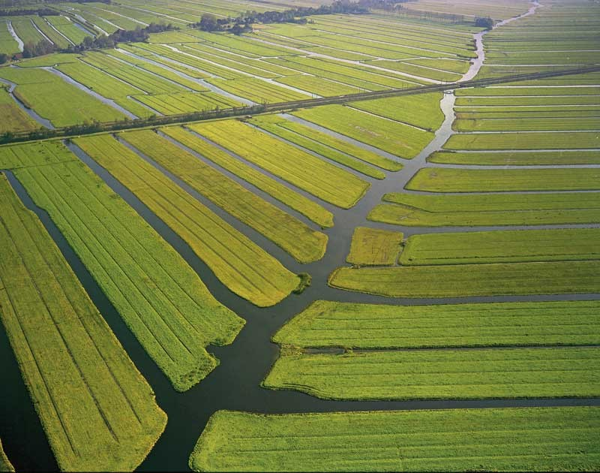
10th-13th century: Great Land Development
Organized by the Count of Holland and the Bishop of Utrecht
These lords owned the unexploited lands in their territories
Gave permission to drain the swaps to:
  Groups of individual peasants
  Businessmen
Drained the land and got permission of to settle there as free peasants
Only had of pay an annual sum to the lord
And do military service
  Produced grain: barley and rye
Notes:
Balrey and rye

Slide 7
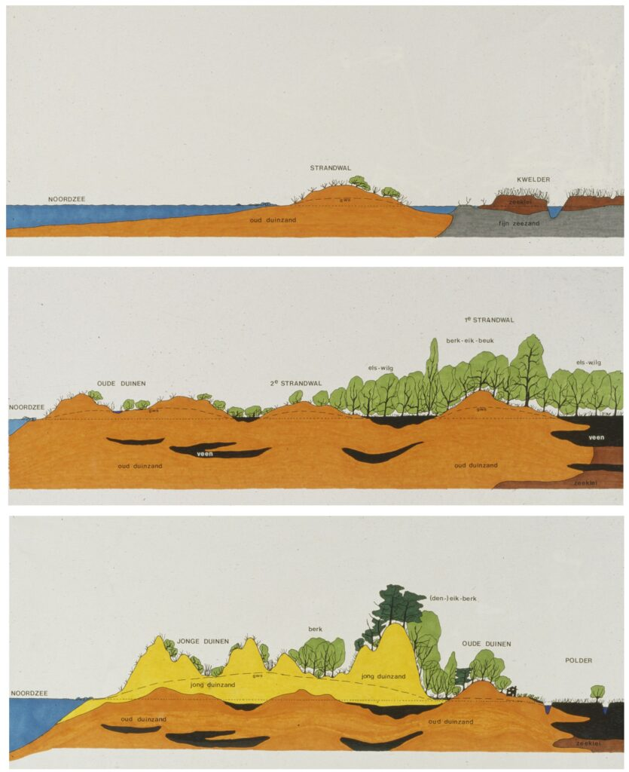
People involved
Count Floris II, the Fat (1084-1121) extremely rich
Where did the people come from who actually did the drainage labour?
Until recently unknown
Archeologists discovered Frisian villages under the so-called new dunes
From 1000 the temperatures rose: dangerous in a dynamic coastal area
  All kind of floods
  Created inland seas
People from the dunes – the most western beach ridges – had to leave as the land became dryer: sand drifts
Dunes became up to 40 m. higher

Slide 8
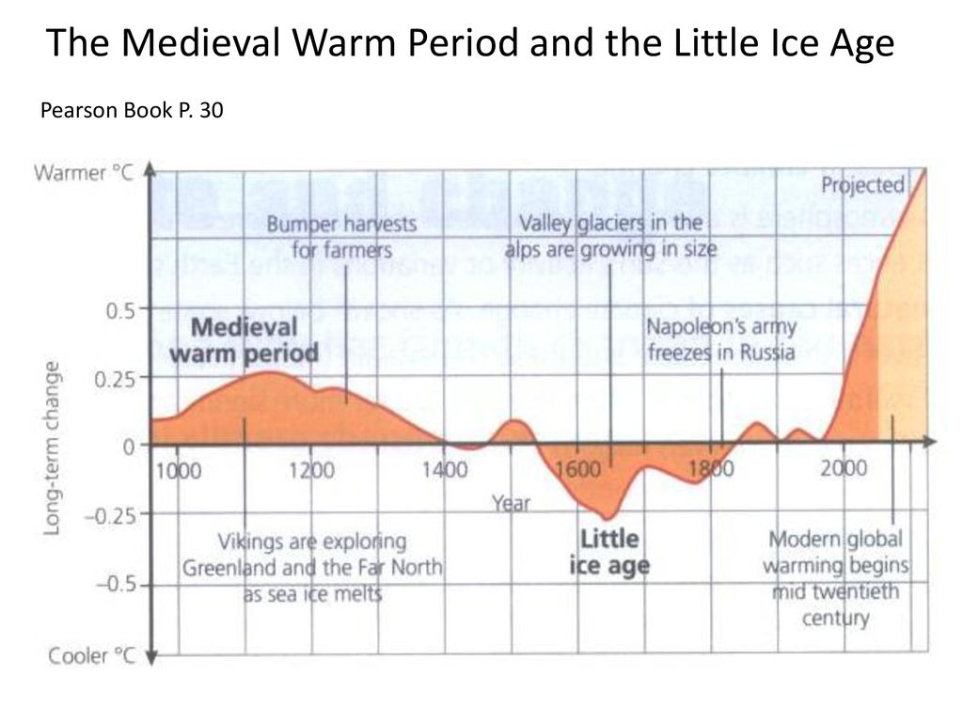
Medieval Climate Optimum
New fertile land and temperature rose: good crops
Population growth
From the 14th century: drainage caused the land to settle
  Land got wet again
  Trend going on until this day
  Pumping out more water only speeds it up
Too wet for grain cultivation from the 14th century
Arable farming exchanged for livestock farming
Fewer people needed for that than for arable farming
  Many left the countryside
  Urbanisation

Slide 9
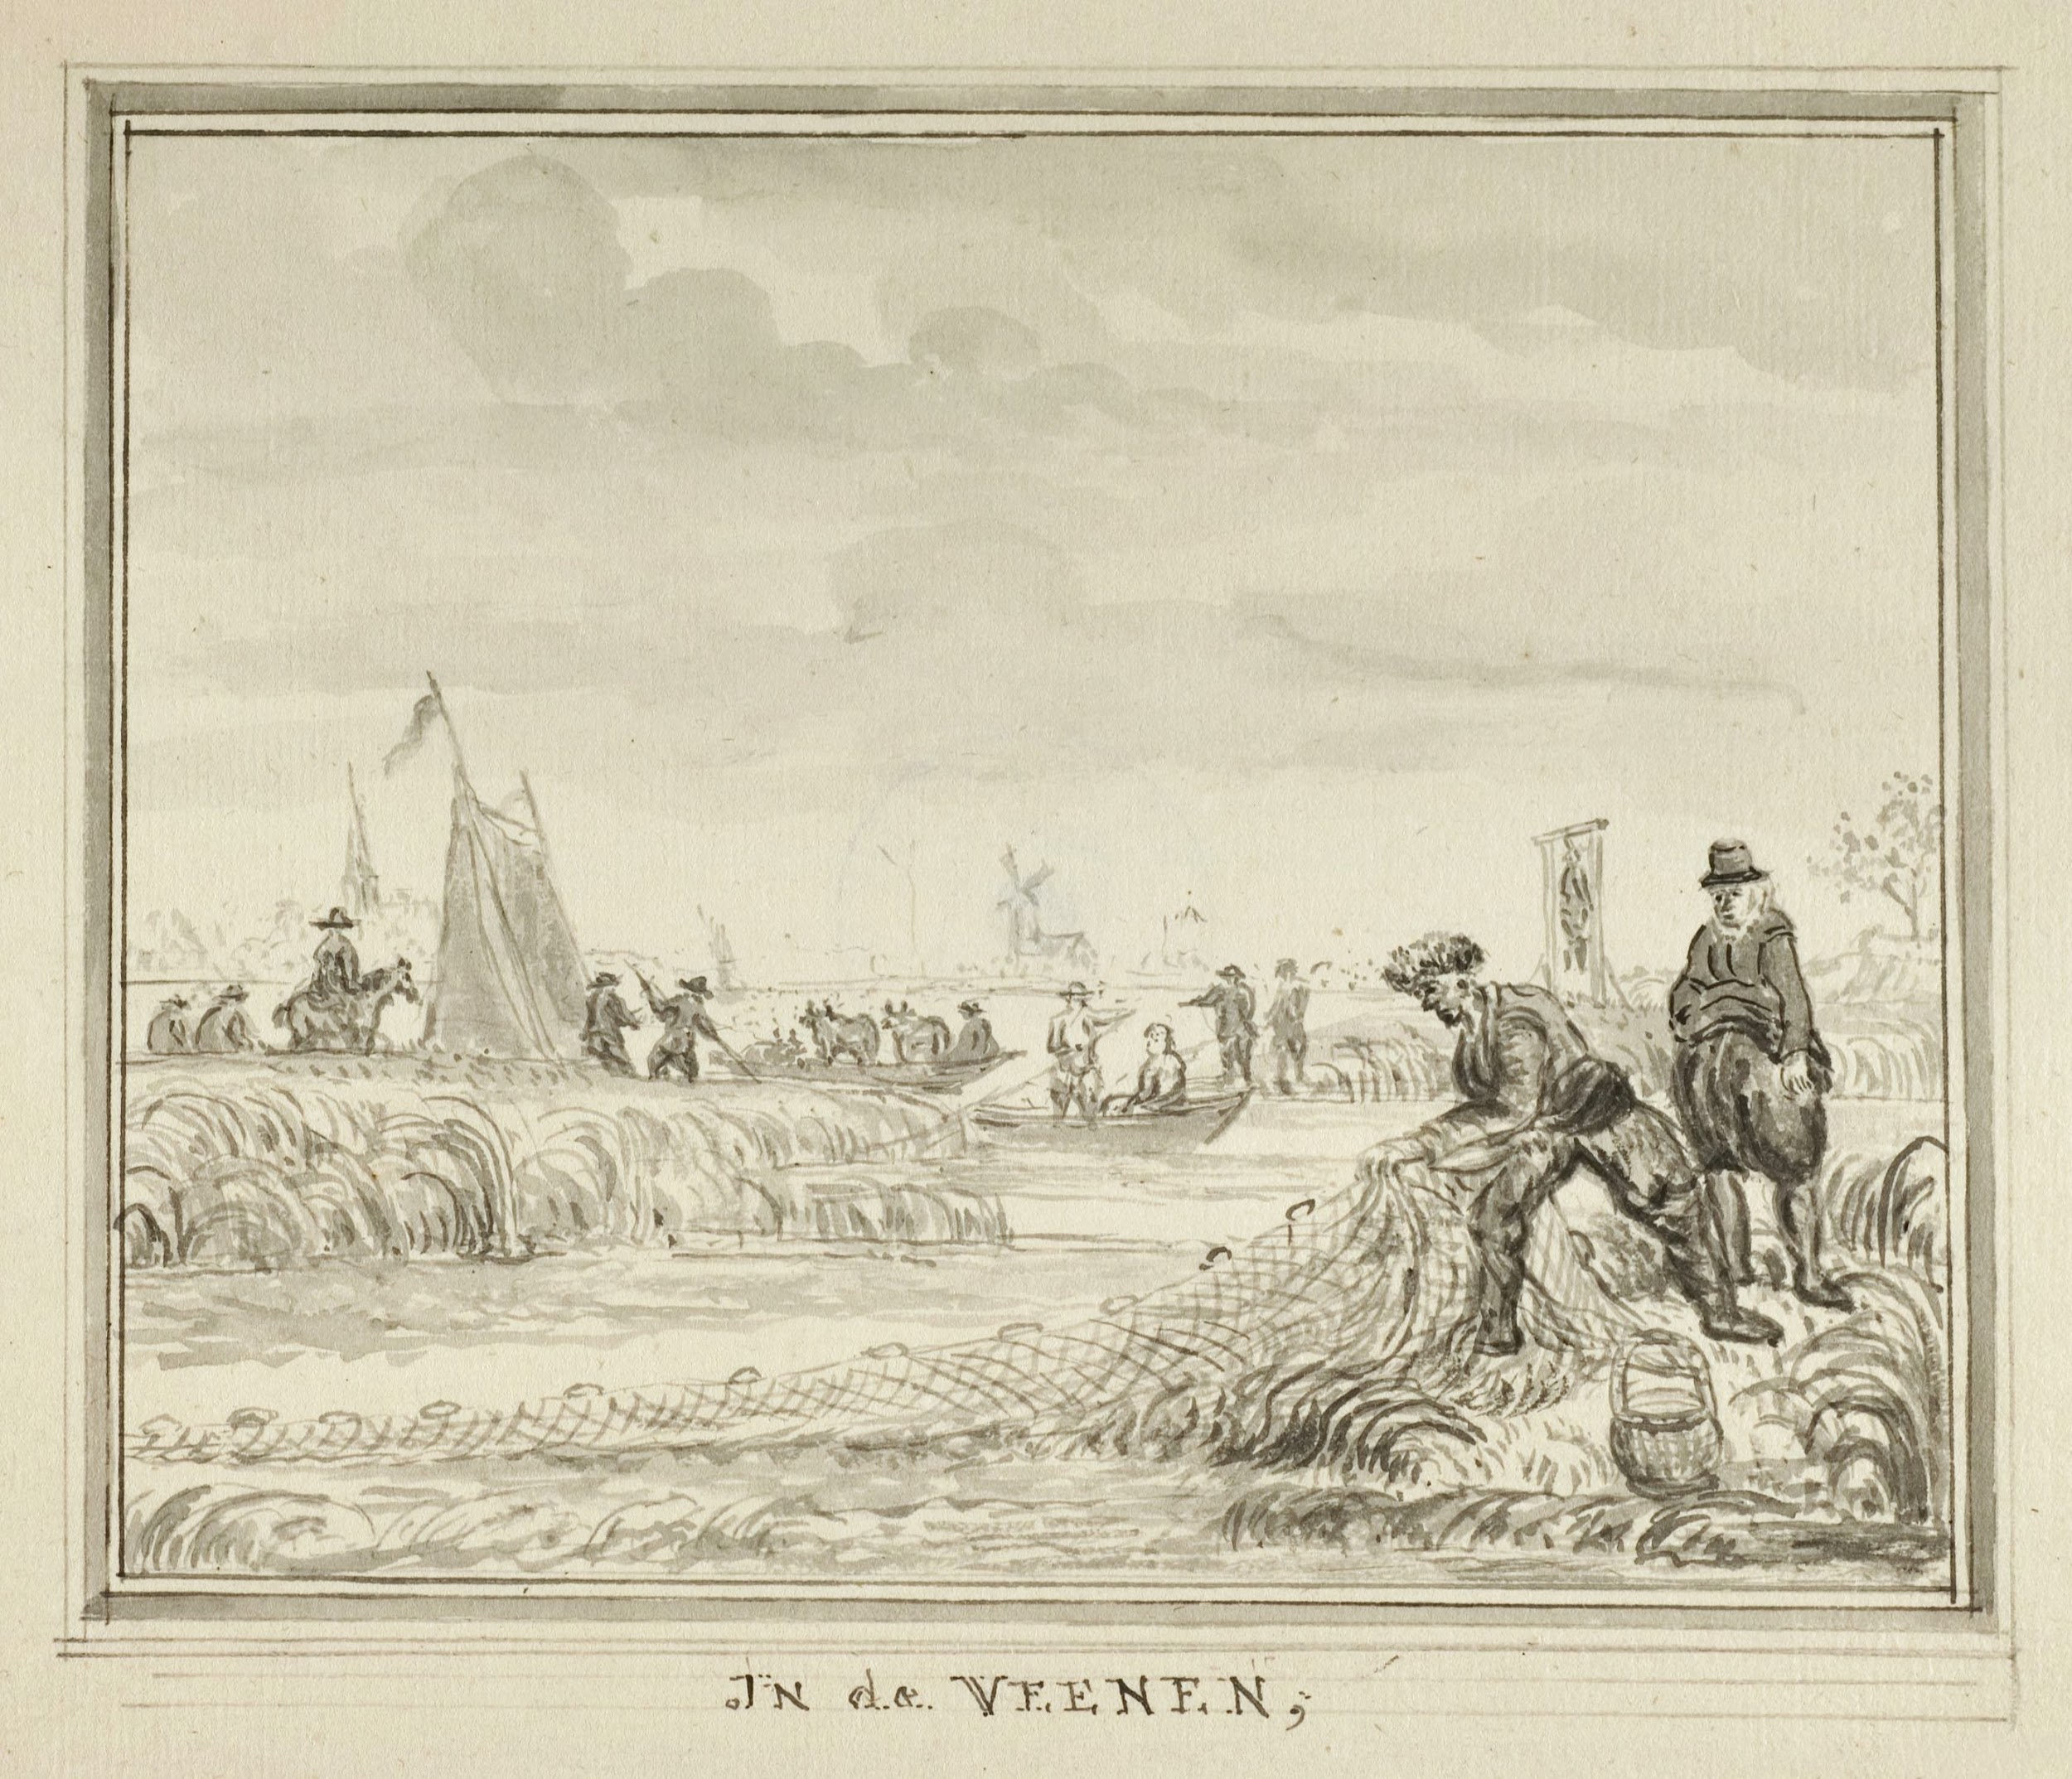
Regional water authorities
Since medieval times regional water authorities
  In its boards local, the landowners decided how to regulated water levels, kept dikes intact and waterways open
  Not just for navigation but also for water regulation
Seen by some historian as the origin of our consensus democracy
Had the high authority
One such a Water Authority, Rijnland, placed a gallow on the dike to show that it had the authority to hang one that damaged it

Slide 10
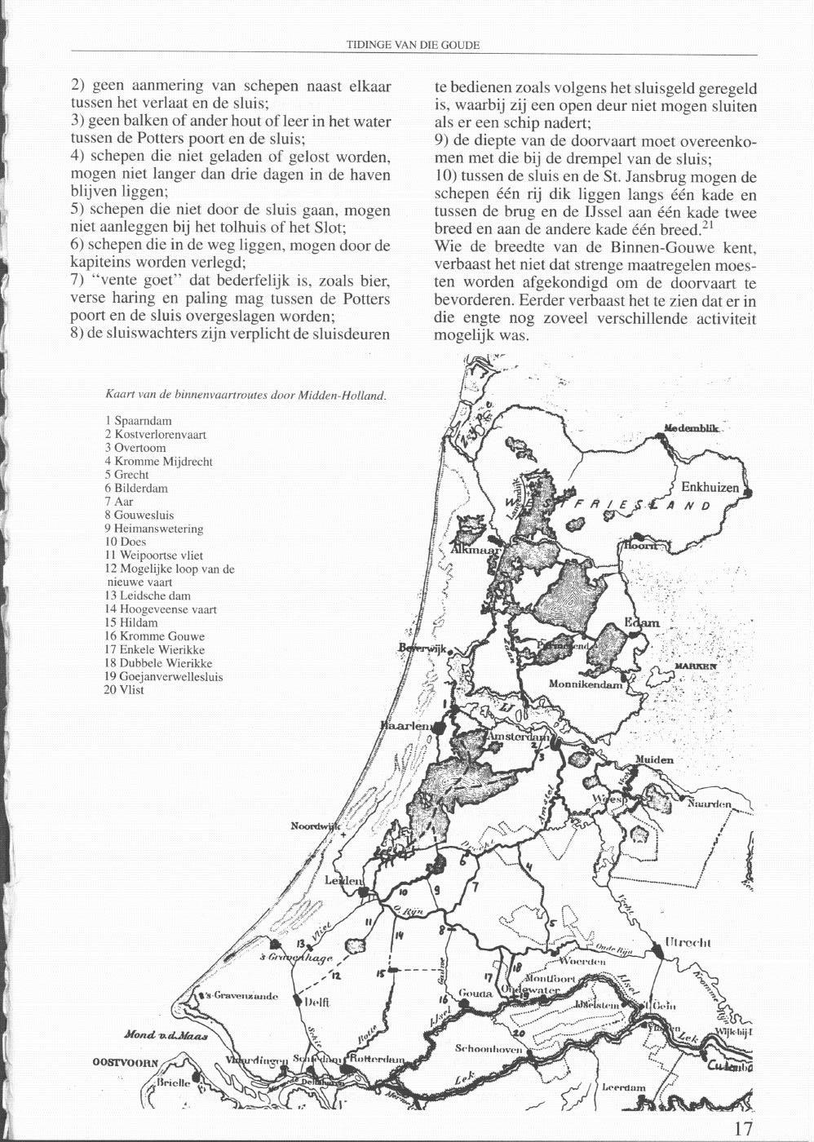
Binnenduinenroute –Inner Dunes Route
One cannot live from livestock farming alone:
  Trade needed
  Waterways everywhere, natural or dug for drainage
  Transport relatively easy
Possible to sail from the Baltic Sea, where the Hanseatic cities dominated trade via Holland, to the rich towns of Flanders,
  Could thus circumvent the dangerous North Sea
  The ships, so-called cogs, were very small
Came past cities like Haarlem, Leiden, Delft, Gouda
These industrialized and became centres of trade
  Commercialization, in a relatively large number of small town

Slide 11
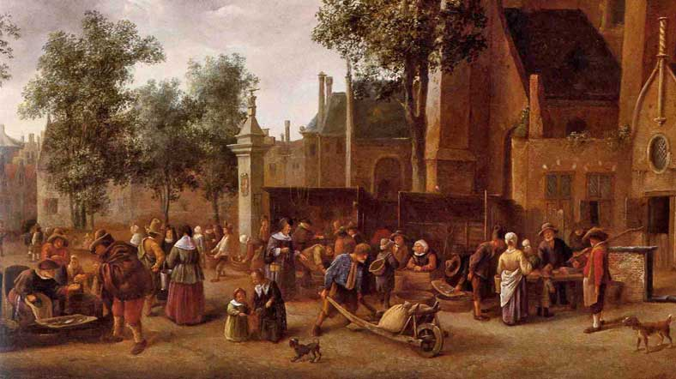
Commercialization of the countryside
One cannot live on livestock farming alone
Cereals and other basic food therefore imported
  Cheese and butter to the market, locally and internationally
  Vegetables and fruit to local markets
  13th Century: young oxen imported in the spring
  Shipped by boat or driven through Germany
  In North of Holland fattened up
Sold on the October fair in Haarlem, just before the canals froze over
  By boat to the rich Flemish cities
Part of the life stuffs bought in the market, also in countryside
Holland not only highly urbanized but also fully commercialized

Slide 12
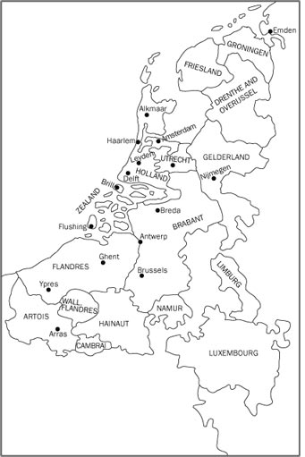
Urban and commercial economy
As early as the 16th century over half of the population lived in an urban centre
  High degree of urbanization
  Not one central city
  Decentralized country
  Relatively free
Direct consequence of the fact that the land was no longer suitable for arable farming anymore
Commercialization: same cause
Further boosted by the fact that there were waterways everywhere
  Natural or man made for drainage
  Made transport and thus trade possible almost everywhere

Slide 13
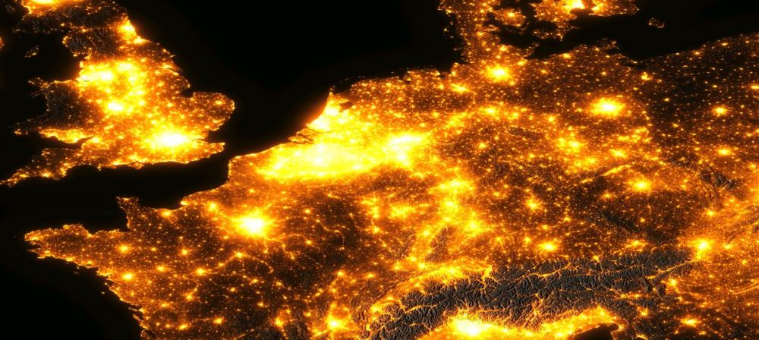
What is nowadays still relevant of this all?
Country highly urbanized, but no big city
As the beach ridges are completely urbanized, east-west connections difficult
Land is settling since the 13th century
Just pumping more water away no solution:
  Fastens the process of settling
  Land need to be kept wetter
We still have local Water Regulation Authorities, but only 21
In 1950 there were still 2600
  Since very recently democratized
  Elections this Wednesday
Still waterways everywhere: clean mode of transport

