Slide 1
I hédate
Commission européenne,
DG MOVE
Julie Buy
Unité Réseau de transport
13 avril 2023

Slide 2
Commission 2019-2024 – Key steps impacting transport
12/21
Efficient & green mobility package
03/20
Prop Loi Climat
06/21
Loi Climat
adoptée
12/20
SSMS
05/19
New COM
12/19
Pacte vert
12/20
MFF
NGEU
07/21
Fitfor55 Package
05/22
REPowerEU
03/23
Net-Zero Act Industry
2020
2021
2022
2023
PANDEMIC COVID 19
RUSSIAN WAR AGAINST UA

Slide 3

Zoom on Climate Law and Green Deal
12/21
Efficient & green mobility package
03/20
Prop Loi Climat
06/21
Loi Climat
adoptée
12/20
SSMS
05/19
New COM
12/19
Pacte vert
12/20
MFF
NGEU
07/21
Fitfor55 Package
05/22
REPowerEU
03/23
Net-Zero Act Industry
2020
2021
2022
2023

Slide 4
Pacte vert et loi climat
The European Climate Law writes into law the goal set out in the European Green Deal for:
Europe’s economy and society to become climate-neutral by 2050
The law also sets the intermediate target of :
reducing net greenhouse gas emissions by at least 55% by 2030, compared to 1990 levels
The Green Deal says, among others, that to achieve climate neutrality, a 90% reduction in transport emissions is needed by 2050.

Slide 5
Zoom on EU Budget and transport
12/21
Efficient & green mobility package
03/20
Prop Loi Climat
06/21
Loi Climat
adoptée
12/20
SSMS
05/19
New COM
12/19
Pacte vert
12/20
MFF
NGEU
07/21
Fitfor55 Package
05/22
REPowerEU
03/23
Net-Zero Act Industry
2020
2021
2022
2023

Slide 6
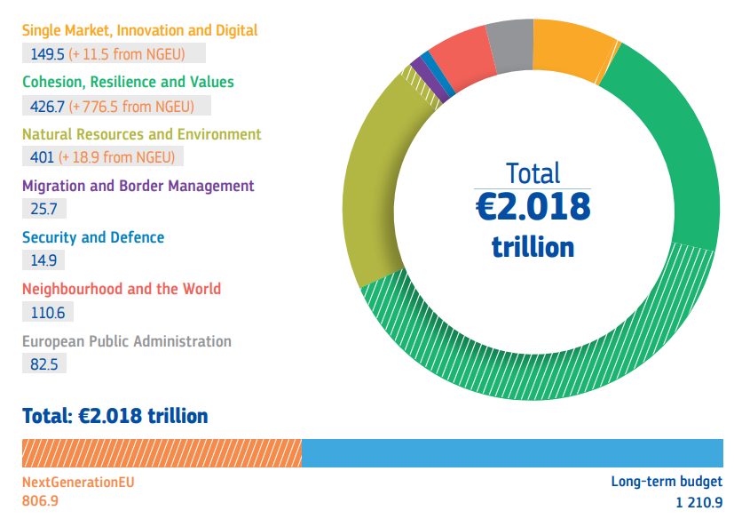
MFF and NGEU (prices 2021) 2021 - 2027

Slide 7

MFF
Direct management based on competitive calls
Method of EU budget implementation
Direct management based on National Recovery and Resilience Plans
Shared management
Indirect management
e.g. CEF Transport
European sustainable transport
EU delegates to EIB, NPBIs, etc. financial products
EU Priority – Single market and EU added-value
R&I - Cross-border - Environment
Selection at project level based on EU priority
European Cohesion (Multi-sectorial)
MS' administrations (at national, regional and local level) choose which projects to finance and take responsibility for day-to-day management.
e.g. Cohesion funds
e.g. Financing instruments
NGEU*
One-off for RECOVERY and CLIMATE TRANSITION
Exceptional nature ➔ Funds disbursed directly to the MS based on the progress in the implementation of national RRP (<EU semester and CSRs)
* NextGenerationEU

Slide 8
















Funding instruments per type of infrastructure projects and their bankability
RRF
Recovery and Climate transition
CEF
Cross-border and climate transition
Regional funds
Cohesion
InvestEU Single market
Innovation
Cross-border
Major
infrastructure
Rail
infrastructure
Alternative fuels infra
Green transition
Profitable
infrastructure
Terminals
Projects’ bankability
HEU R&I
Direct management
based on expenditures & competitive calls
Direct management
based on milestones
Shared management
Indirect management
EU funding intensity
EIB, IFIs & NPBIs

Slide 9

Principaux financements européens pour le transport
MFF 2021-2027:
FEDER/Cohesion €25,5bn – planifiés < OP
RRF €35,7bn – planifiés < RRP
MIE €25,8bn (€11bn cohesion)
~ €87bn
MFF 2014-2020:
FEDER/Cohesion €30bn – planifiés < OP
MIE €24bn (€11bn cohesion)
~ €54bn

Slide 10
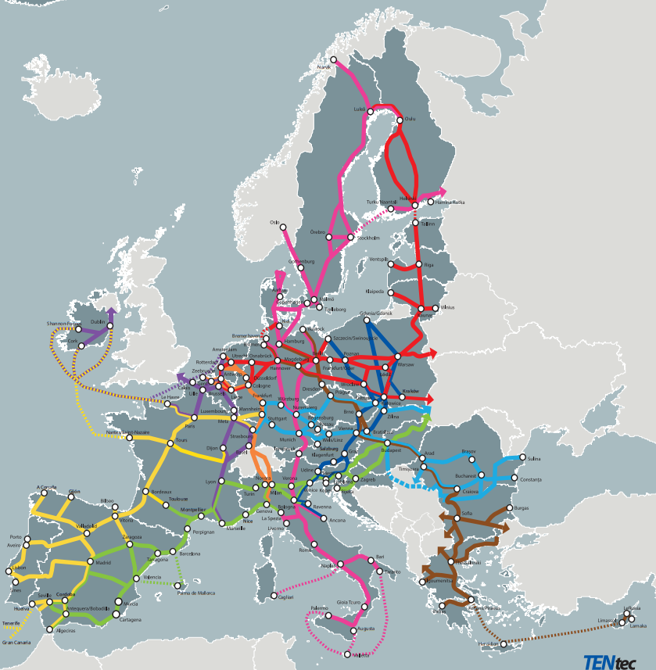
Estimations of investment needs
EUR 700 billion
Until the end of the next MFF to finalise the TEN-T core network and advance the extended core-network (by 2040) (incl. ERTMS)
Additional EUR 65 billion
To deploy alternative fuels and digitalisation

Slide 11
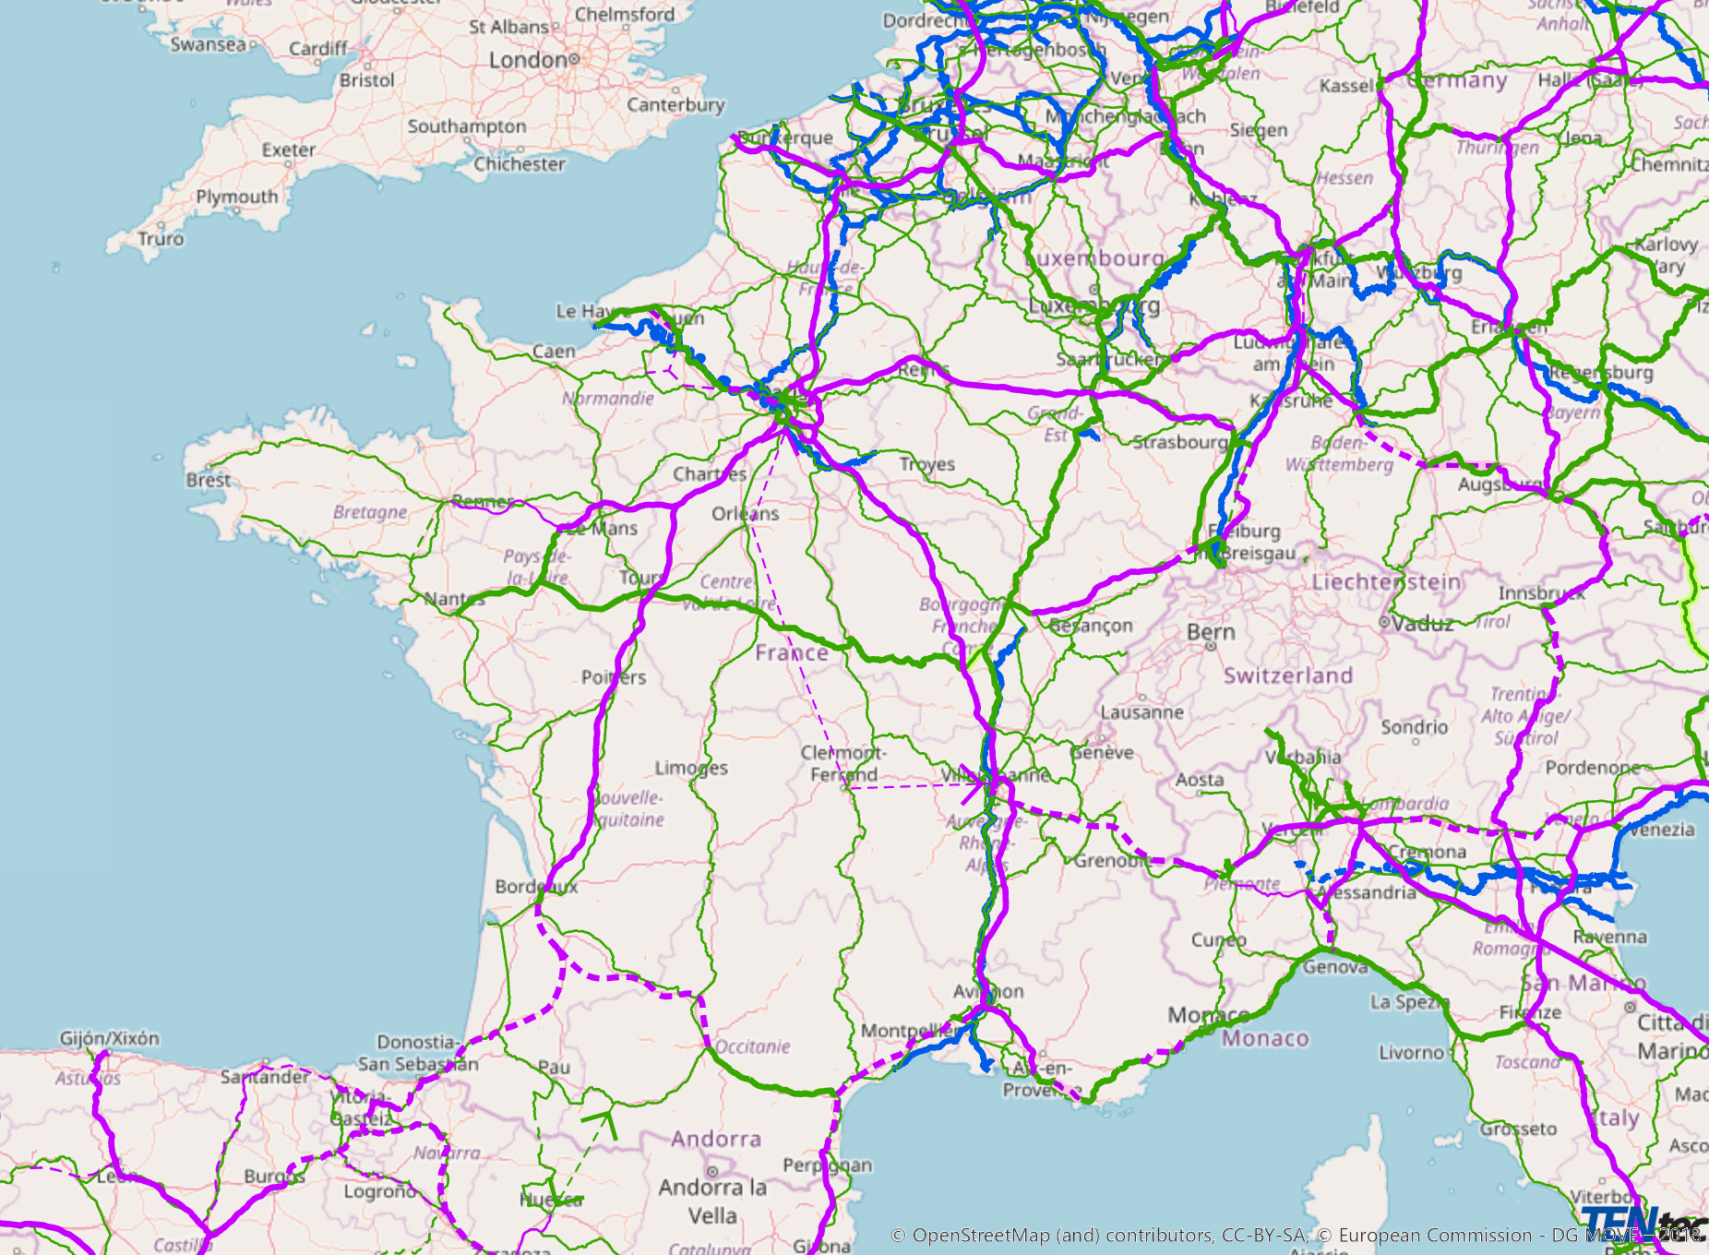
Approximative estimated costs for FR on major cross-border projects (not incl. possible EU funding)
Seine Escaut: ~ 5,1 Mds
Lyon-Turin: ~ 11,5 Mds
(incl. Access roads)
Bdx-Dax-ES: ~ 11 Mds
(GPSO Cross-border branch)
LNMP: ~ 6,1 Mds
Total ~ 33,7 Mds

Slide 12
Zoom on SSMS
12/21
Efficient & green mobility package
03/20
Prop Loi Climat
06/21
Loi Climat
adoptée
12/20
SSMS
05/19
New COM
12/19
Pacte vert
12/20
MFF
NGEU
07/21
Fitfor55 Package
05/22
REPowerEU
03/23
Net-Zero Act Industry
2020
2021
2022
2023

Slide 13
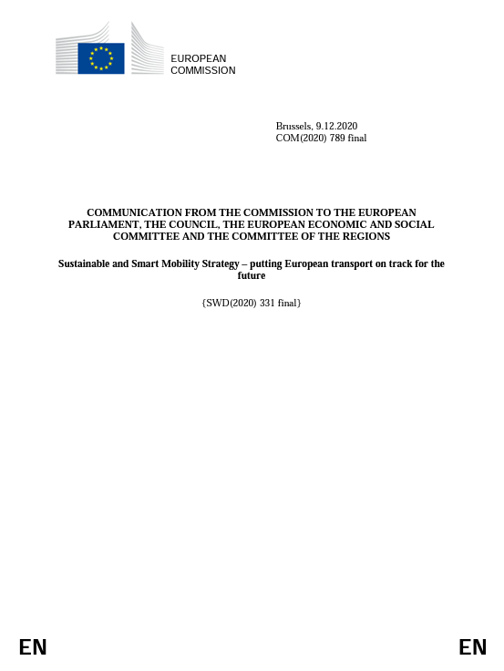
Stratégie de mobilité durable et intelligente – mettre les transports européens sur la voie de l'avenir
  European Green Deal
  90% reduction in transport emissions is needed by 2050
  SSMS = Roadmap to achieve it
Link: https://eur-lex.europa.eu/resource.html?uri=cellar:5e601657-3b06-11eb-b27b-01aa75ed71a1.0001.02/DOC_1&format=PDF

Slide 14
Milestones – 2030/35
By 2030
Min. 30 million zero-emission cars and 80 000 zero-emission lorries in operation
Min. 100 climate neutral cities
Scheduled collective travel under 500 km should be carbon-neutral within the EU
Doubled high-speed rail traffic, rail freight traffic increases by 50%
Transport by inland waterways & short sea shipping increases by 25%
Rail & waterborne-based intermodal will be able to compete on equal footing with road-only transport in the EU
Paperless freight transport
Automated mobility deployed at a large scale
Integrated electronic ticketing
Operational multimodal Trans-European Transport Network equipped for sustainable and smart transport with high-speed connectivity (core network)
Zero-emission ocean-going vessels ready for market
By 2035
Large zero-emission aircraft ready for market
Notes:
Rail & waterborne traffic increase: compared to 2015

Slide 15
Milestones – 2050
By 2050
Nearly all cars, vans, buses as well as new heavy-duty vehicles will be zero-emission
Doubled rail freight traffic, tripled high-speed rail traffic
Transport by inland waterways & short sea shipping increases by 50%
External costs of transport within the EU will be covered by the transport users
Death toll for all modes of transport in the EU close to zero
Operational multimodal Trans-European Transport Network equipped for sustainable and smart transport with high speed connectivity (comprehensive network)
Notes:
Rail traffic increase: Compared to 2015

Slide 16
Zoom on Fitfor55
12/21
Efficient & green mobility package
03/20
Prop Loi Climat
06/21
Loi Climat
adoptée
12/20
SSMS
05/19
New COM
12/19
Pacte vert
12/20
MFF
NGEU
07/21
Fitfor55 Package
05/22
REPowerEU
03/23
Net-Zero Act Industry
2020
2021
2022
2023

Slide 17
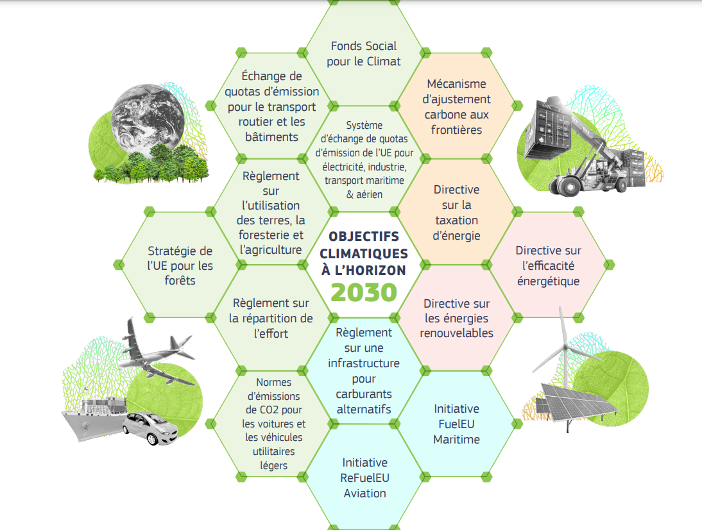
Fitfor55 - Mise en œuvre du pacte vert pour l’Europe
Negotiations ongoing
Revised with REPowerEU from 40 to 45% of RE
AFIR
28/03/2023
Provisional agreement for more recharging and refuelling stations across Europe
On 23/03/2023 Parliament and Council reached a deal on cleaner maritime fuels, asking to cut the carbon content of marine fuels by 2% as of 2025 and by 80% as of 2050, to help the EU become climate neutral.
On 02/06/22 General Approach Council
07/07/22 EP adopted its position
➔ Negotiations ongoing

Slide 18
Zoom on Efficient & Green Mobility Package
12/21
Efficient & green mobility package
03/20
Prop Loi Climat
06/21
Loi Climat
adoptée
12/20
SSMS
05/19
New COM
12/19
Pacte vert
12/20
MFF
NGEU
07/21
Fitfor55 Package
05/22
REPowerEU
03/23
Net-Zero Act Industry
2020
2021
2022
2023

Slide 19

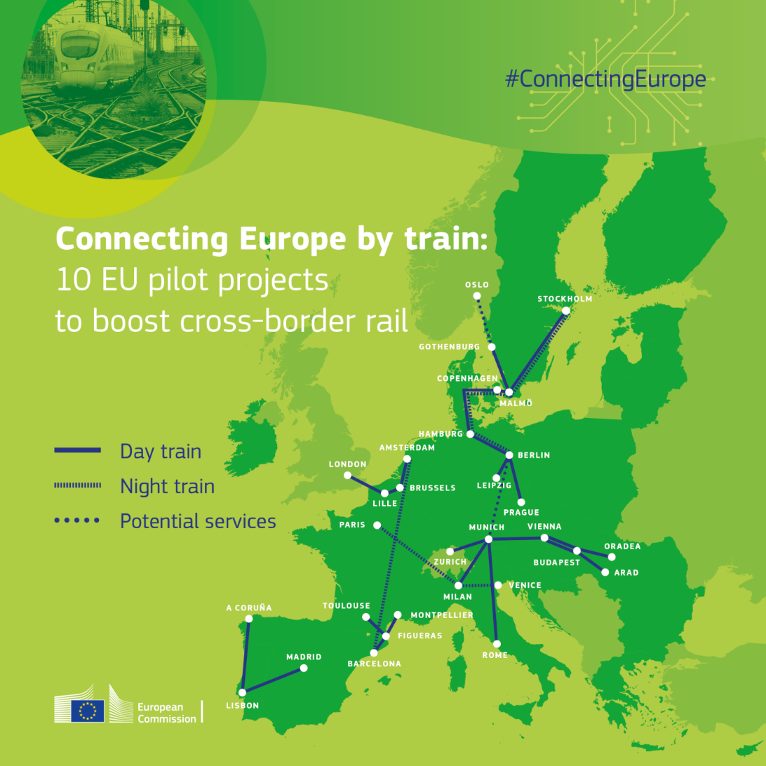
Winter package December 2021
Council’s General Approach agreed 12/2022
Trilogue about to start April/May
TEN-T Regulation
Revision
Guidance for local action and offer cities a toolbox for sustainable mobility
ITS
Directive
Communication
Action plan to boost long distance and cross-border passenger rail
Communication
On the new EU Urban Mobility Framework

Slide 20
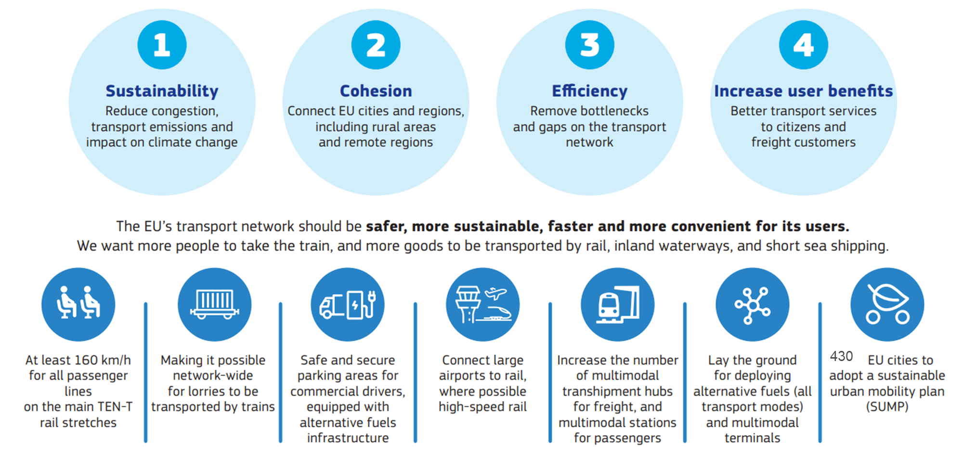
What is the new TEN-T aiming at?

Slide 21
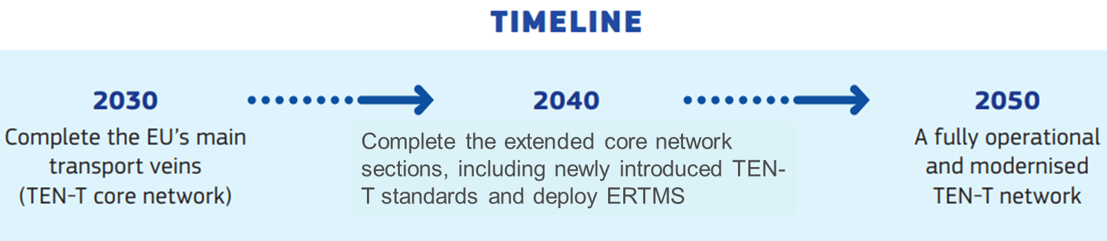
July 2022: amendment of the TEN-T revision
    Network changes
      extension of four European Transport Corridors to Ukraine and the Republic of Moldova
      removal of indicative TEN-T maps for Russia and Belarus
      downgrading of “last-mile” connections to Russia and Belarus and integration of the modified indicative maps of Ukraine
    New standard for the European nominal track gauge
      new railway infrastructure on the TEN-T shall provide for the European standard nominal track gauge (1435 mm)
      For existing lines of the ETCs: migration plan to be drawn up by MS at the latest 2 years after the entry into force of the Regulation
      no formal obligation to migrate, Member States keep margin of appreciation, also on timing for migration

Slide 22
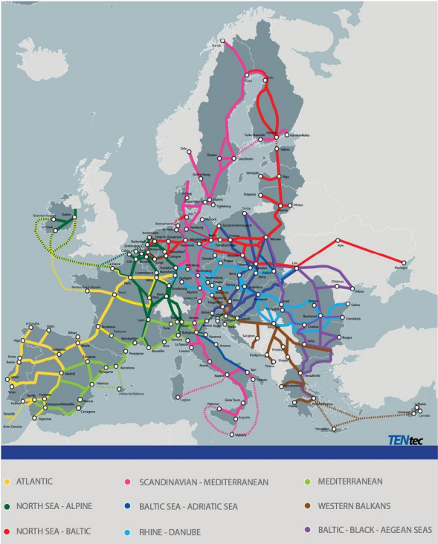
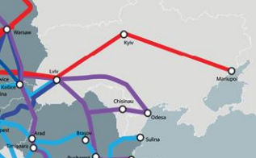
Amended TEN-T proposal
Extension of European Transport Corridors
    North-Sea Baltic Corridor -> Lviv, Kyiv, Mariupol
    Baltic-Black-Aegean Sea Corridor -> Lviv, Chisinau, Odesa
    Baltic Sea-Adriatic Sea Corridor -> Lviv
    Rhine-Danube Corridor -> Lviv

Slide 23
TEN-T revision – next steps
  European Parliament:
      Rapporteurs Barbara Thaler (EPP) and Dominique Riquet (Renew)
      Presentation of draft report in TRAN on 26 October 2022; more than 1.700 amendments tabled
      Vote in TRAN Committee on 13 April 2023
  Trilogues: Opening start on 24 of April 2023
  Adoption of the revised Regulation towards the end of 2023 (Spanish Presidency)
  Entry into force of the Regulation possibly as of January 2024

Slide 24
Zoom on REPowerEU
12/21
Efficient & green mobility package
03/20
Prop Loi Climat
06/21
Loi Climat
adoptée
12/20
SSMS
05/19
New COM
12/19
Pacte vert
12/20
MFF
NGEU
07/21
Fitfor55 Package
05/22
REPowerEU
03/23
Net-Zero Act Industry
2020
2021
2022
2023

Slide 25
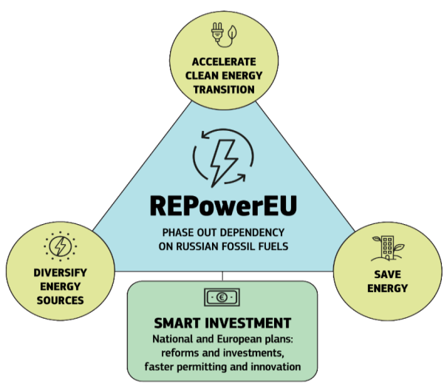
REPowerEU
March 22: Communication
May 22: Action Plan
Objectives:
save energy;
diversify supplies;
quickly substitute fossil fuels by accelerating Europe’s clean energy transition;
smartly combine investments and reforms.
We need to assess the impact of those initiatives on the transport

Slide 26
Zoom on Net Zero Industry Act & critical raw Materials Act
12/21
Efficient & green mobility package
03/20
Prop Loi Climat
06/21
Loi Climat
adoptée
12/20
SSMS
05/19
New COM
12/19
Pacte vert
12/20
MFF
NGEU
07/21
Fitfor55 Package
05/22
REPowerEU
03/23
Net-Zero Act Industry
2020
2021
2022
2023

Slide 27
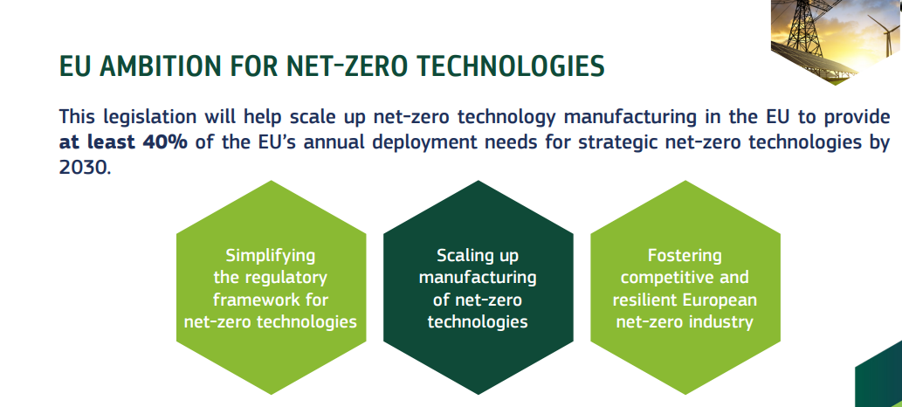
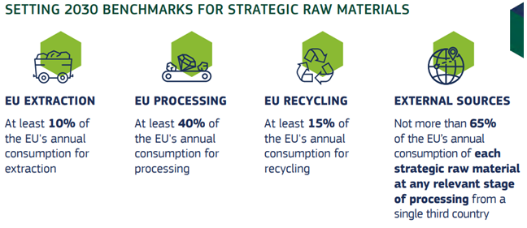
In March 2023
Proposal for a regulation on establishing a framework of measures for strengthening Europe’s net-zero technology products manufacturing ecosystem (Net Zero Industry Act)
Proposal for a regulation establishing a framework for ensuring a secure and sustainable supply of critical raw materials
We need to assess the impact of those initiatives on the transport

Slide 28
Conclusions
The resilience of the economy and of the transport system is under pressure with the recent crises, geopolitical threats and climate change.
INSTITUTIONAL + ECONOMIC SHOCKS
PANDEMIC
WAR
ENERGY
CLIMATE
Brexit
Blockage of the Suez Canal
Interoperability issues (e.g. Rastatt)
Closure of internal borders
Blockade of the UA ports & world food crisis
Energy autonomy and acceleration of the green transition
River floods, droughts, wildfires, heatwaves
Adaptation of traffic flows, alternative routes
Green lanes
Solidarity lanes
Alternative fuels infrastructure, ports as energy hubs
Resilient infrastructure and climate adaptation

Slide 29
The NextGenerationEU, the EU Social Climate fund, the EU Sovereignty Fund and the Green Deal Industrial Plan are all initiatives which are boosting our economy, avoiding recession, increasing GDP and employment and accelerating climate transition.
A single transport area of high quality as the TEN-T is the backbone for full completion of the single market of goods and services, hence an answer for Increasing European added value in an age of global challenges.
It is therefore instrumental to increase the investment in transport, both at EU and national levels.

Slide 30
What is next? Zoom on Greening Freight Package
03/20
Prop Loi Climat
06/21
Loi Climat
adoptée
12/21
Efficient & green mobility package
12/20
SSMS
05/19
New COM
12/19
Pacte vert
12/20
MFF
NGEU
07/21
Fitfor55 Package
05/22
REPowerEU
03/23
Net-Zero Act Industry
Spring 23
Greening Freight Package
2020
2021
2022
2023
Rail Capacity Initiative
Revision of the Train Drivers Directive
Revision of Weights and Dimension Directive
Revision of the Combinet Transport Directive
CountEmission EU

Slide 31

Thank you
© European Union 2020
Unless otherwise noted the reuse of this presentation is authorised under the CC BY 4.0 license. For any use or reproduction of elements that are not owned by the EU, permission may need to be sought directly from the respective right holders.
Slide xx: element concerned, source: e.g. Fotolia.com; Slide xx: element concerned, source: e.g. iStock.com
Notes:
Update/add/delete parts of the copy right notice where appropriate.
More information: https://myintracomm.ec.europa.eu/corp/intellectual-property/Documents/2019_Reuse-guidelines%28CC-BY%29.pdf

Slide 32
How decisions are made within the Commission
Planning:
Before the Commission proposes a new policy or law, it:
describes the initiative in a roadmap or inception impact assessment
examines the potential economic, social and environmental consequences in an impact assessment
requests input from the public and stakeholders, e.g. via public consultations on Have your say
Decision:
Once the draft text is finalised, having taken into consideration all of the input received on the initiative, it is submitted for inter-service consultation. All relevant departments are consulted.
Depending on its level of political importance, an initiative for a new policy or law is either agreed on by the Commission during the Commissioners' weekly meetings, using the oral procedure, or by written procedure.
Finalised initiative:
Depending on the nature of the act finalised by the Commission, the text of the initiative can be sent to the European Parliament and Council, as well as to those it is intended for, such as the EU member countries. It may also be published in the Official Journal of the EU.

