Slide 1
HS2 – a very brief summary
Ihédate – mobility in transition
23rd May 2025
Tom Cohen, University of Westminster
Notes:
Launched in 2009, the High Speed Two (HS2) rail project was initially conceived as a strategic “Engine for Growth”, designed to relieve congestion on the West Coast Main Line, stimulate economic development, and address regional disparities between Northern and Southern England. Over time, however, the scope of this ambitious initiative has been significantly reduced.
Plans for a direct link to HS1 and a spur to Heathrow Airport were dropped in 2014 and 2015, respectively. In 2021, the eastern leg to Leeds was cancelled, and in October 2023, the northern extension to Manchester was scrapped. The line will now terminate in Birmingham.

Slide 3
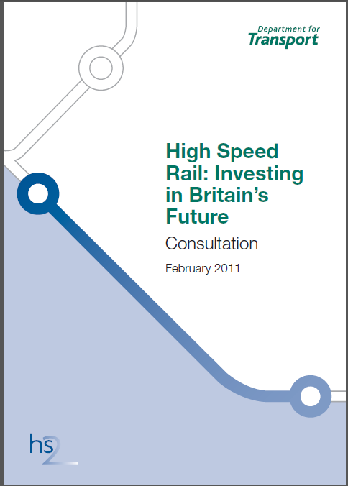
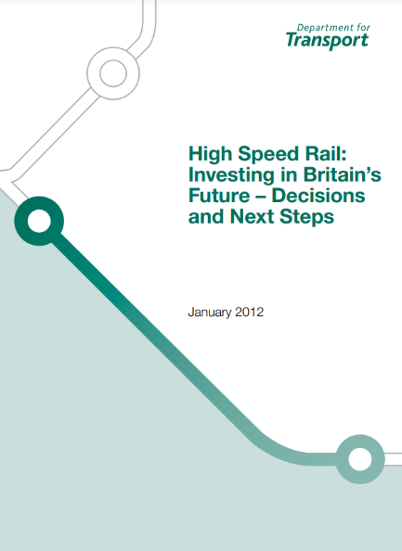

Slide 4
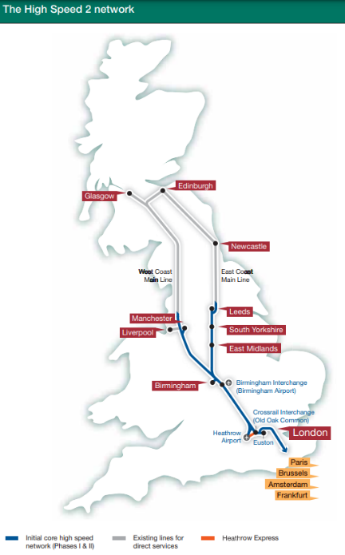
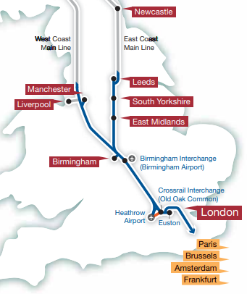

Slide 5
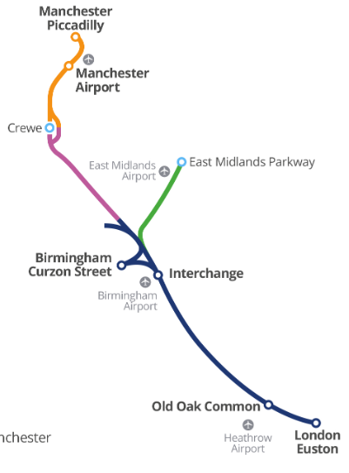
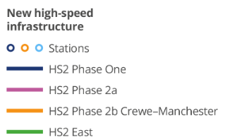

Slide 6
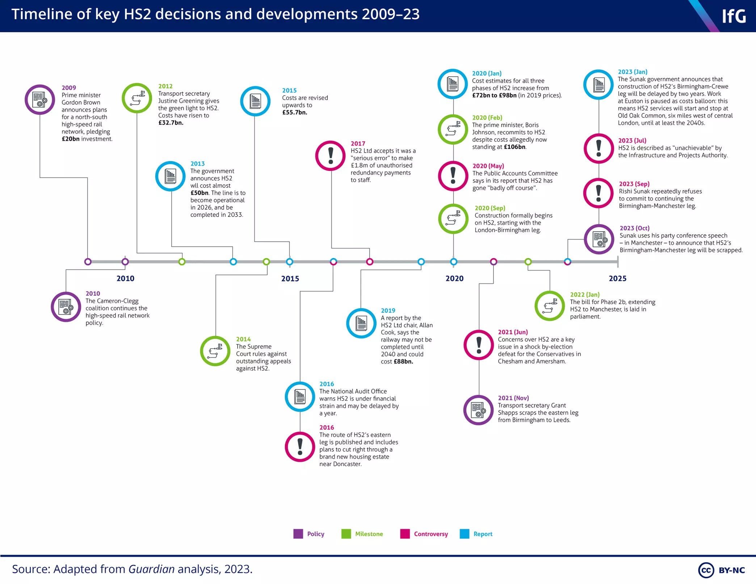
Notes:
https://www.instituteforgovernment.org.uk/article/data-visualisation/timeline-key-hs2-decisions-and-developments-2009-23

Slide 9
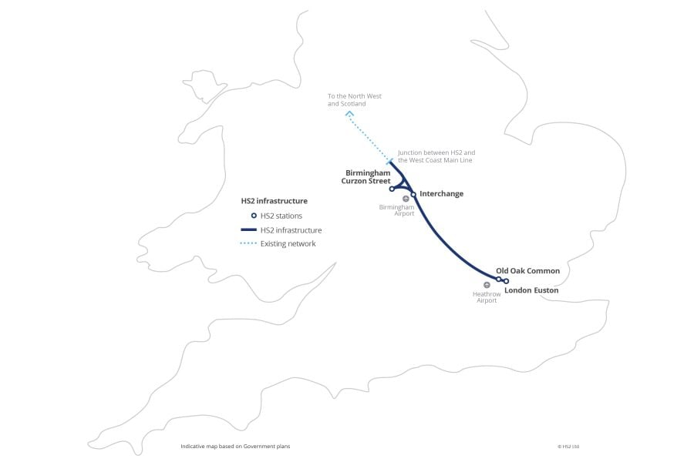

Slide 10
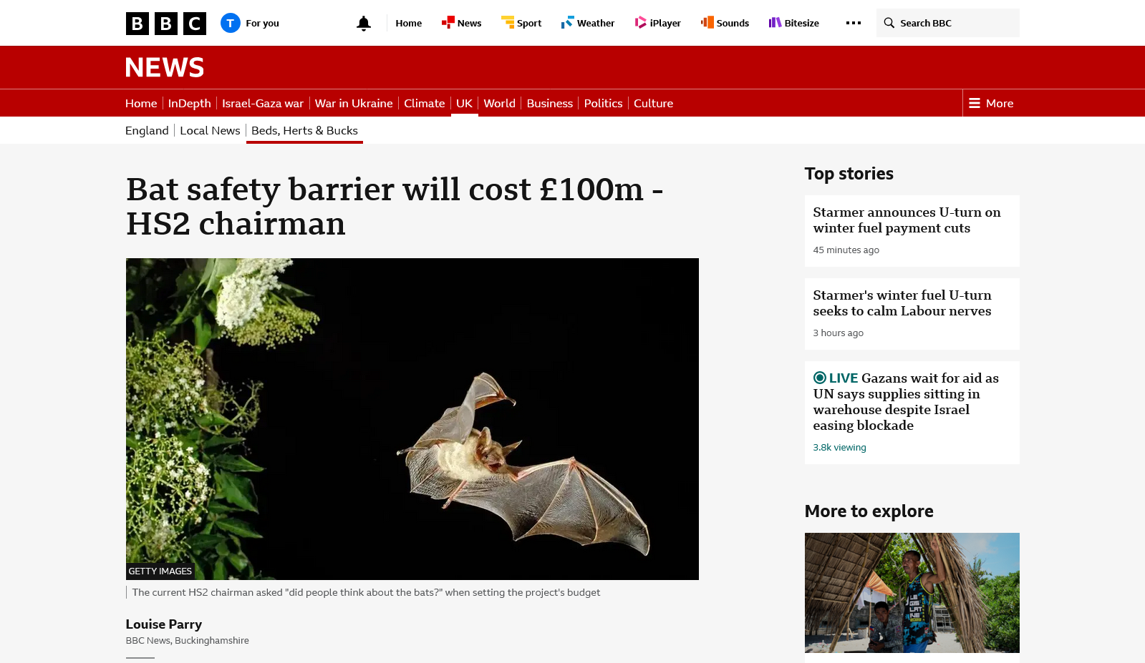

Slide 11
In summary
Consistent controversy including lengthy legal battles
Costs increasing very significantly
  Often because of mitigatory measures
A series of reductions in scope, some quite dramatic
Now an easy target for those critical of:
  Megaprojects
  The UK’s approach to infrastructure planning
  Relations between the public and private sectors

Slide 12
Thanks
Tom Cohen
t.cohen@westminster.ac.uk

