Slide 1
The ‘Manchester Model’ – a path for London to follow?
Paul Swinney, Centre for Cities

Slide 2
Why devolution is important

Slide 3

Cities are important to the national economy
Source: ONS; The Data City; Gov.uk

Slide 4
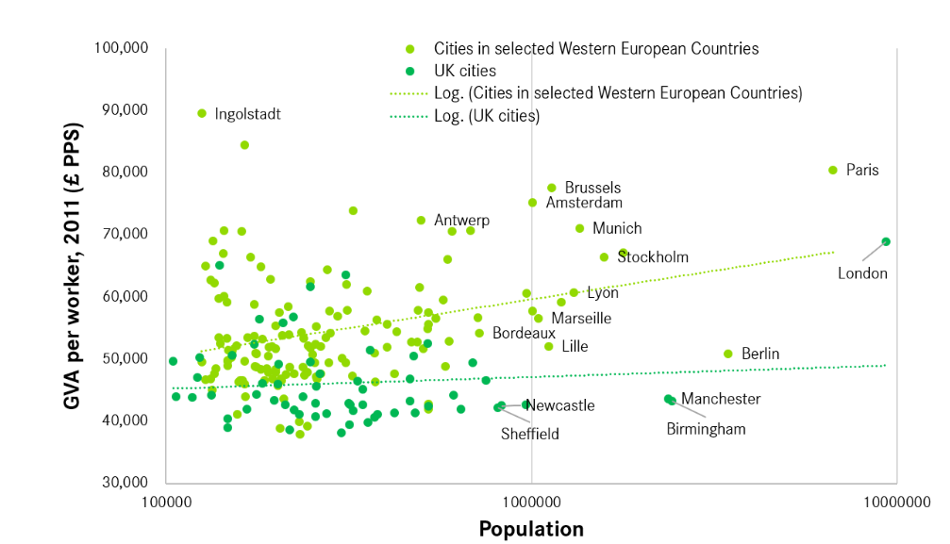
But large cities in the UK aren’t playing the role that they should be (1)
Source: ONS; Eurostat; Centre for Cities’ calculations
Note: The Western European countries used here are France, Germany, the Netherlands, Belgium, Denmark and Sweden. Population is on a log scale.

Slide 5

But large cities in the UK aren’t playing the role that they should be (2)

Slide 6
Why devolution is important

Slide 7


English policy has slowly realised that we need to decentralise
2000
2017
Source: Evening Standard

Slide 8
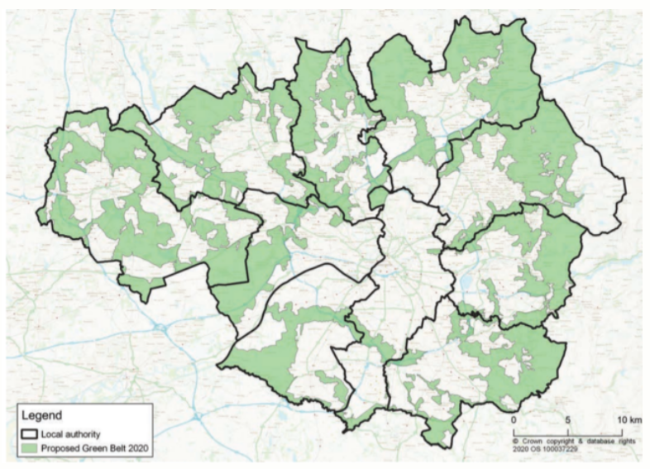
The Manchester model largely works because of a long history of working together
Source: Place North West/PfE

Slide 9

But even in this best case scenario the model struggles

Slide 10
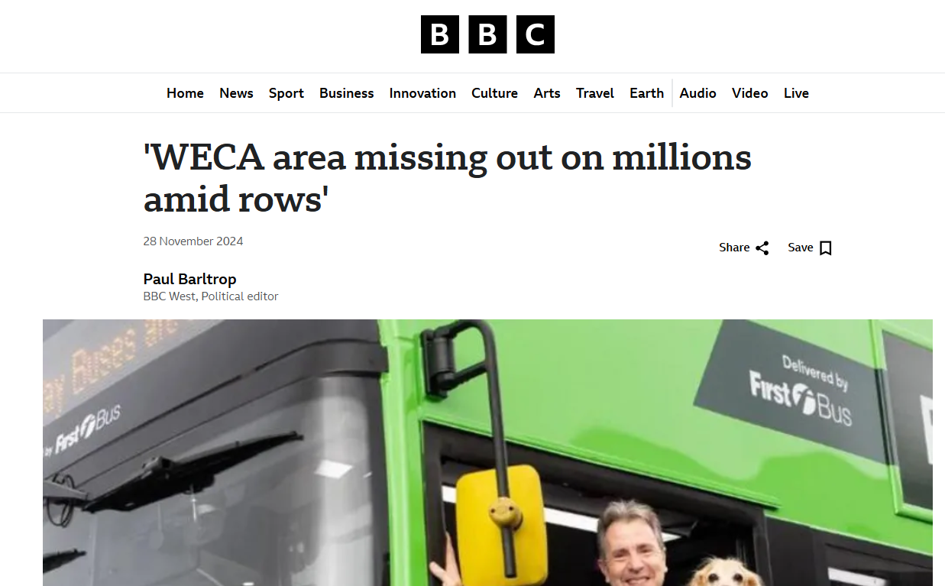
And is worse elsewhere

Slide 11
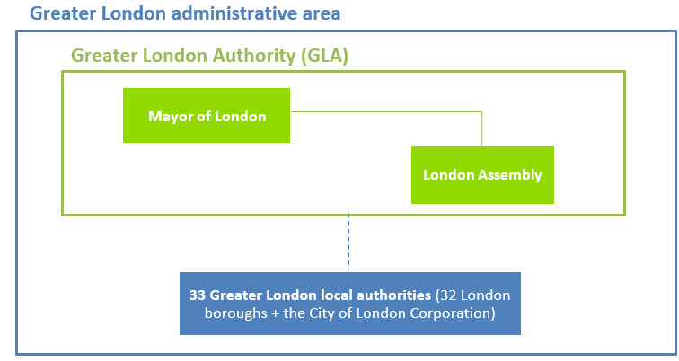

This happens because mayors outside of London are ‘one amongst equals’

Slide 12

But even London is constrained by international standards

Slide 13

The goal should be to improve the London model, not replicate the Manchester one

Slide 14
Questions

