Slide 1
Housing and urban development in the Netherlands
Arjan HARBERS
13 Maart 2023
Rotterdam

Slide 2
Advisory board for ministries and parliament for the Environment, Nature and Spatial Planning
Part of :
Ministry of Infrastructure and Water Management
Primary Clients
Ministry of Infrastructure and Water Management
Other ministries: Economic Affairs and Climate Policy, Foreign Affairs, Finance, Interior, Agriculture, Nature and Food Quality, Education, Culture and Science
EU, UNEP, OECD
Provinces

Slide 3
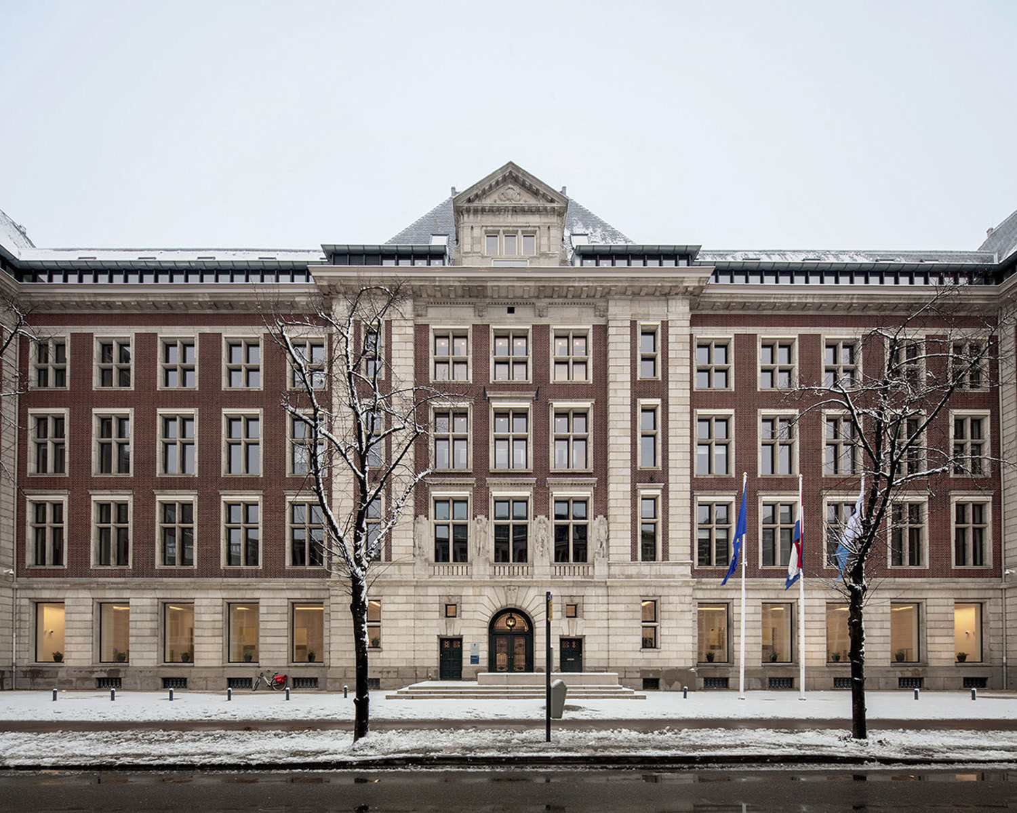
PBL
SCP
CPB

Slide 4
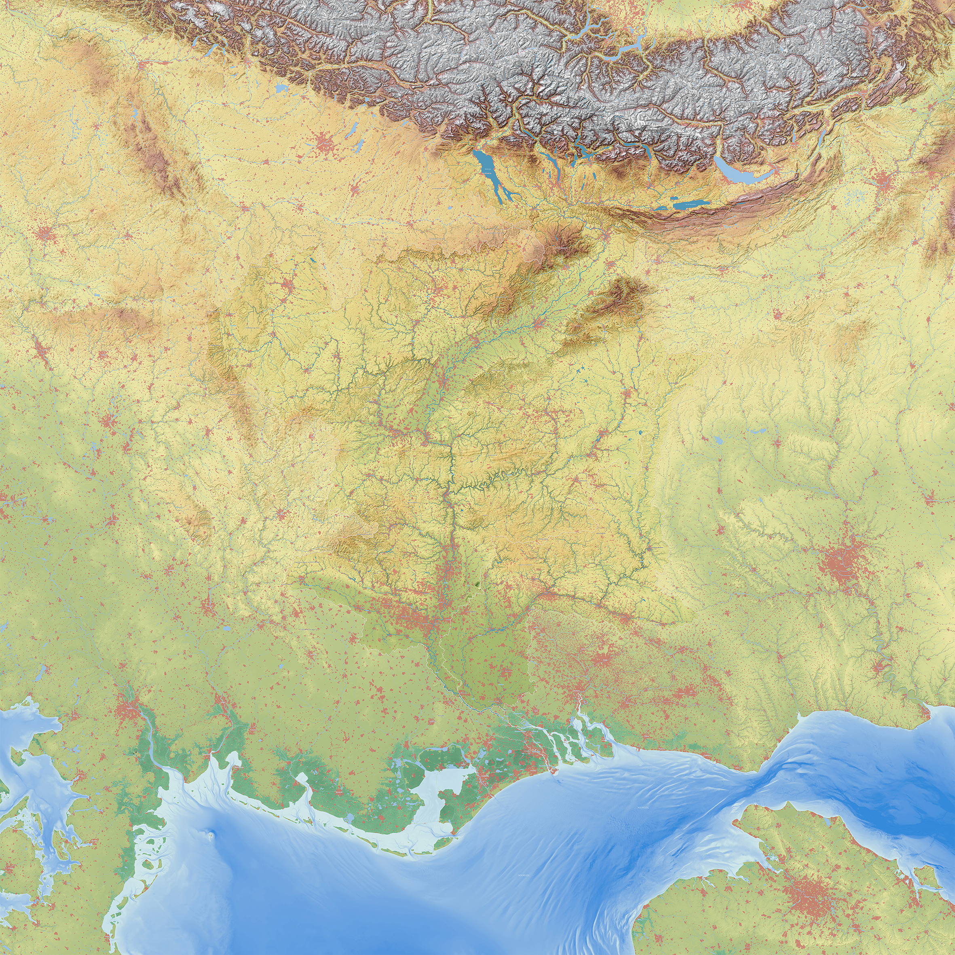
Notes:
Nederland is een laaggelegen Delta dat grotendeels onder de zeespiegel ligt.
Dit land heeft allen kunnen ontstaan en kan alleen blijven bestaan door een goede samenwerking van partijen die het land gezamenlijk veilig, droog en leefbaar houden. Hier is ons ooit fameuze poldermodel uit ontstaan.
De Delta brengt ook met zich mee dat het land heel vruchtbaar is en onze landbouw groot is geworden.
Kenmerkend voor het natuurlijke landschap zijn de talrijke gradiënten tussen hoog en laag, zoet en zout en droog en nat.
Gebruik makend van deze gradiënten, heeft de mens, Nederland gevormd.
Door de aanleg van dijken en polders. Molens en gemalen, verdedigingslinies en forten. Kanalen en landgoederen.

Slide 5
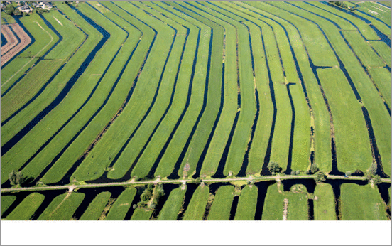
.
“Before I came here I was confused about this subject. Having listened to your lecture I am still confused. But on a higher level”
Nobelprijswinnaar Enrico Fermi
A land of order

Slide 6
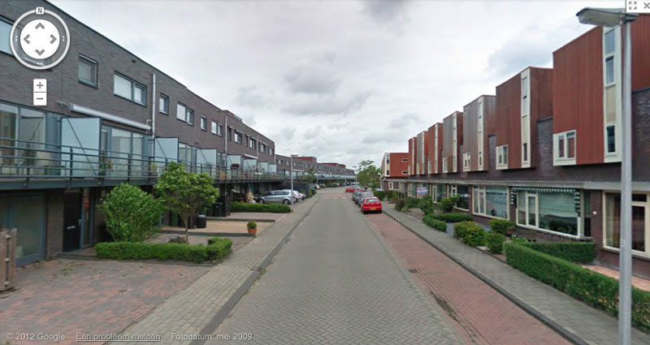
.
“Before I came here I was confused about this subject. Having listened to your lecture I am still confused. But on a higher level”
Nobelprijswinnaar Enrico Fermi

Slide 7


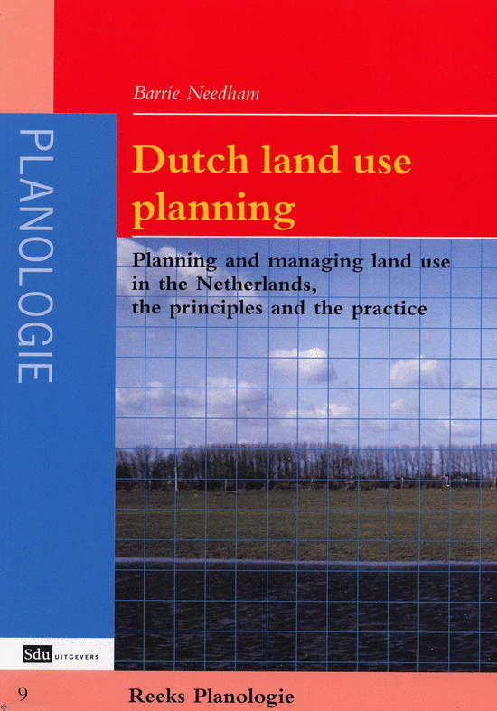
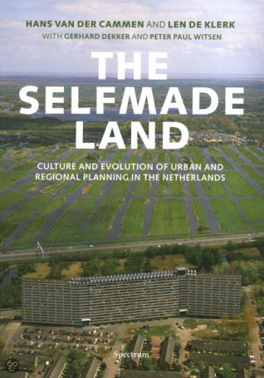
Dutch planning world famous
Since 1960s especially national planning has attracted attention of planning scholars and practicioners

Slide 8
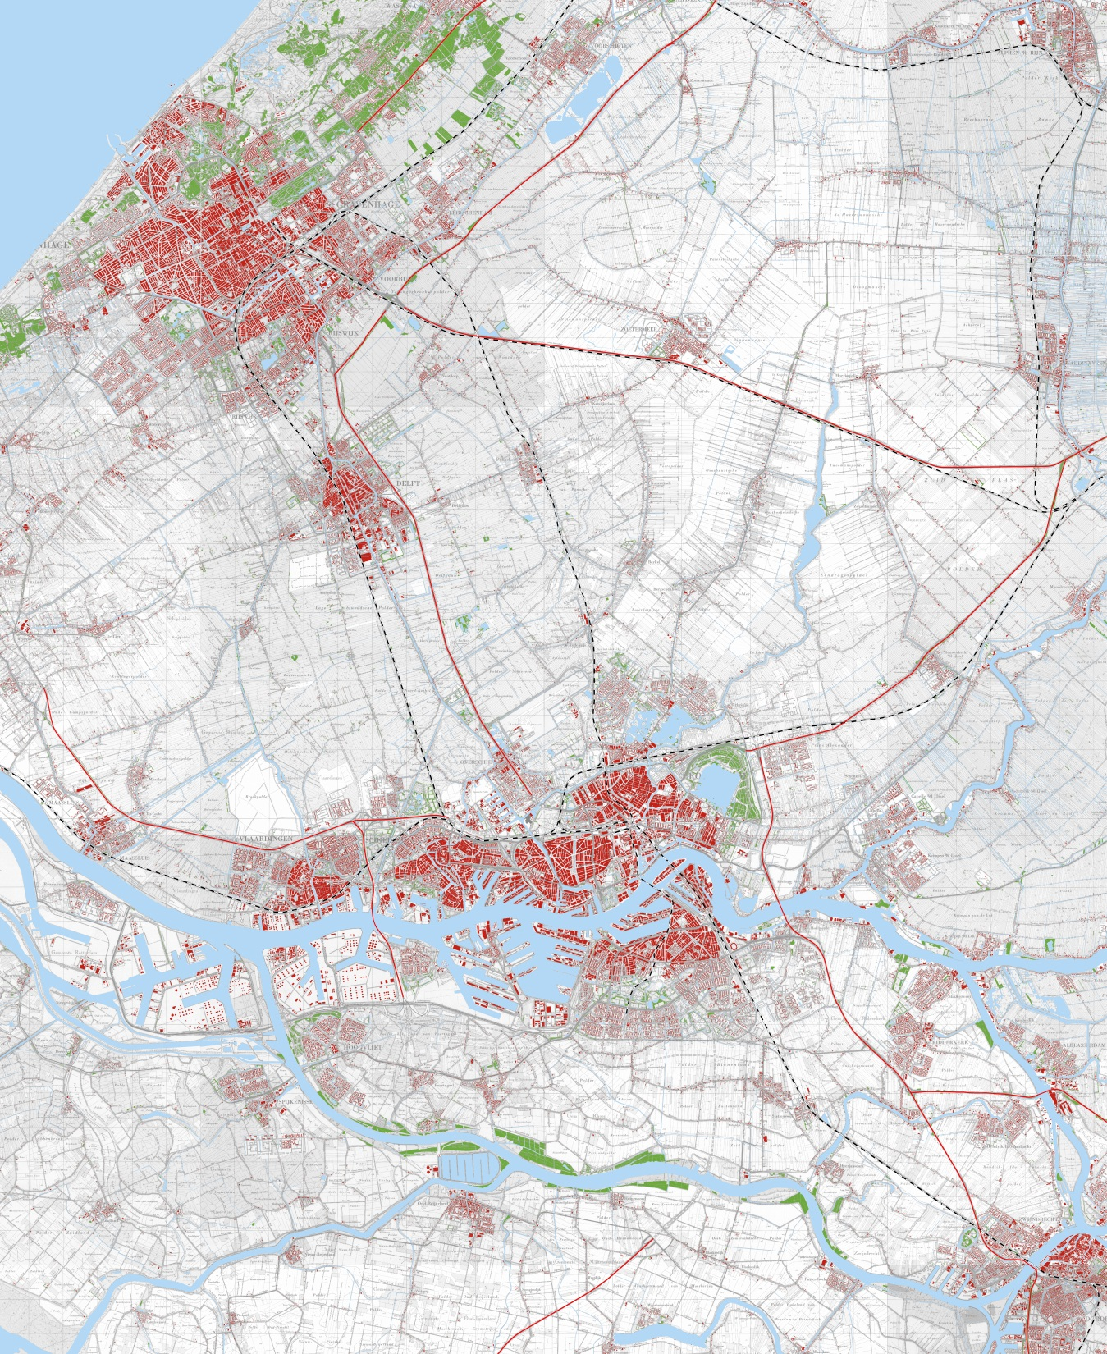
Randstad Rotterdam-The Hague region, 1970
Notes:
Top middle Zoetermeer still as a village…

Slide 9
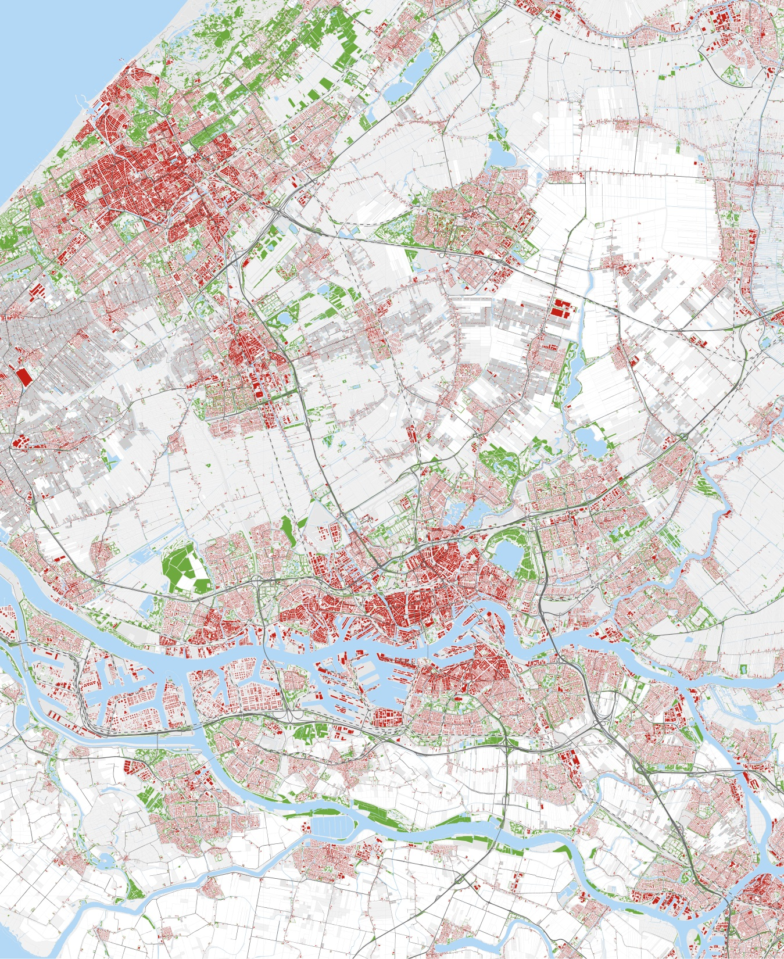
Randstad Rotterdam-The Hague region, 1990
Notes:
And as a new town

Slide 10
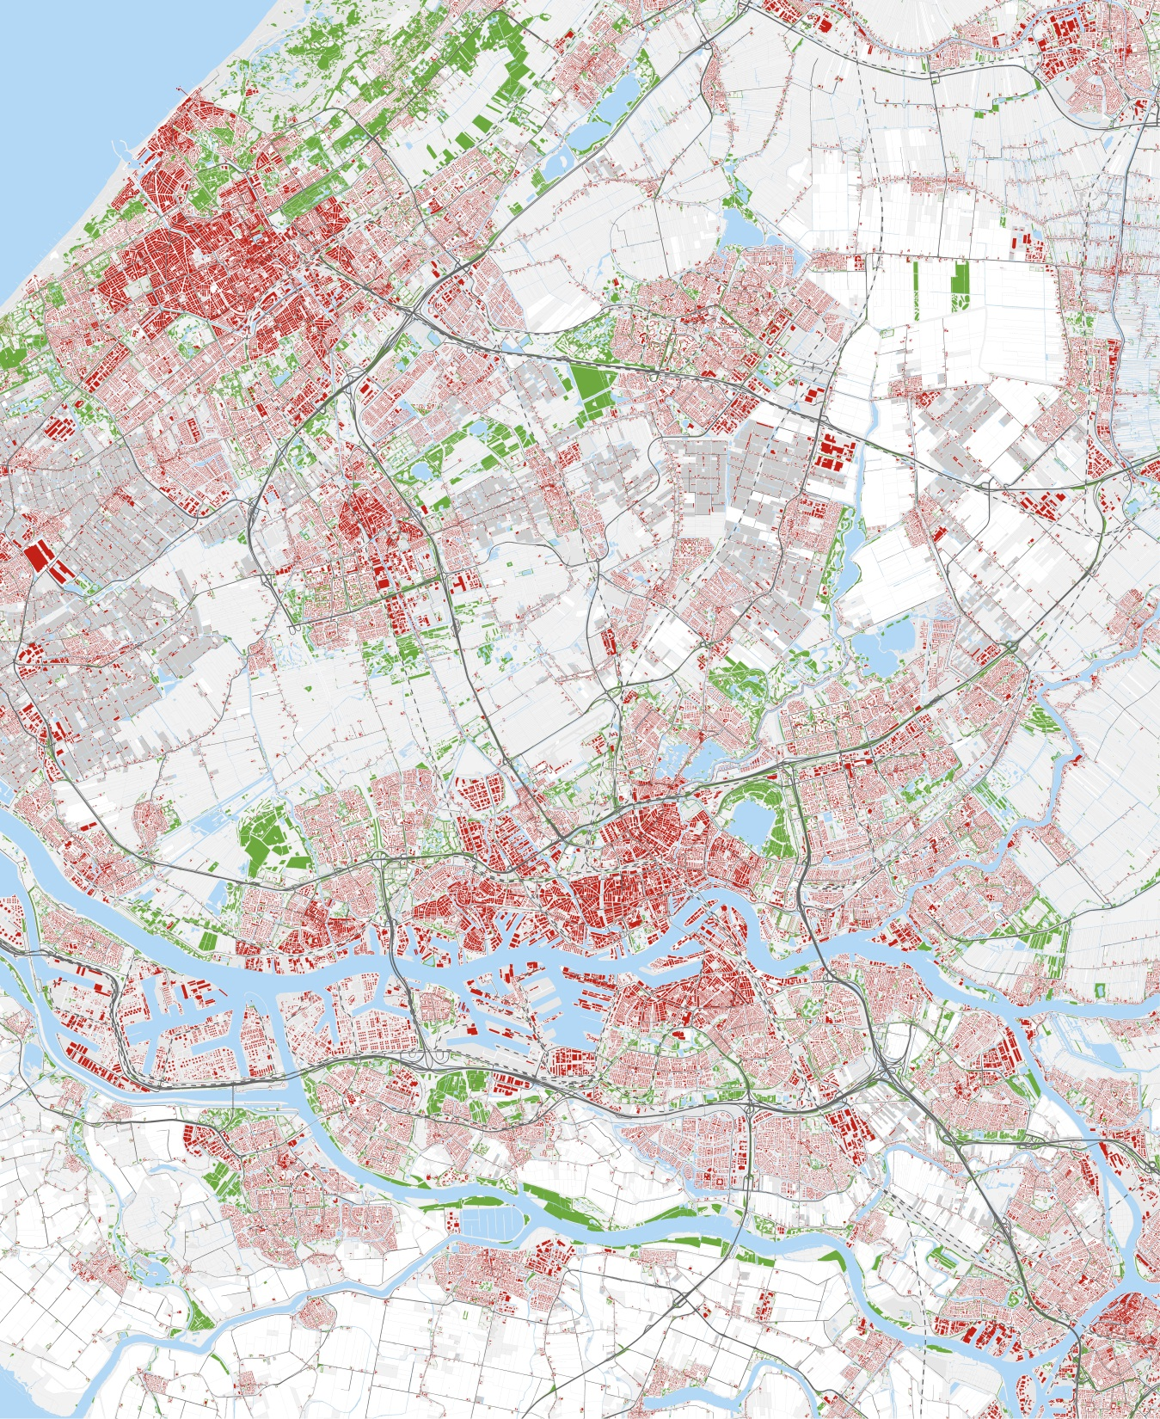
Randstad Rotterdam-The Hague region, 2010
Notes:
And here we see the effects of the building of several vinex suburban areas, between The Hague and Zoetermeer, The Hague and Delft and around Rotterdam. Also the growth of the greenhouse agriculture (grey) especially around Zoetermeer.

Slide 11
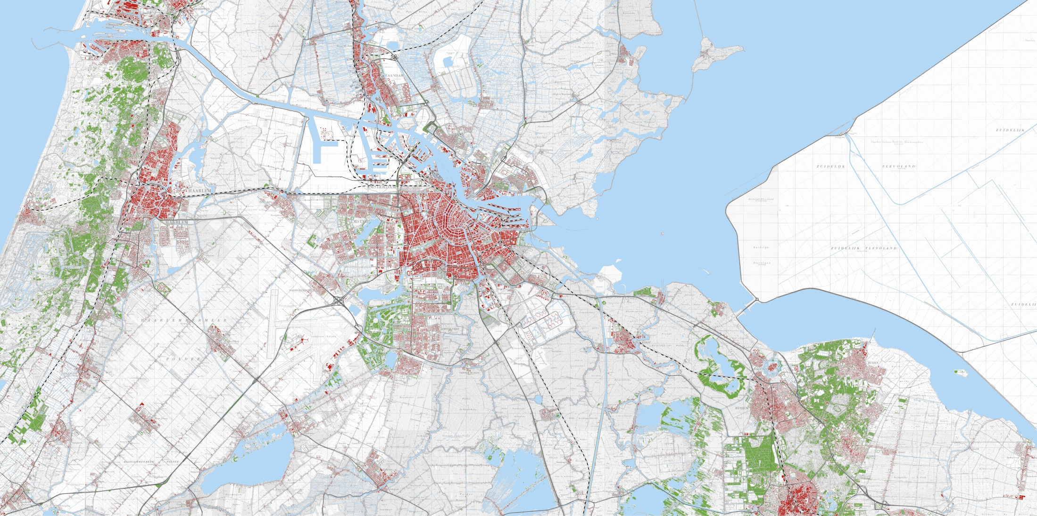
Urbanisation in the Randstad: 1970 - 2010
Randstad Amsterdam region,1970
Notes:
Amsterdam region in 1970, SE of Amsterdam the airport area, East of Amsterdam land reclaimed from the sea.

Slide 12
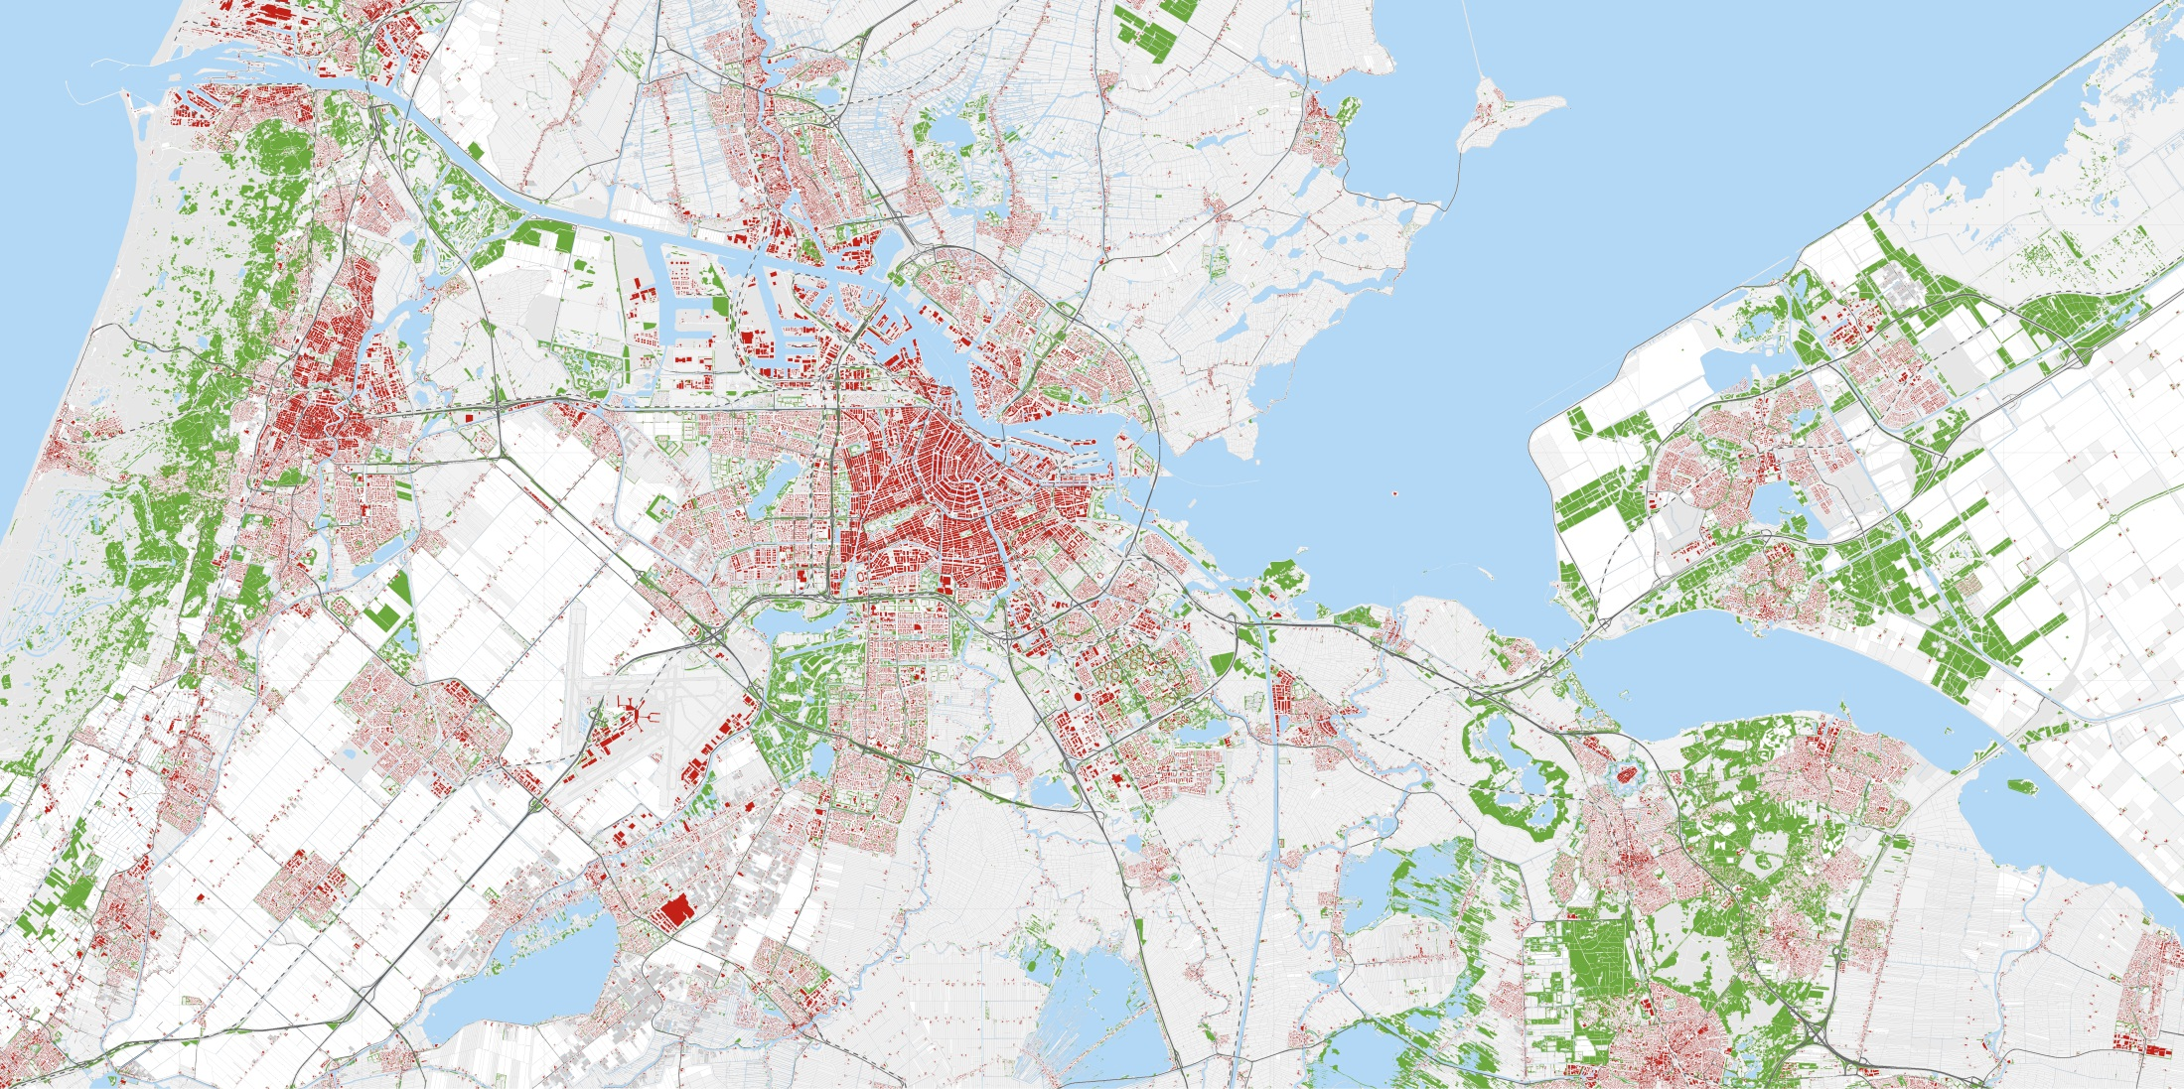
Urbanisation in the Randstad: 1970 - 2010
Randstad Amsterdam region,1990
Notes:
With Almere growing

Slide 13
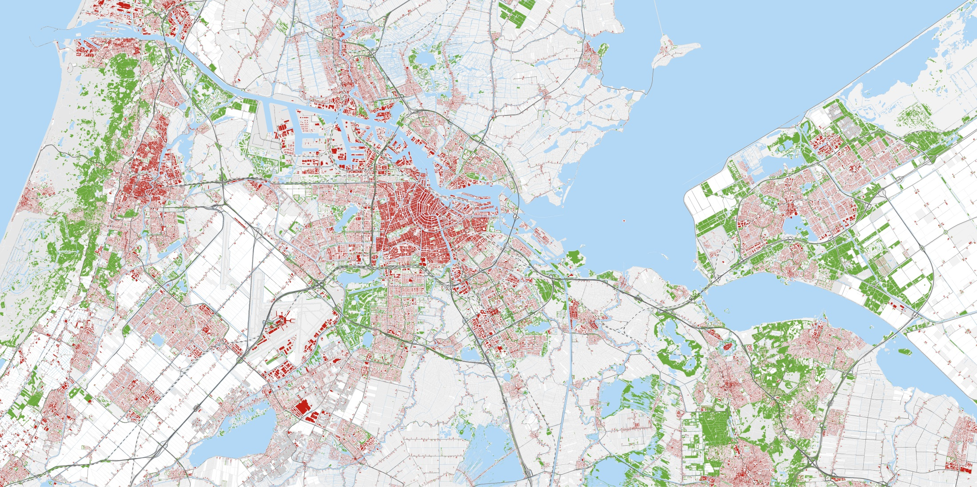
Urbanisation in the Randstad: 1970 - 2010
Randstad Amsterdam region, 2010

Slide 14
1900-
Social housing

Slide 15
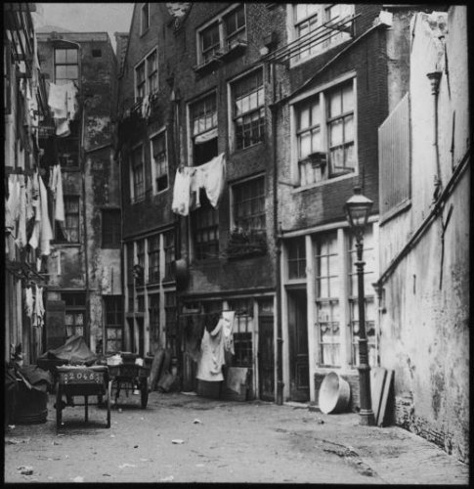
Reaction to industrial city
Planning and social housing arose from concerns about hygiene, social unrest, etc.
1901 Housing Act: provided for minimum housing standards and granted powers to municipalities to plan, including expropriation
Housing associations: good quality housing for workers

Slide 16
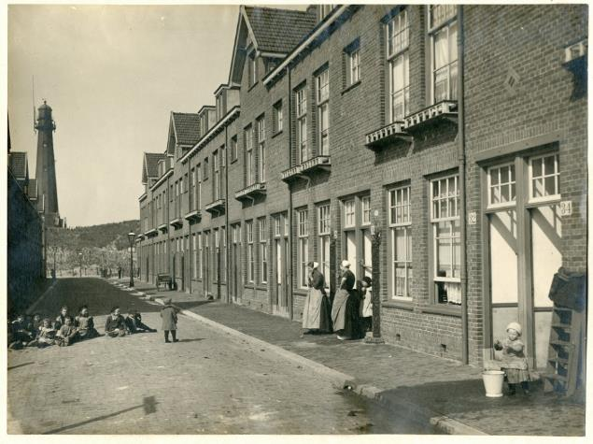
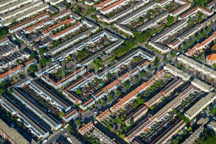
Social housing

Slide 17
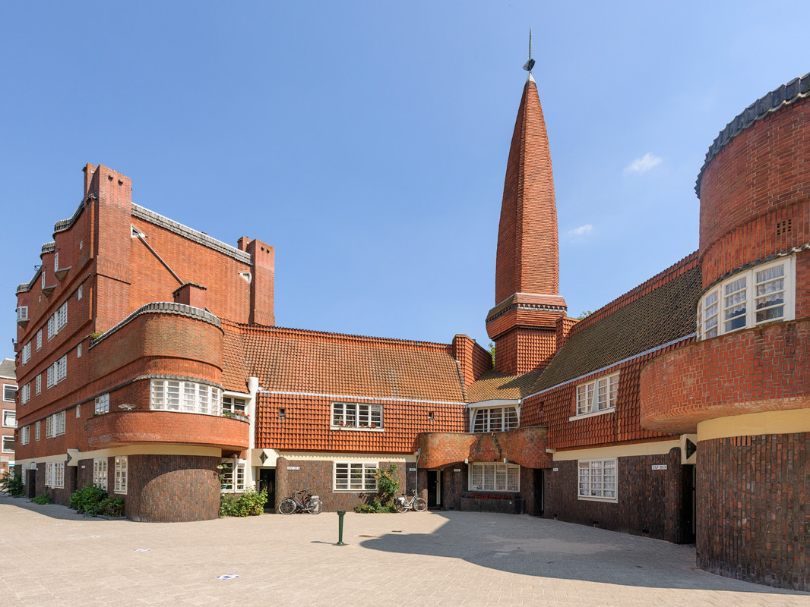
Workers’ palaces: ‘t Schip in Amsterdam
Since 1901 Act with government support

Slide 18
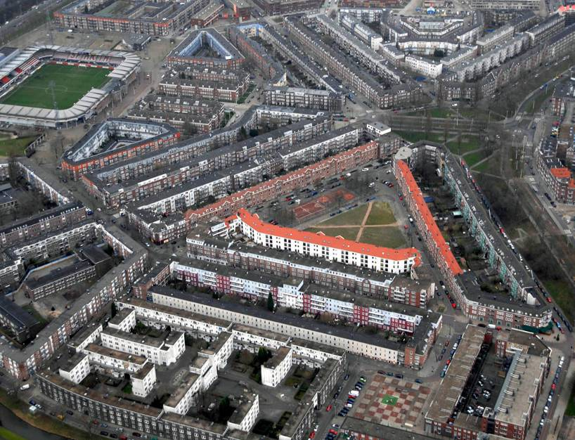
… and Rotterdam
Rotterdam Spangen
Notes:
And this is the Spangen urban area here in Rotterdam. Stimulated by the local government, it was designed by famous architects and mostly built during the 1920s. The pattern of streets has a symmetrical design. Left at the top you see the Sparta football stadium. Up to the 1950s, Spangen was a living area for civil servants, craftsmen and teachers. During the 1980s and 90s Spangen became more and more an area for immigrants, and had many problems with drugs-related crime. Partly because of civil protests, the local government took initiatives to improve the living conditions in the area.

Slide 19
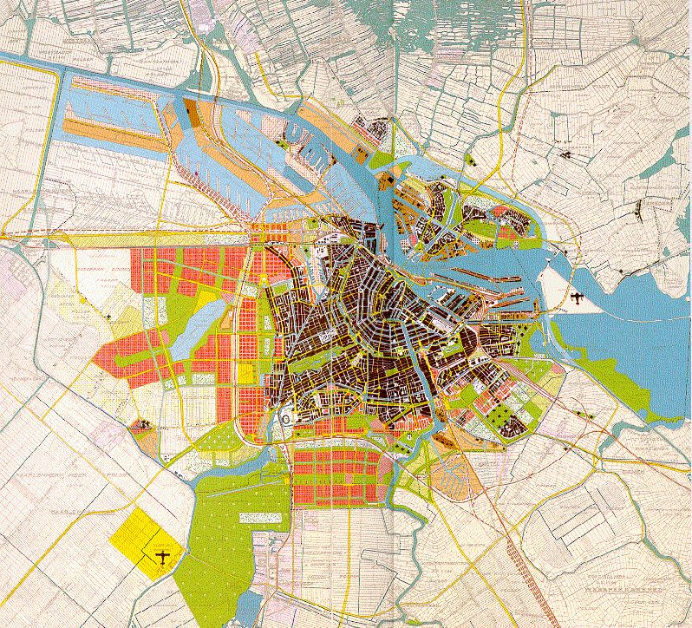
Planning in the 1930s and 1940s: urban regions
Van Eesteren, Plan for Amsterdam 1938
Notes:
The plan of 1938 was the start of the ‘finger-shaped’ urban extensions of Amsterdam. Urban extensions with green areas in between. Cities like Copenhagen and Hamburg also adopted this urban extension model. Central idea is to have recreational nature close to urban living.

Slide 20
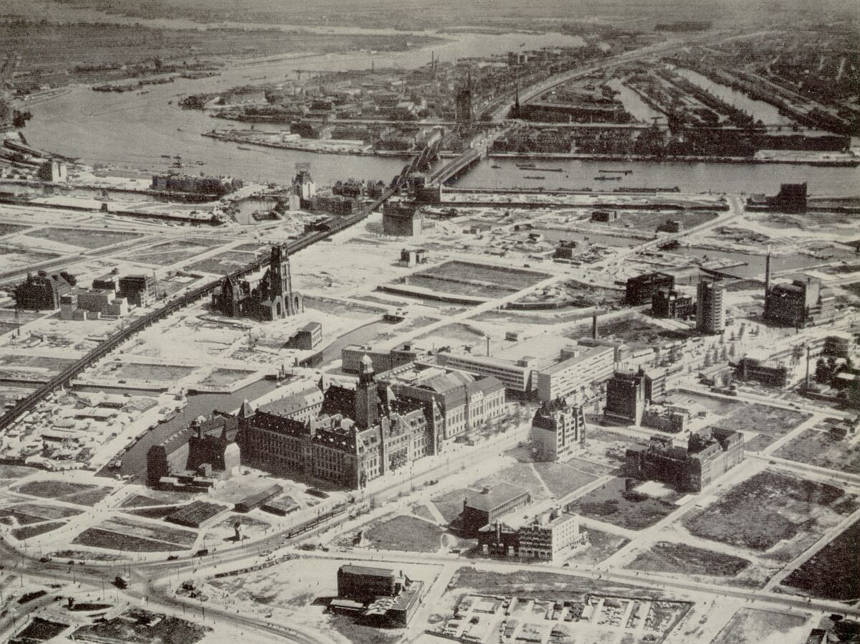
Postwar rebuilding
Rotterdam 1946
Notes:
The city centre of Rotterdam was devastated by the German bombing in May 1940. In the centre of the picture is the city hall and adjacent post office. Restoring the damage was one of the first priorities after the war.
And even more; to catch up the 5 years stop on building houses

Slide 21
National spatial planning takes off, 1945 - 1970
Start of national spatial planning because of:
  Restoring the damages of the Second World War (Cities of Rotterdam, The Hague, Nijmegen, Arnhem)
  Modernisation of industrial economic structure
  Fighting housing shortages
  Expected growth of the population from 10 million 1950 to 20 million in 2000 (in reality: 16 million)
  Start of suburbanisation wave in the 1960s
  Fearing uncontrolled (sub)urbanisation of the Randstad area: “a sea of houses”.

Slide 22
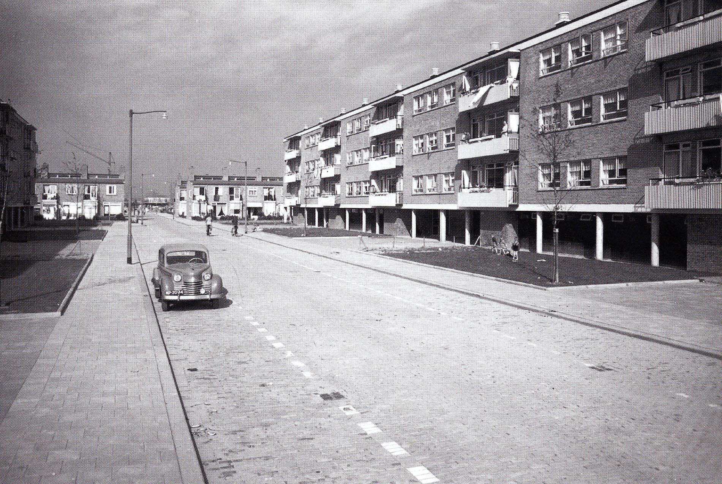
1950s: fighting the housing shortage
Rotterdam, Pendrecht
Notes:
And the second priority was fighting the housing shortage and boosting u the housing production. This became a goal of the national government, not only of local governments. Many new urban areas came into the existence under this new national spatial planning regime,especially around the big cities. Here is Pendrecht, at the south bank of the river in Rotterdam. The 4 layer appartment buidings were typical of the new neighbourhoods of the 1950s. 4 layer buildings could do without an elevator.

Slide 23
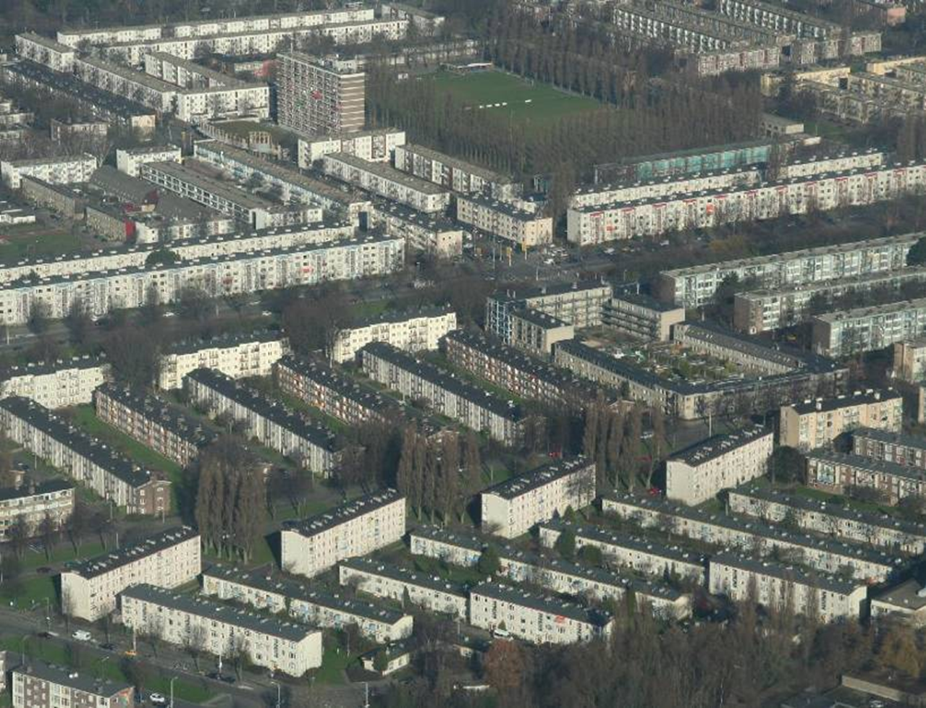
1950s: fighting the housing shortage
The Hague, Moerwijk
Rotterdam, Pendrecht
Notes:
And the second priority was fighting the housing shortage and boosting u the housing production. This became a goal of the national government, not only of local governments. Many new urban areas came into the existence under this new national spatial planning regime,especially around the big cities. Here is Pendrecht, at the south bank of the river in Rotterdam. The 4 layer appartment buidings were typical of the new neighbourhoods of the 1950s. 4 layer buildings could do without an elevator.

Slide 24
Notes:
And it worked. Housing production rose, and came to its peak in the first years of the 1970s. After 1973, the building of new houses stagnated because of the economic crisis. It rose above the level of hunderd thousend houses during the 1980s, but decreased during the 90s. From 2008 onwards, the effects of the recent economic crisis become visible.

Slide 25
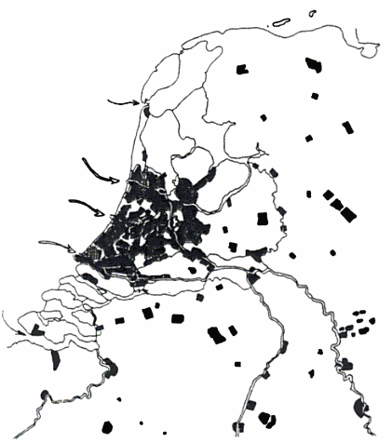
First National Spatial Strategy (1958/60)
Context
  Housing shortage
  Fear for a ‘sea of houses’
  Space for agriculture ‘no more hunger’
Principle
  Deconcentration to relieve pressure in the West
Concepts
  Randstad / Green Heart
  Buffer zones

Slide 26
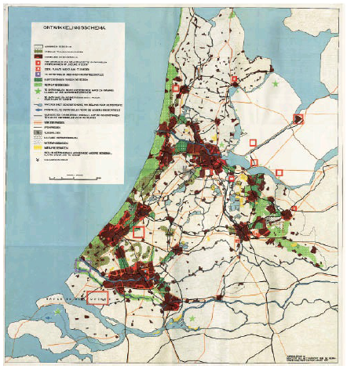
First National Spatial Strategy (1958/60)
Context
  Housing shortage
  Fear for a ‘sea of houses’
  Space for agriculture ‘no more hunger’
Principle
  Deconcentration to relieve pressure in the West
Concepts
  Randstad / Green Heart
  Buffer zones

Slide 27
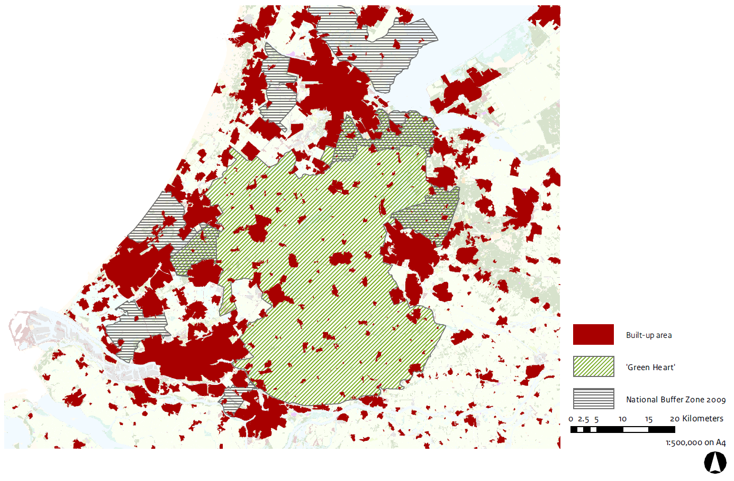
Randstad policy zones – Green Heart & Buffer zones

Slide 28
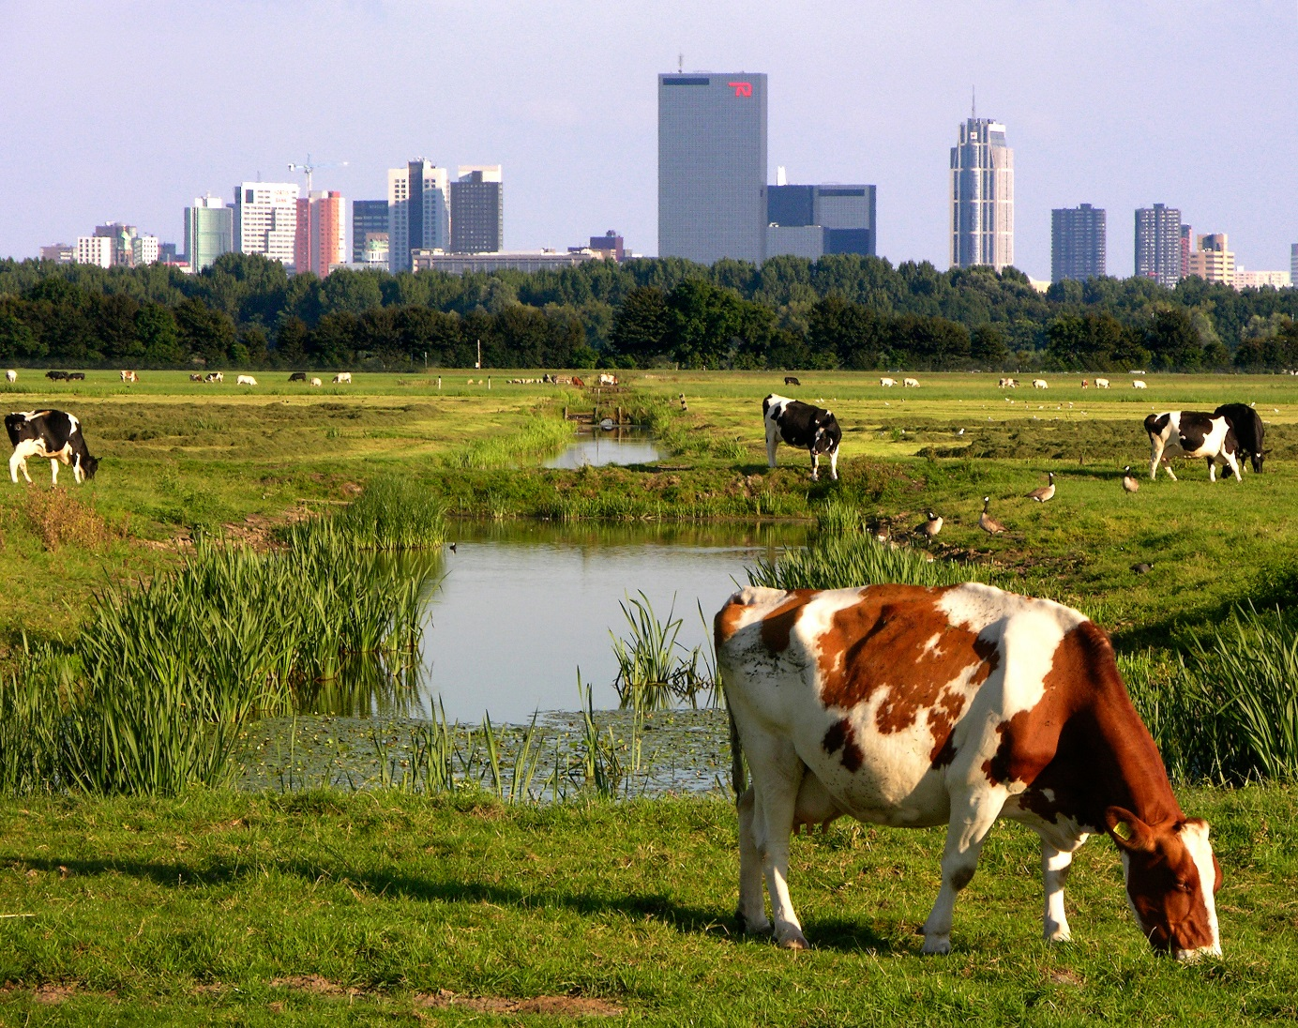
Green Heart protection and maintaining buffer zones around the large cities matched the wish for a more efficient, large-scale agriculture.
Buffer zone next to Rotterdam, maintaining a strict policy boundary between rural and (sub)urban land use

Slide 29
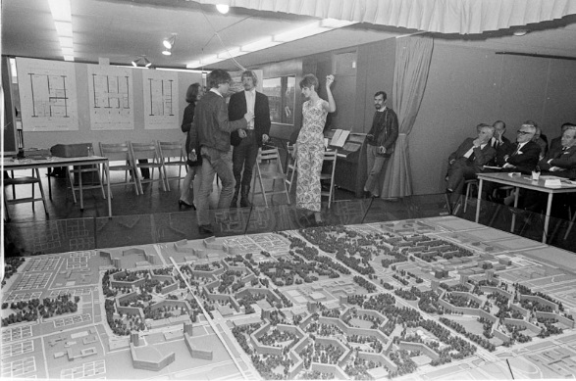

Slide 30
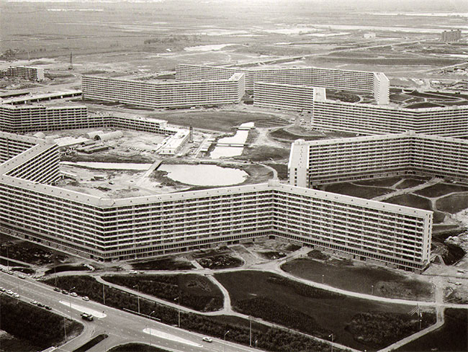
1960s: high-rise extensions of the cities
Bijlmermeer district, Amsterdam
Notes:
During the 1960s, many urban extensions with high rise buildings were planned. This extension of the South Eastern part of Amsterdam started in 1966. Soon after it became clear that these high rise appartment buildings were not popular anymore amoungst inhabitants of the cities. The preferred a house with a garden in a suburban environment instead. Because the rise of car ownership, these type of houses became within reach of many people. This change in preferrences lead to another major turning point in urban and spatial planning.

Slide 31
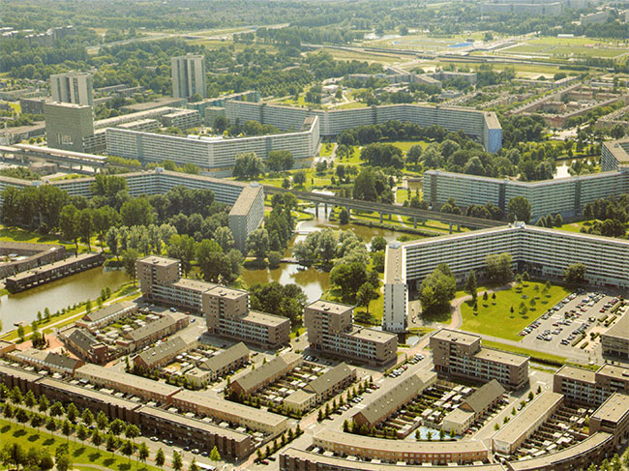
1990’s: transformation

Slide 32
Population of the three largest cities, 1950-2012
1950
1960
1970
1980
1990
2000
2010
Notes:
Suburbanisation had serious effects upon the cities! Amsterdam lost 200.000 inhabitants in 20 years, Rotterdam and The Hague each 150.000. From the end of the 1980s onward, the population levels started to rise slowly again.

Slide 33
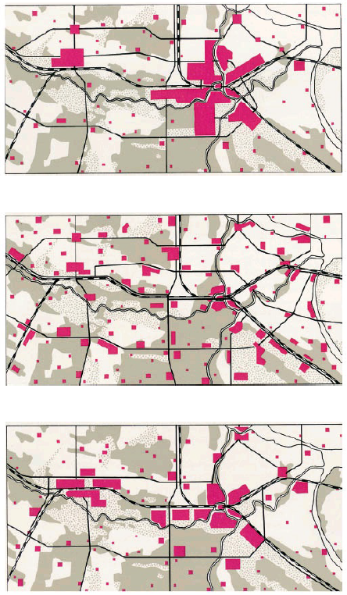
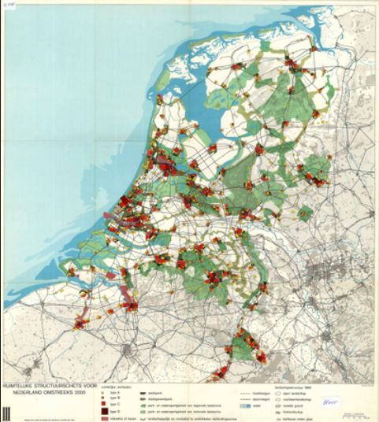
Second National Spatial Strategy (1966)
Concentration
Diffusion
Polycentricity

Slide 34
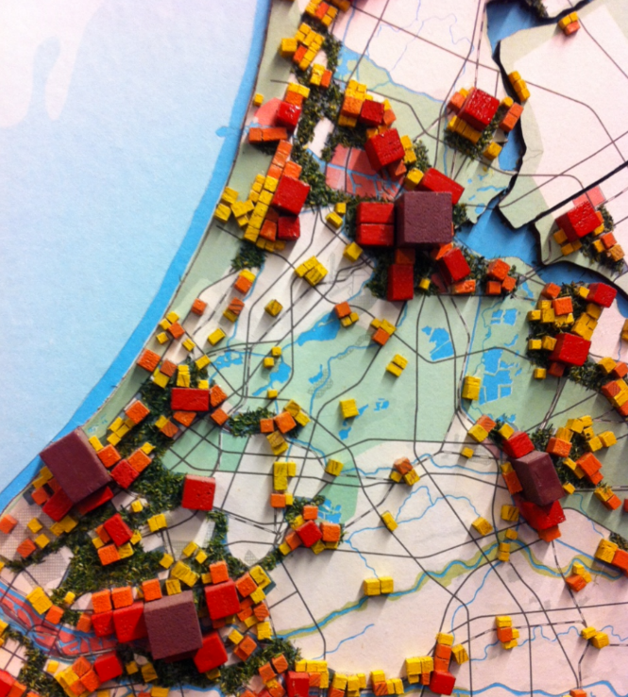
Second National Spatial Strategy (1966)
Concentration
Diffusion
Polycentricity

Slide 35
1970s: suburbanisation and New Town planning
Middle-class and lower-middle-class families leaving the cities for the suburbs during the 1960s and 1970s
Rise of car-ownership and mobility
Preferences for suburban houses with garden instead of high-rise buildings
Second National Spatial Planning document 1966: ‘concentrated deconcentration’ policy. New towns at some distance of the cities to prevent massive suburbanisation of the ‘Green Hart’ of the Randstad

Slide 36
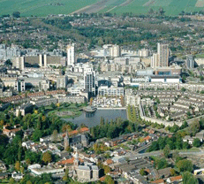
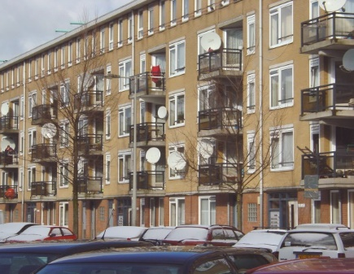
Housing and planning: 1970-80s
New towns
  High levels of social housing
  National designation, subsidies
  Self-sufficient communities, TOD
Cities
  Decline of pre-war areas
  Urban renewal efforts
  Protests and bottom-up plans

Slide 37
1970-
From regulatory to development planning

Slide 38
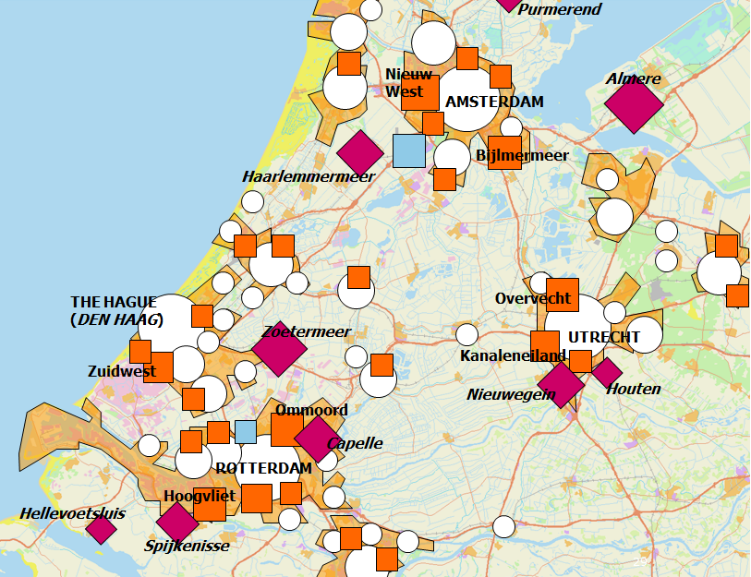
Third National Spatial Strategy (1970-80s)
Regulatory planning is effective to restrict but not promote urban development
Implementation using subsidies
Existing cities and towns
Major extensions
New towns
Airports

Slide 39
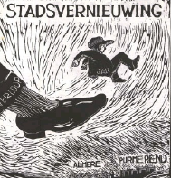
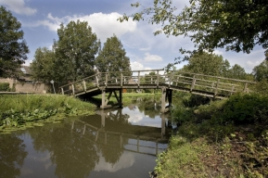
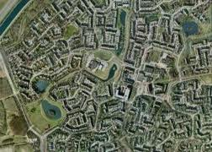
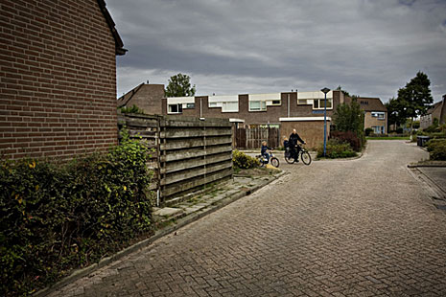
Urban renewal and “growth centers”(suburbs)
Advantages for baby-boomers: child friendly design, good amenities, etc.
Too successful: cities depleted of middle class population, commuting traffic jams

Slide 40
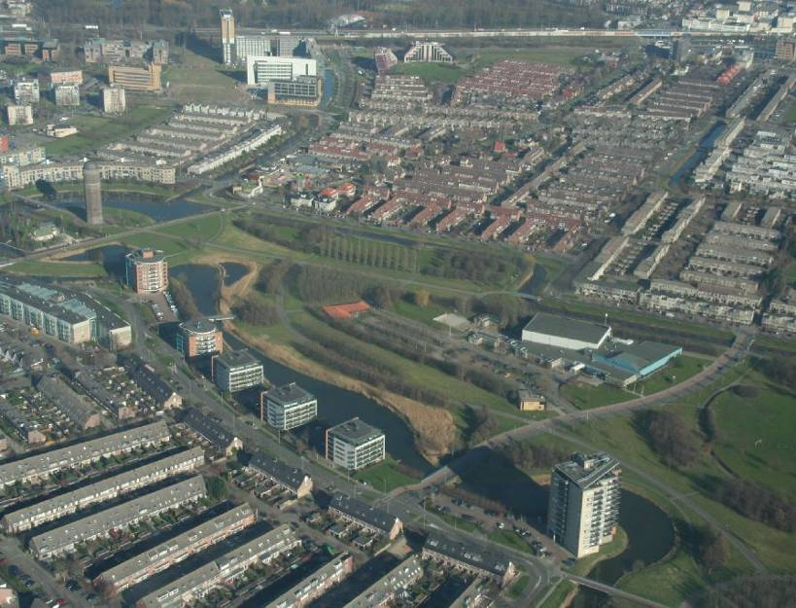
1970s: new town planning
Zoetermeer new town
Notes:
Zoetermeer new town (a former small village near The Hague). The typical Dutch suburban row-house with garden is dominant.

Slide 41
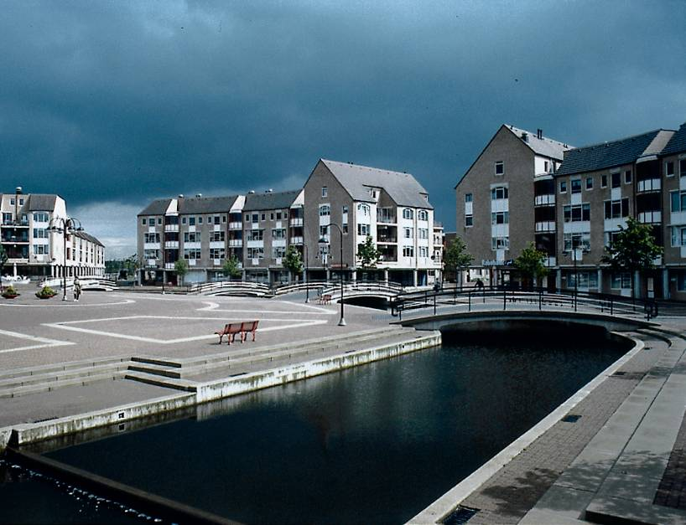
1970s: new town building at a ‘human scale’
Houten new town
Notes:
And this became the most popular form of living for the middle and lower middle classes: appartment blocks not more than 4 or 5 levels high, close to the street level, in a safe and quiet environment….

Slide 42
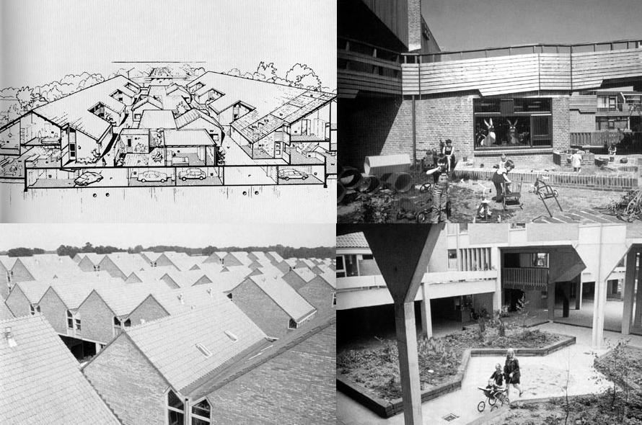
1970s: new town building at a ‘human scale’
Zoetermeer and Hengelo
Notes:
Or street-level houses with gardens and playgrounds for the children, parking in the basement areas of the houses.

Slide 43
National spatial planning in the 1980s and 1990s
Reorientation of national spatial planning because of a serious urban crisis in the 1970s and 1980s:
Population of the big cities in the 1980s at its lowest level since the Second world war
Loss of industrial jobs, rising unemployment levels
Middle class families leaving the cities, poor immigrants coming in
Upcoming creation of the common European economic market in 1992 with more competition between European cities
Environmental problems: air pollution by traffic and industry, industrial and agricultural waste in soil and water, traffic jams in and around cities

Slide 44
Fourth national spatial planning document 1988 and 1991 (Vinex, revised), major goals:
Compact cities, building new houses in and adjacent to the cities
Filling in open urban spaces (former harbour areas and industrial sites)
New town developments closer to the cities (called ‘Vinex suburbs’)
Strenghtening the economic position of cities by attracting business
Priority for further development of the two Mainports: Schiphol airport and Rotterdam harbour
Reducing automobility
Public-private cooperation

Slide 45
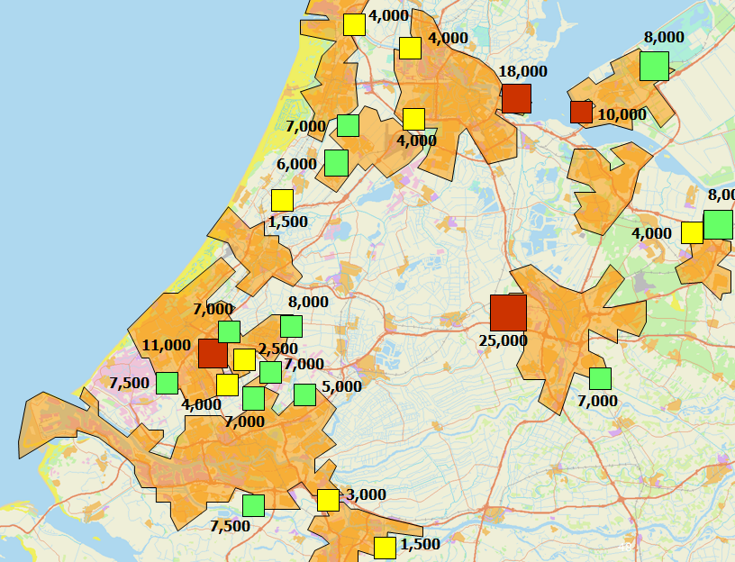
Fourth National Spatial Strategy Extra (1991-00)
VINEX-areas
  focus on quality (owner-occupied) in and at edge of city
  Subsidies from national government
  30% affordable, density 30-50 h/ha
ABC-policy
  locate businesses at transit nodes
10,000 units and over
5,000-10,000 units
less than 5,000 units

Slide 46
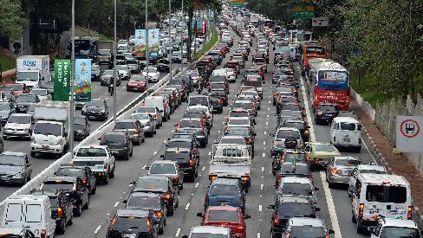
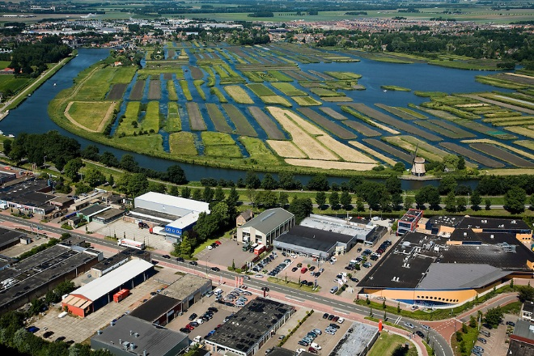
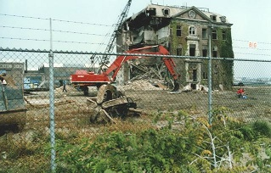
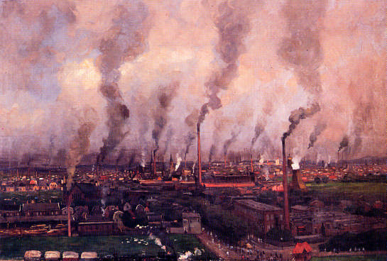
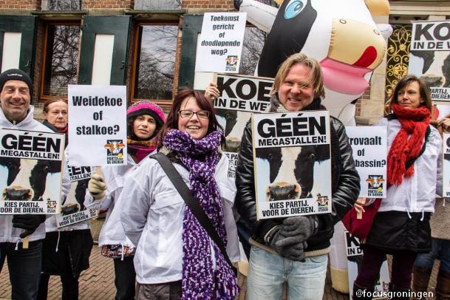
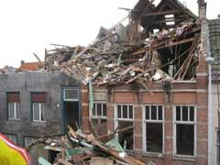
Degradation landscape, nature, environment
Notes:
Many mistakes were made. Degradation of landscape, nature, environment and monumental buildings and city centres, due to quick economic growth without sustainability.
There were even plans to tear down vast parts of the inner city of Amsterdam, and to make highways on the place of the famous canals. Today; it’s World Heritage.
People were worried about it. That made policies change.

Slide 47
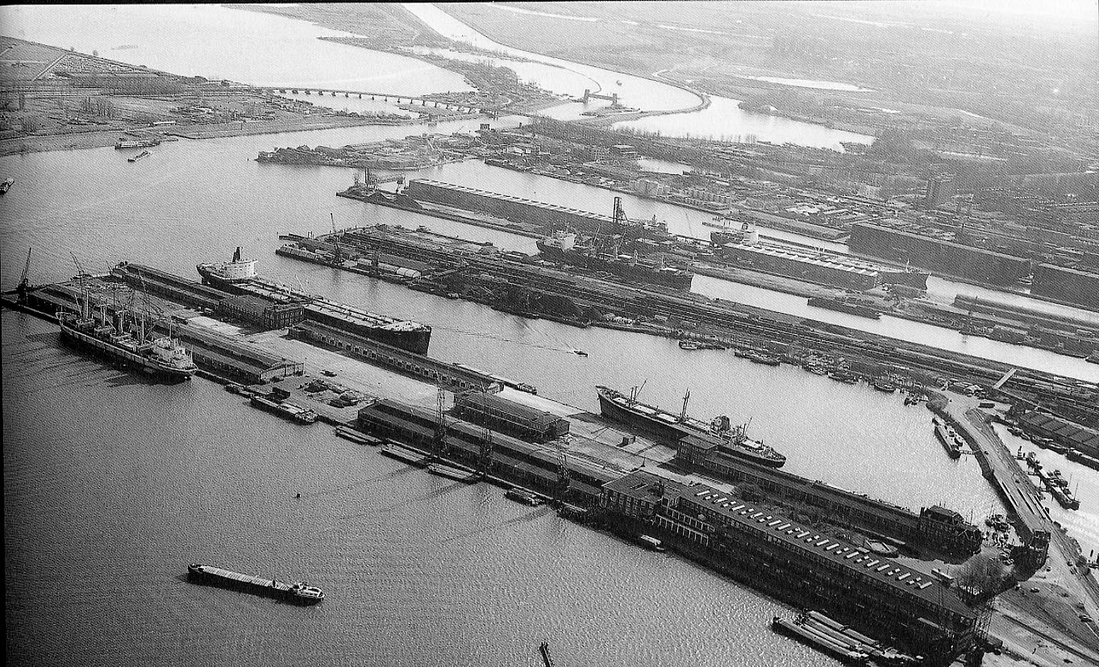
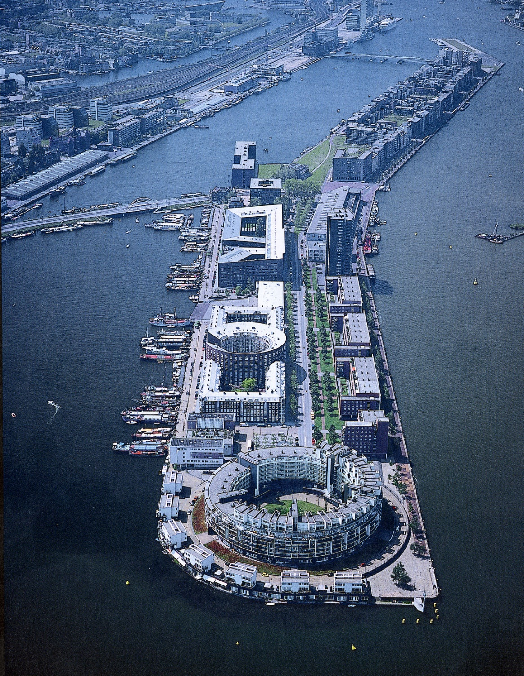

Filling in open urban spaces
Amsterdam Eastern Docklands
Notes:
As ships became larger, the harbour areas of Amsterdam and Rotterdam moved west, closer to the North Sea. The former harbour areas close to the cities were left nearly unused, and were redeveloped into living and working areas from the 1990s onward.

Slide 48

Vinex suburbs: close to the existing city
Emerald suburb, Delft

Slide 49


…but with high density centres
Stadshagen (Zwolle) and Ypenburg (The Hague)

Slide 50

Nature Policy Plan
Ecological network with links between habitats “green infrastructure”
Policy = protection through planning and by purchasing land for nature parks and subsidies for management
Became a European-level policy (Natura 2000)
Notes:
One exemple of changed policies is the Nature Policy Plan.
This plan was a succes; more protection of nature, and development of new nature areas on former farmland.
Fragmentised nature reserves were connected to each other again.
This national succes became a European-level policy (Natura 2000).

Slide 51

Nature and biodiversity designation of a nationwide ecological network
connects habitats and restores ecosystems,
provides recreational opportunities
acts as a barrier to haphazard suburbanisation.
An “ecoduct” over infrastructure to connect nature areas.

Slide 52
2000-
Decentralization of national planning

Slide 53


Policy document on spatial planning
“development planning”
Decentralisation

Slide 54


Growth of retail and leisure at highways

Slide 55


1970s: peripheral development policy forbids all retail outside existing centers, except for cars, boats, garden centers, etc.
Top-down national policy largely successful
1) supported by provinces
2) supported by retailers

Slide 56

Suburban shopping mall
  City center shopping out-of-town
  US origins and global success

Slide 57

…en niet die detailhandelstructuur?
Hypermarket
Grocery shopping out-of-town
French origins, global phenomenon

Slide 58



Growth of office/industrial at motorways

Slide 59

Failed office location policy

Slide 60


Slide 61

National Policy Strategy for Infrastructure and Planning (2012)
  Decentralization intensified: provinces should now play main planning role
  Most national urbanization policy abolished
    Green Heart
    Buffer Zones
    Retail policy
    Densification policy
    Housing locations
  Enforcement/control of policy abolished

Slide 62

Housing stock
Continuous supply of new housing fueled by owner occupied sector since 1990
owner-occupied
social housing
private rentals

Slide 63

Breaking the cycle
Problem: too much development at the wrong sites
  Oversupply
  Development model favors greenfields
Solution: not more top-down regulatory planning…
but a 3-step procedure for plans that allow new urbanization to demonstrate that the development is sustainable (the ladder)

Slide 64

Sustainable urbanization procedure

Slide 65

National Environment and Planning Vision (2019)
Four long-term environmental/spatial challenges
  Energy transition
  Greening the economy
  Livable cities
  Landscape
Need a national approach
  Coordination across sectors needed
  Coordination between levels needed
Formulation of ‘national interests’
  Basis for deployment of legal/financial instruments

Slide 66

Water management protected river floodplain areas for nature, recreation, and cultural activities (Room for the river).
Room for the River. Improving flood protection and environmental quality simultaneously in Nijmegen

Slide 67












A
Perspectief voor landbouw en natuur
1. Natuur en landbouw verweven
2. Iconisch landelijk
gebied
3. Bouwen met de boer
Ordenende netwerken voor energie en (circulaire) economie
B
1. Grootschalige clusters van bedrijventerreinen
2. Energienetwerken
3. Circulaire werklocaties bij steden
C
Leefbare steden en regio’s
1. Groen en gezond leven
in de stad
2. Woonwijken van de toekomst
3. Hoogstedelijke knooppunten
Notes:
Dat doen we op een negental thema’s , geordend langs de drie perspectieven van de RO-brief
perspectief voor landbouw en natuur,
ordenende netwerken voor energie en (circulaire) economie,
leefbare steden en regio’s.
We zorgen voor het breed delen van de ontwikkelde oplossingen en instrumenten.

Slide 68



Slide 69

RUDIFUN dataset on
Floor Space index
And Mixed Use index

Slide 70
Arjan.Harbers@pbl.nl
+31 650 8292 10

