Slide 1

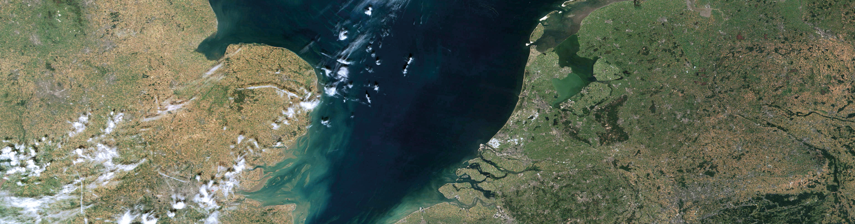
Urgency to adapt to
climate change
Presentation 14 March 2023
Public Water Center, Hoek van Holland
Deltacommissioner Peter C.G. Glas LLM MSc
14 March 2023
Peter Glas, Delta Commissioner

Slide 2
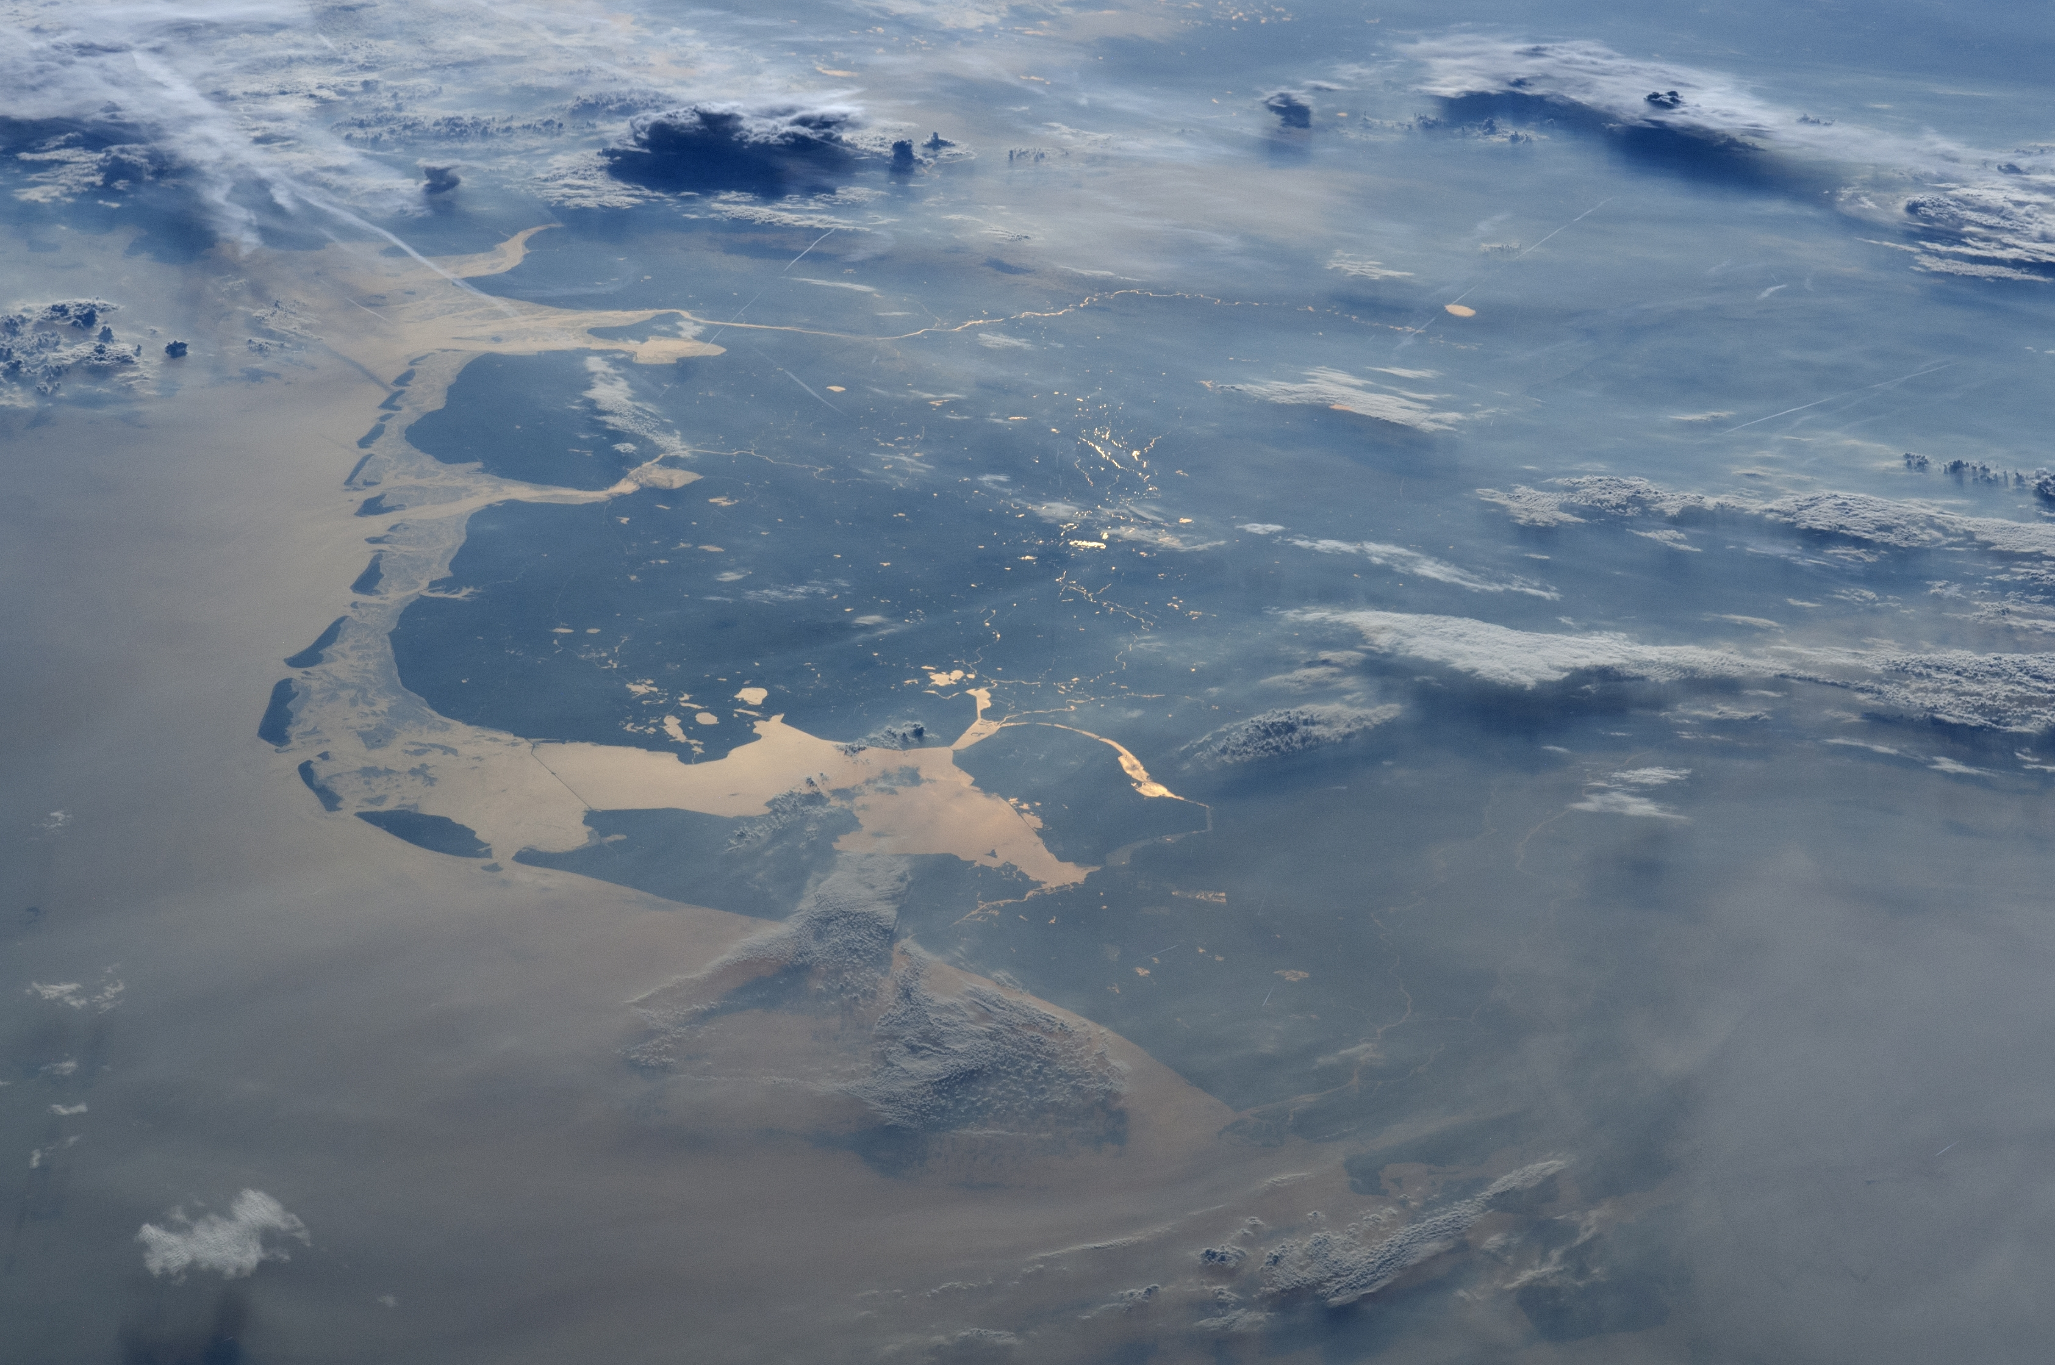
The Netherlands, a delta
2
Notes:
Satellietbeeld André Kuipers

Slide 3
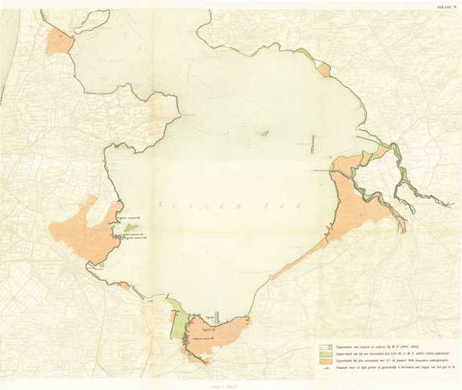
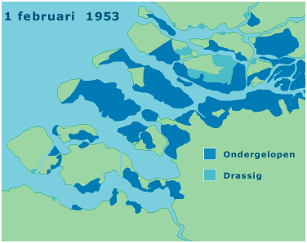
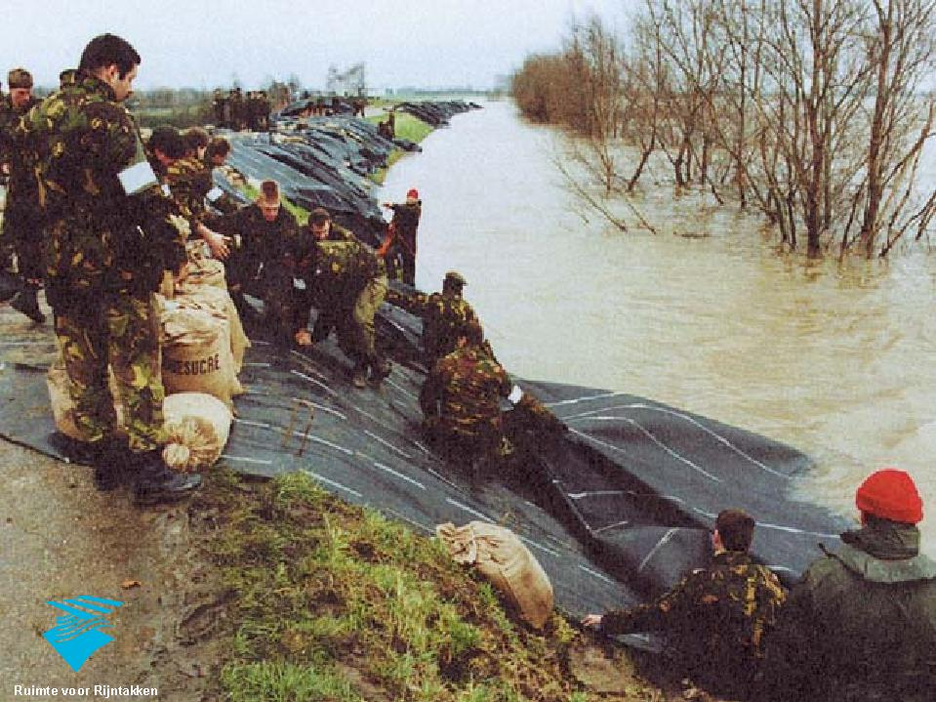
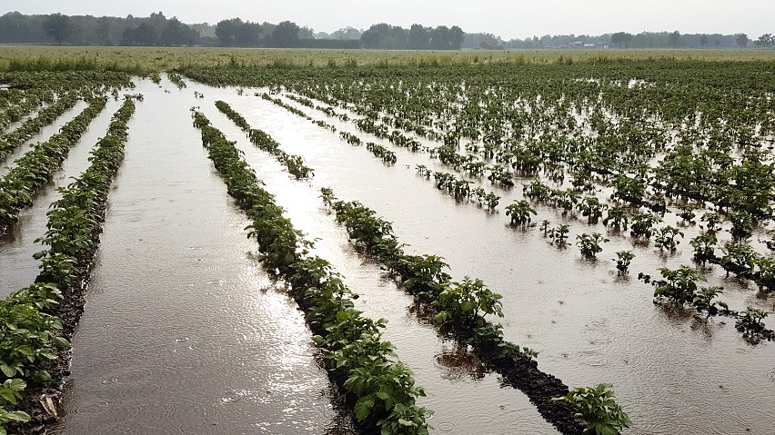
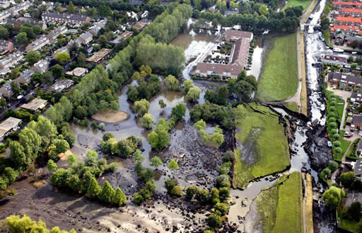
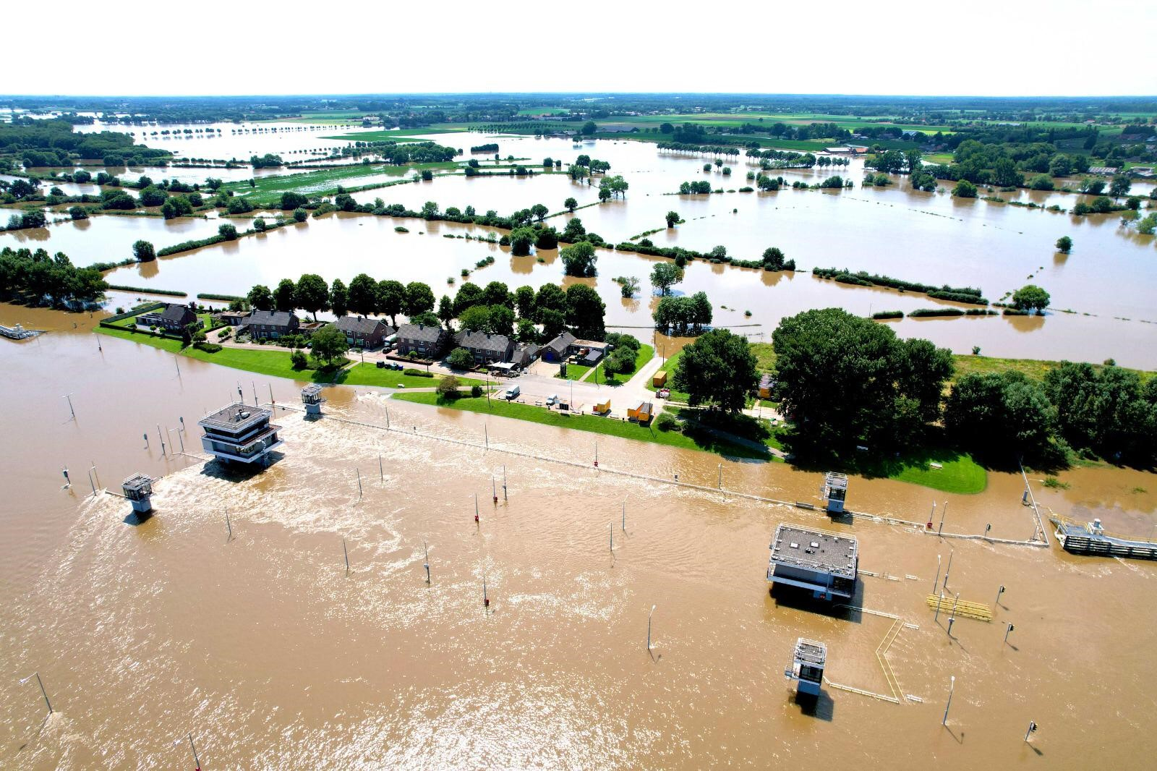
Recent floods in the Netherlands
1916
1953
1993-1995
1998
2003
2021

Slide 4
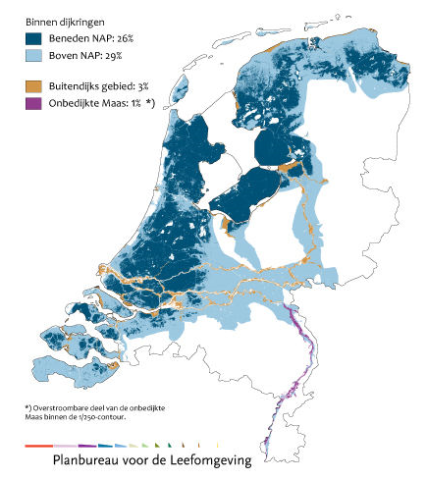
Our delta is very well protected but also inherently vulnerable
Without flood protection 60% would be at risk
10 million inhabitants live behind the dikes
2/3 GDP is earned behind the dikes

Slide 5
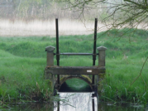
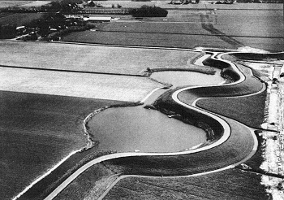
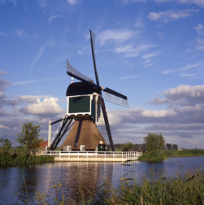
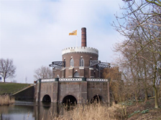
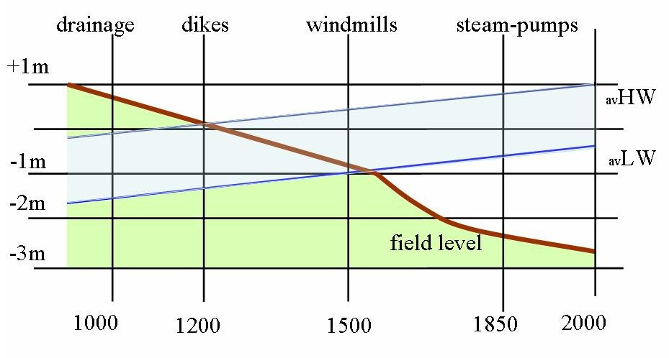
A millennium of land subsidence and sea level rise

Slide 6
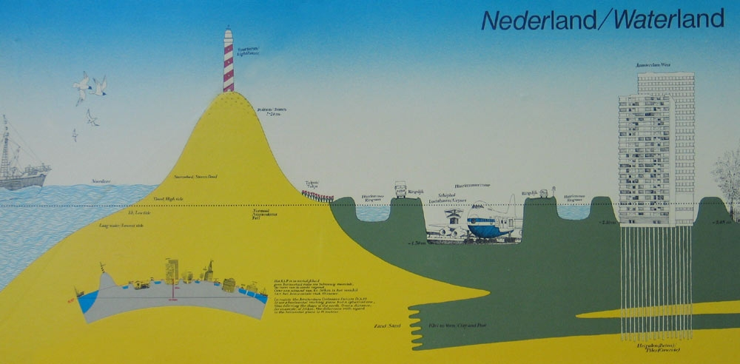
Challenges in a low lying country
drought/
heat
extreme
storms
extreme
rainfall
high river
discharge
+ 10%
sea level rise
(20 cm-->
> 100 cm/100j)‏
investements
coastal
erosion
salinization
low river
discharge
- 60%
Subsidence
10 cm/100j

Slide 7
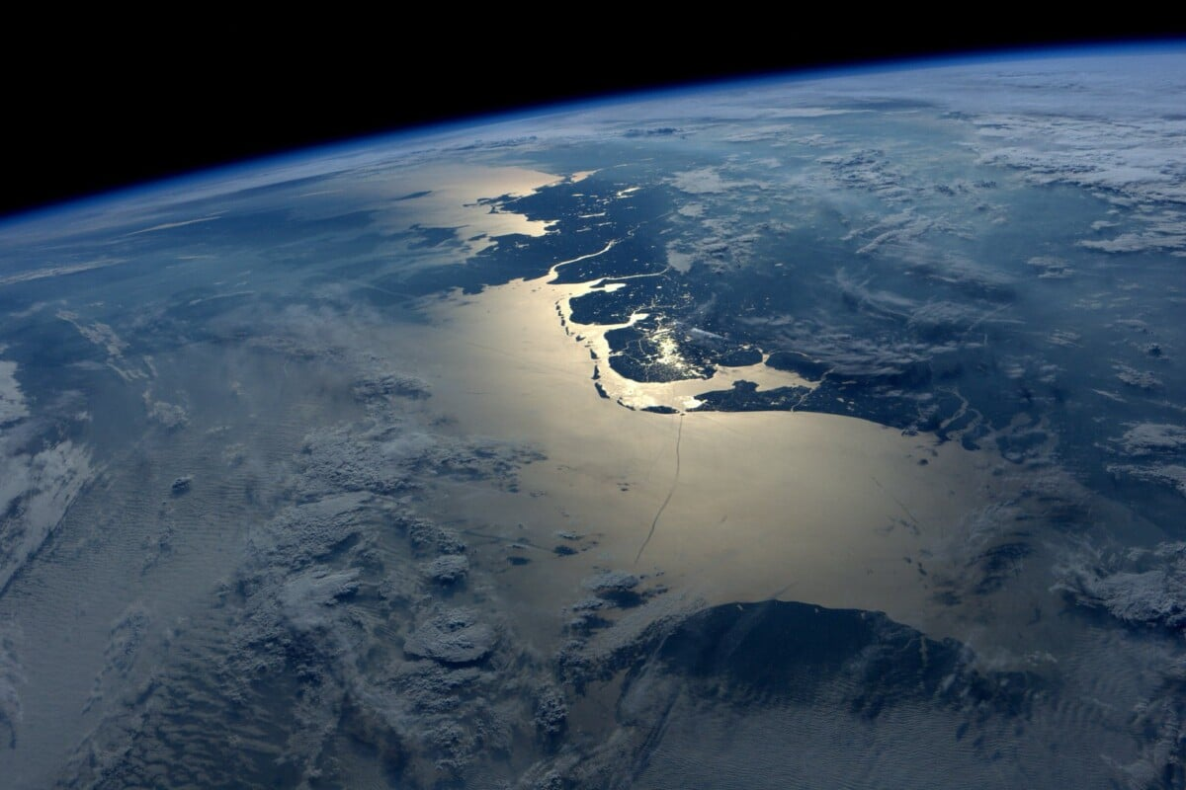
2007: Delta Committee
Question: can we stay in this delta, in times of climate change?
Answer: yes we can, providing we take pro-active measures.
Be aware
Prevention first
Invest in climate adaptation as well as mitigation
With a long term view!
Prepare for the worst and mitigate the effects
Target
2050

Slide 8
Delta Programme verankerd
  updated water safety standards for flood defences
      (risk of drowning <10⁻⁵/yr; risk of economic damage)
  maintain the sandy coastline
  maintain the strategic fresh water supply
      (main riviers, Lake IJssel, groundwater)
  invest in resilient adaptive spatial planning
  provide national multilevel coordination
  Codified in the Delta Law (2012) with:
  Annual Delta Programme
  Independent Delta Commissioner
  Delta Fund: € 1,3 - 1,5 billion/yr (14 yr horizon)
Target
2050

Slide 9
Sea level rise
2.0 m?
+ 0.3 -1.0 m
Bron: IPCC WG1, 2021

Slide 10
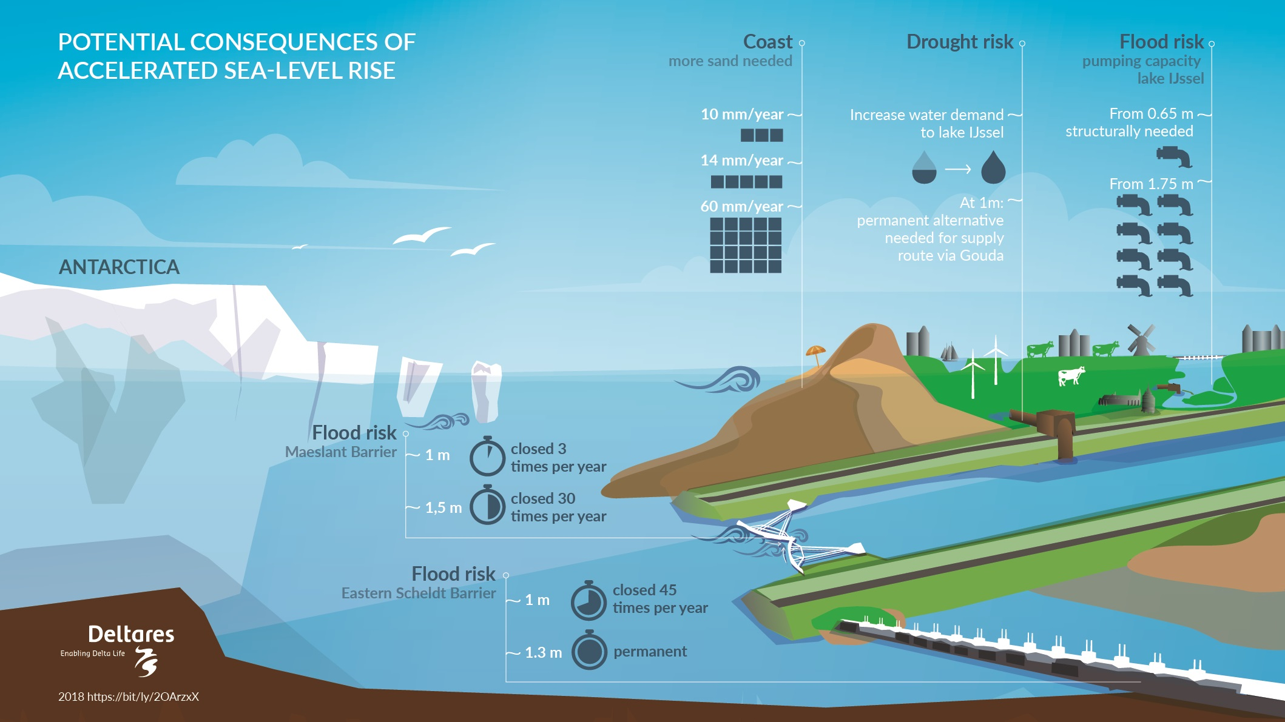
Effects sea level rise
- coastal maintenance/sand
- salt intrusion
- pump capacity
- storm surge barriers
- outside the dikes

Slide 11
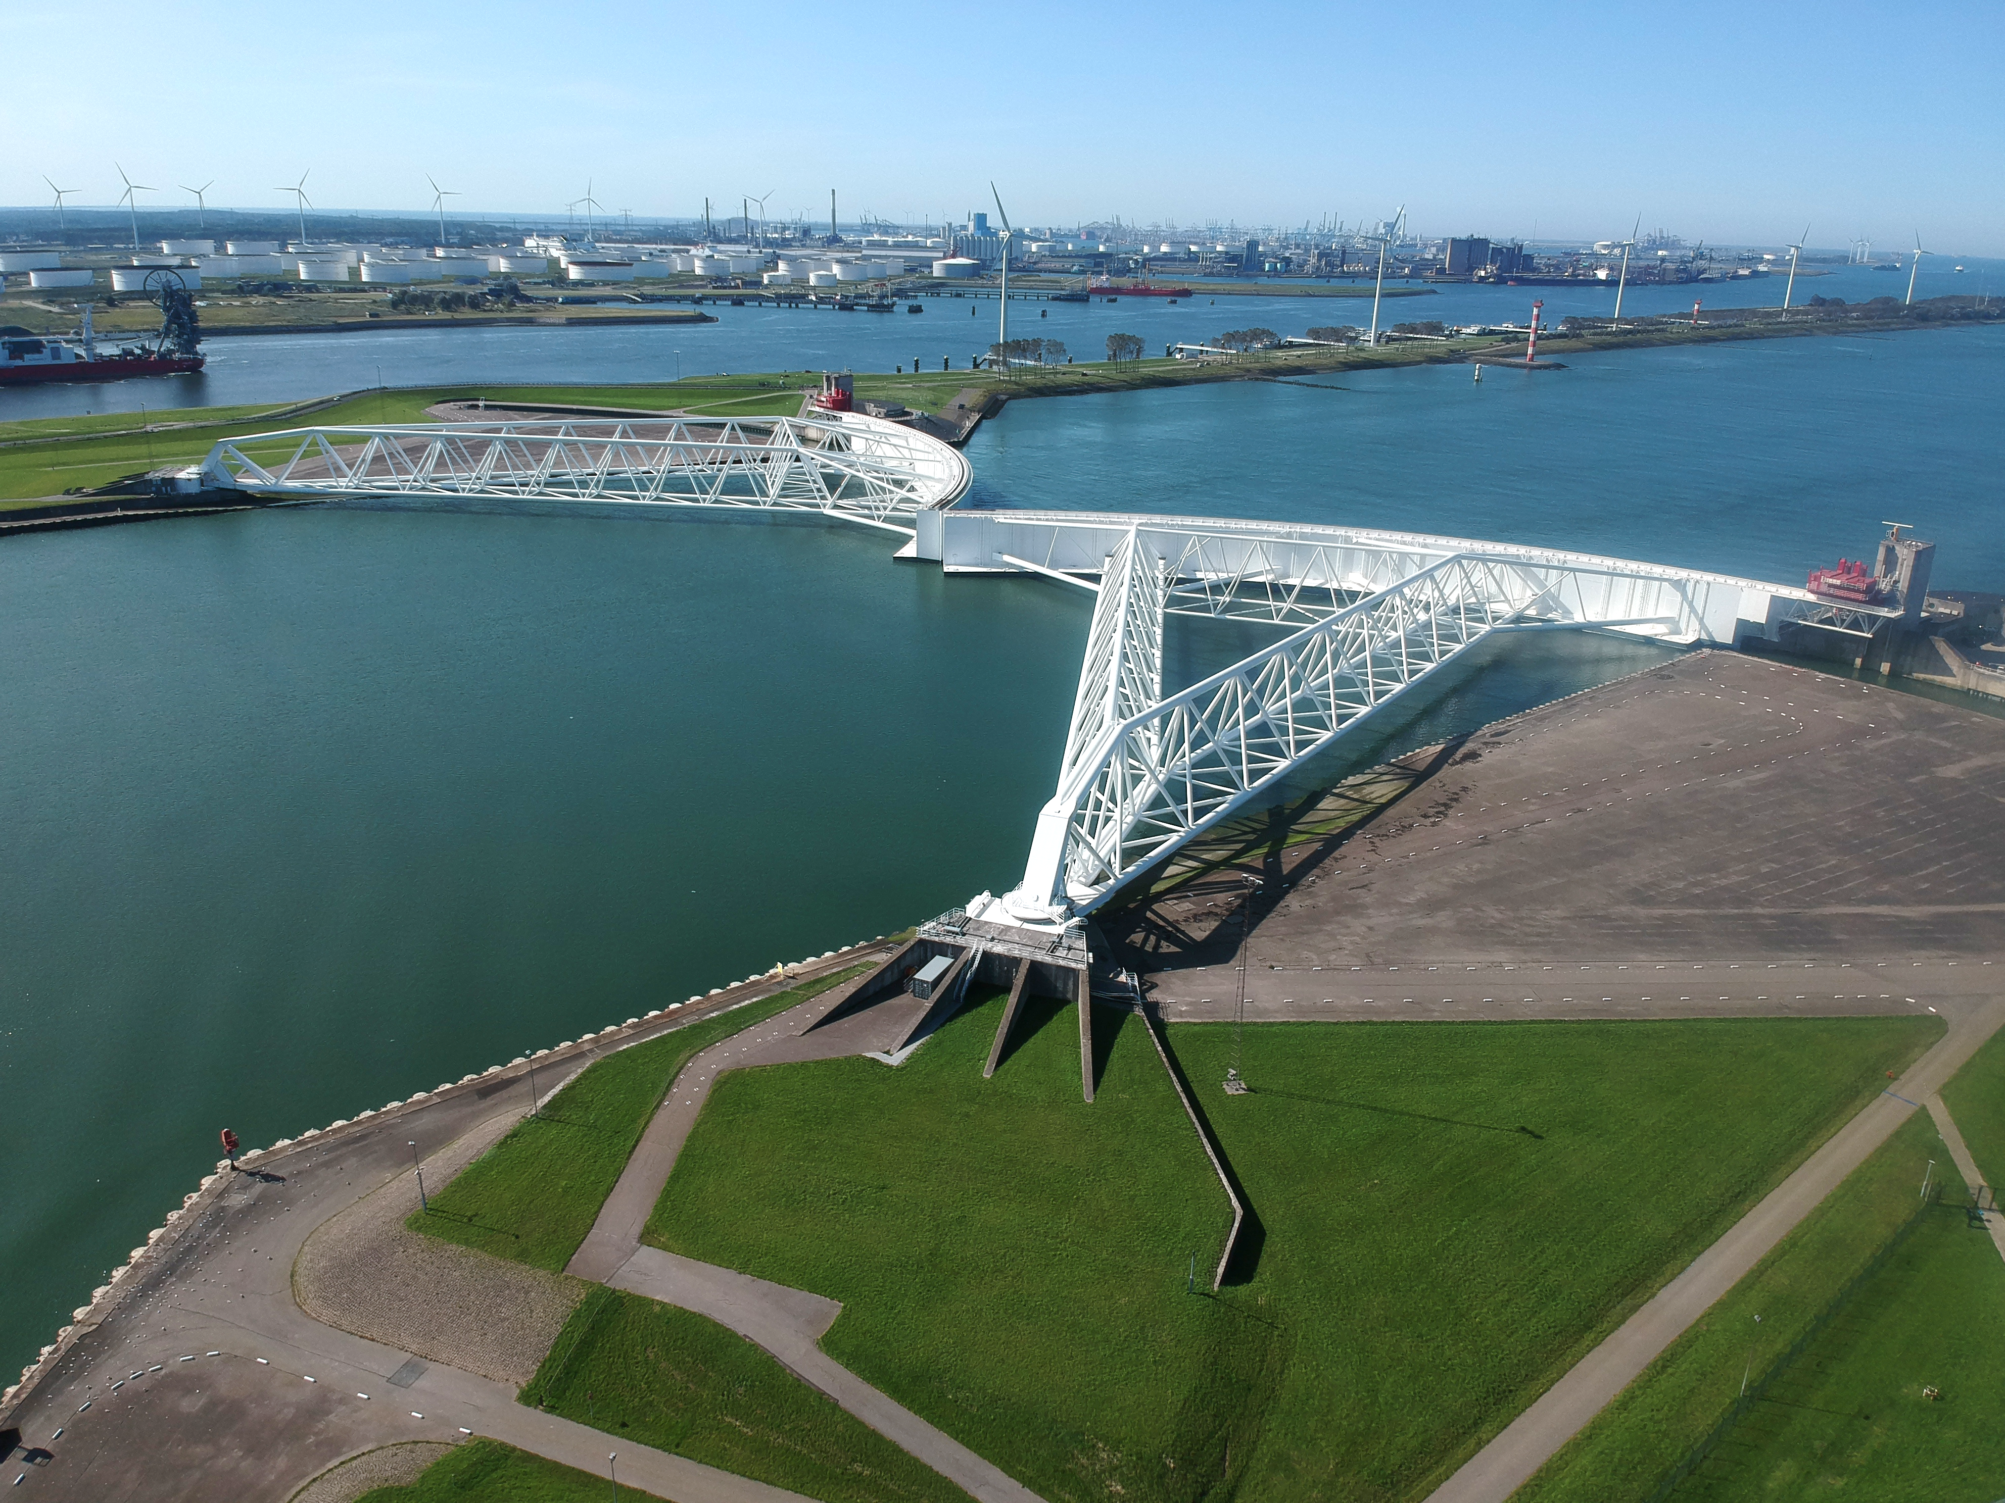
Effects sea level rise
Maeslant storm surge barrier
Design ‘90’s:
Life-time: 100 yr (20 cm SLR)
Closure 1/10 year
75 cm SLR (2075-2080): 1/1 yr
130 cm SLR (2090 - >2100): 10/yr
increasing probability for coincidence
closure and high river discharge
→ reduced time for maintenance

Slide 12
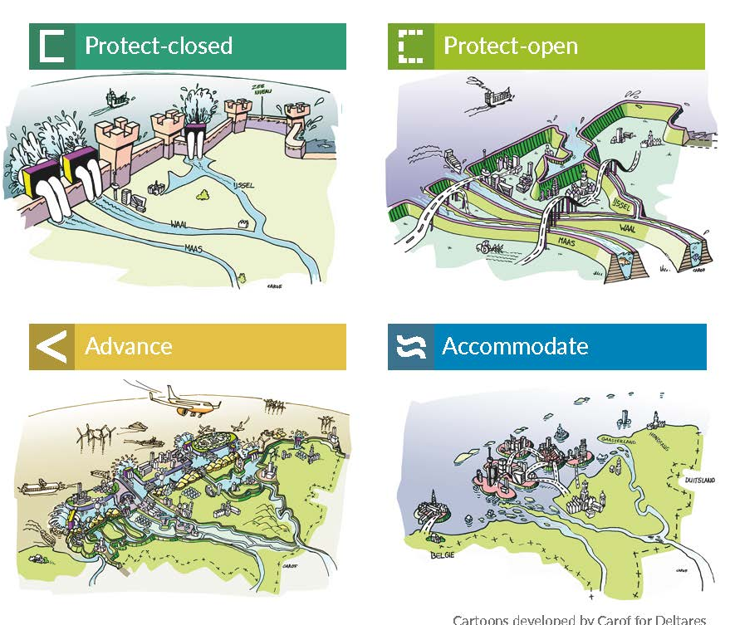
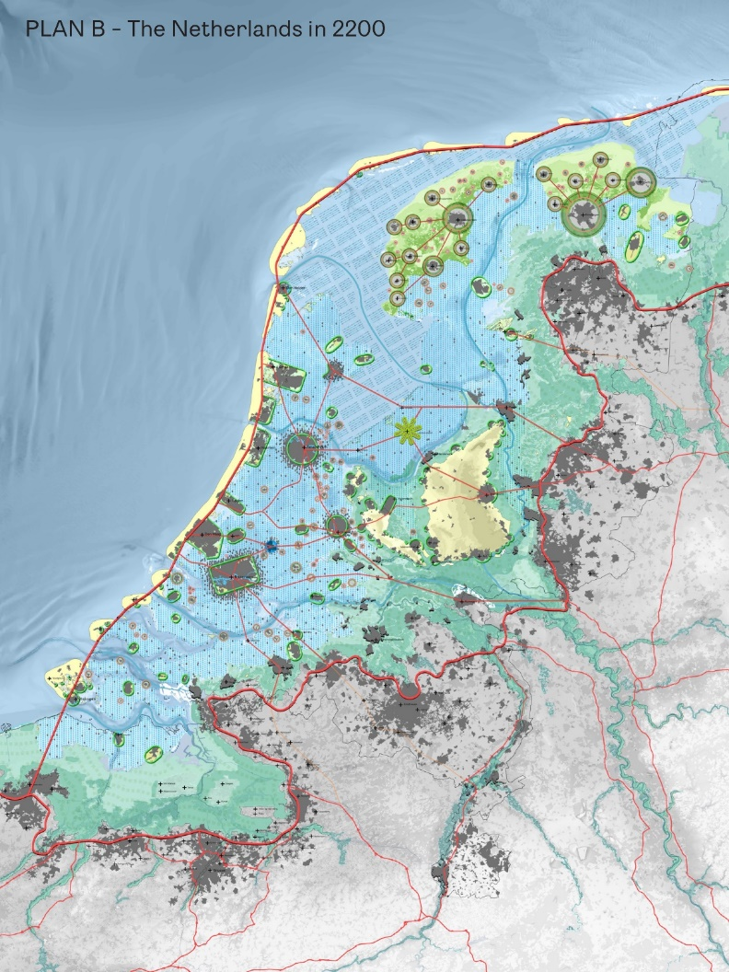
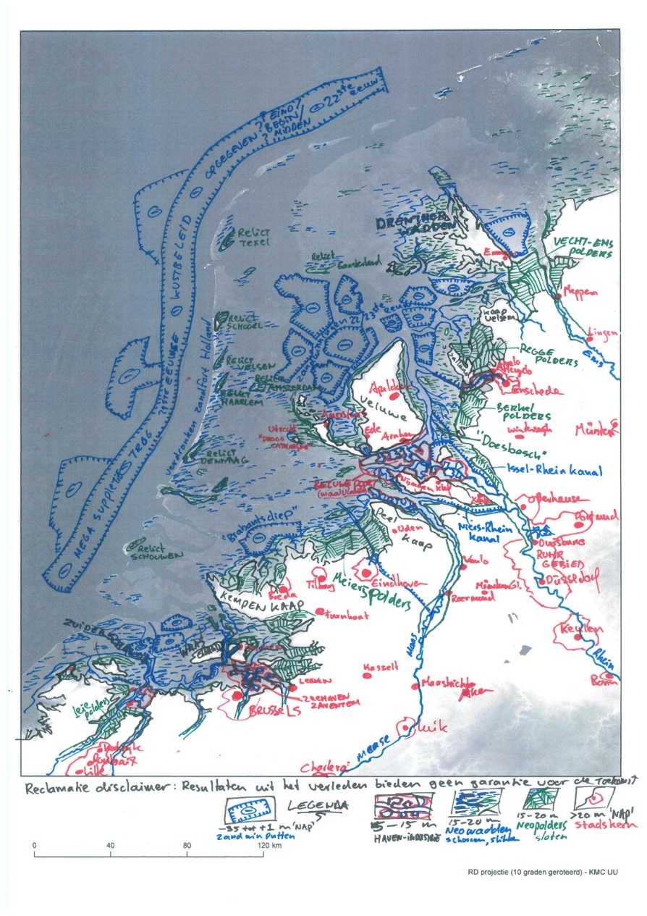
Knowledge Programme Sea Level Rise – 2100/2150

Slide 13
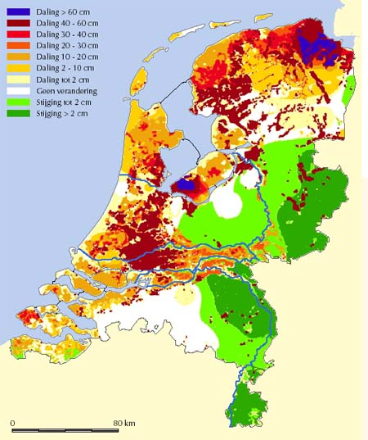
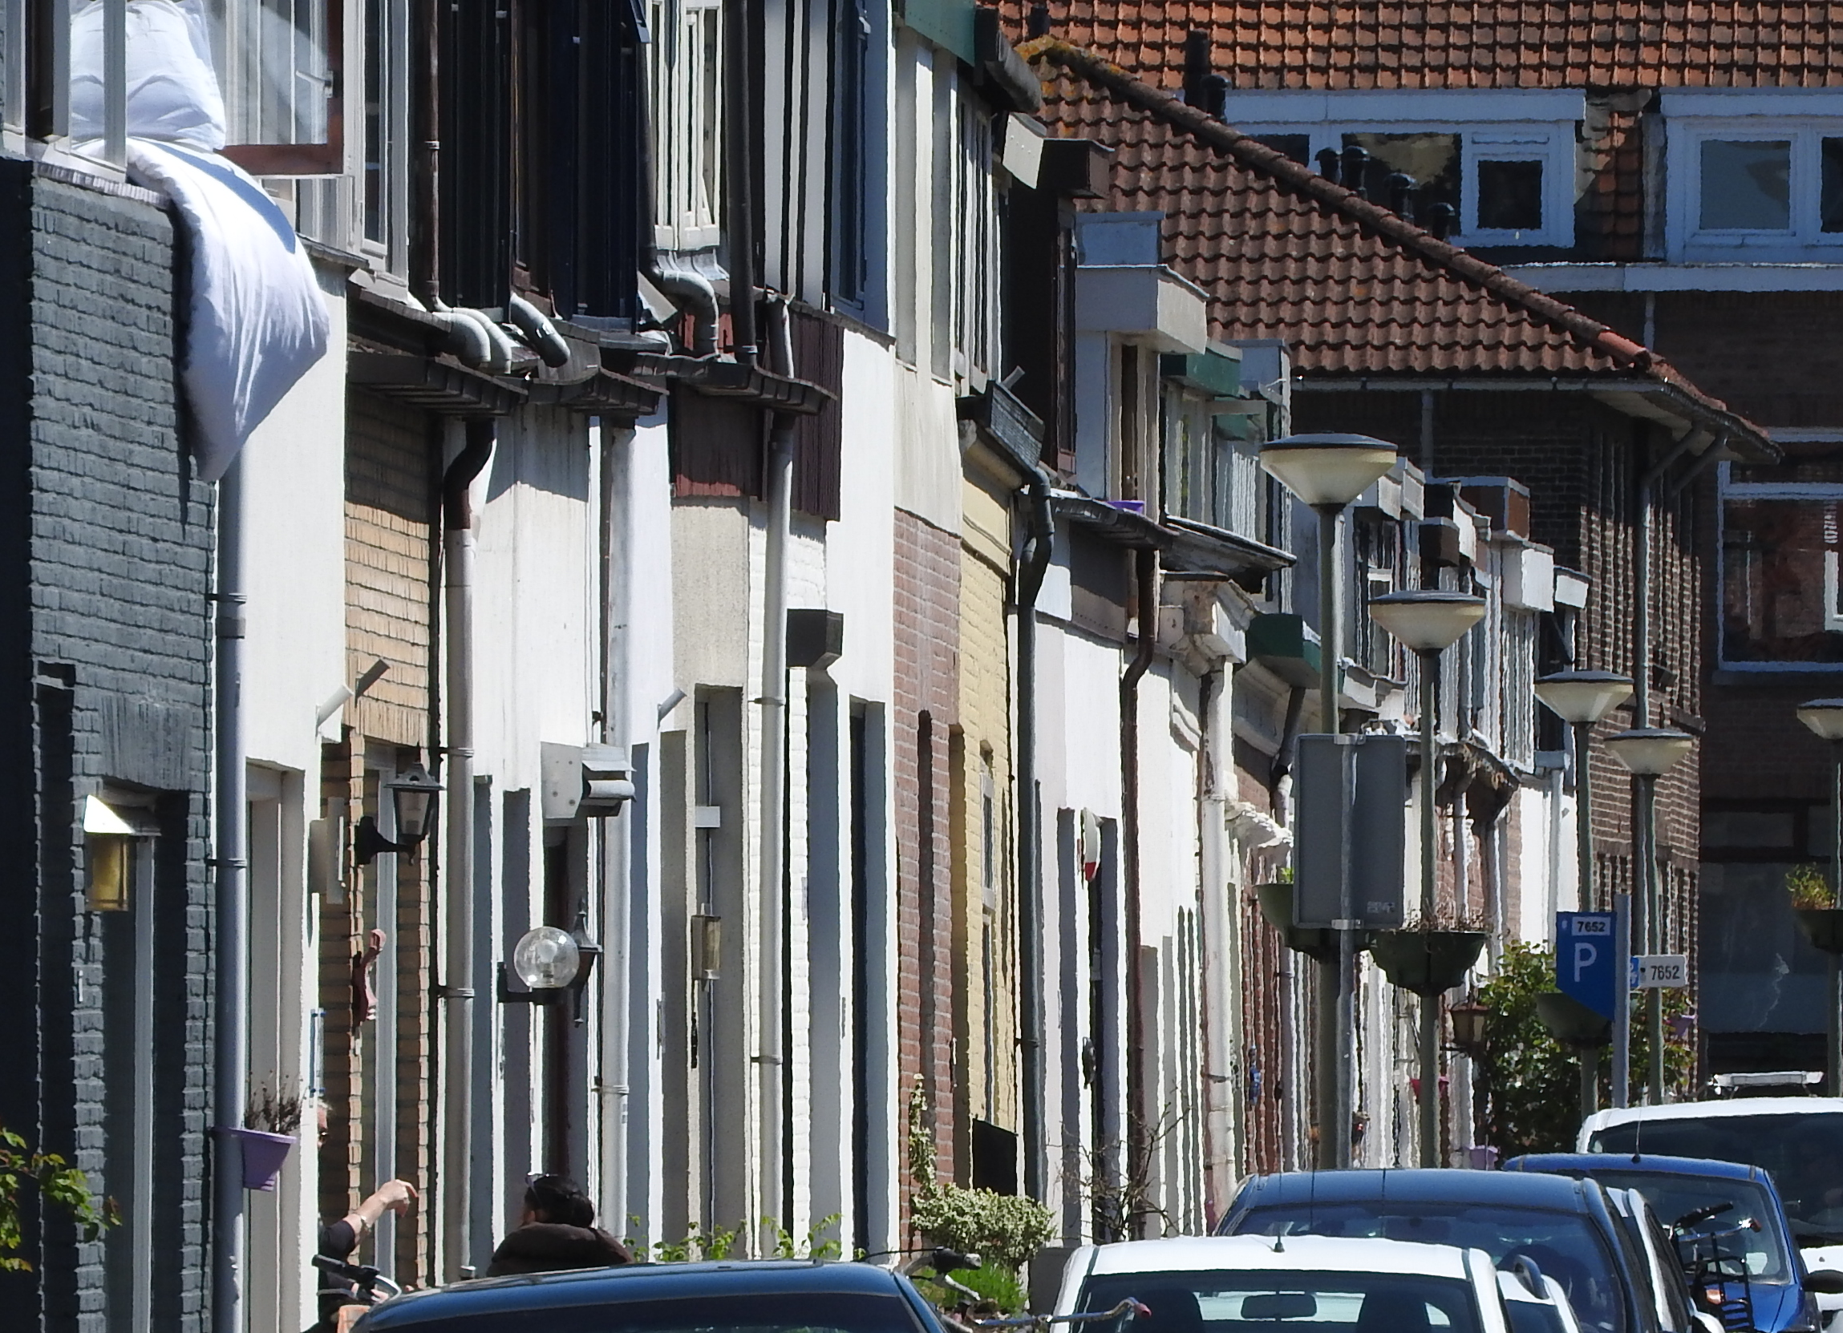
Soil subsidence (cm/100 yr)
Waterlogging → pump capacity
Peat oxidation → emission CO₂
Damage to buildings and infrastructure

Slide 14
‘Water and Soil determine’
Occupation layer
Networks layer
Subsoil layer

Slide 15
‘Water and Soil determine’
Make / maintain space for water storage and water discharge
New investments in housing, infrastructure and economic activities:
  Avoid soft soils
  Avoid flood-prone areas
  Adapt to saline and drought-prone soils

Slide 16
Example sea-level rise:
→ spatial reservations
Sand extraction Salinization Dike Water storage Water discharge
reinforcement

Slide 17
Example : housing
900.000 new houses to be build before 2030
820.000 projected in areas with one or
more vulnarabilities:
Flood risk
Land subsidence
Soft soils
Saline groundwater
17
Notes:
Adaptation is urgent
Climate change must be taken in consideration in all decisions
Of major transititions:
The challenge to build up to 1 miljon houses in the coming years in a climate-proof way
Integration of climate adaptation in spatial plans
Development of a framework to apply water and soil criteria
Standardization of building techniques
Climate resilient networks and vital functions
Linking the climate adaptation transition to other transitions, e.g.:
Energy transition strategies
Reduction of soil subsidence problems (especially for peat)
Adaptation towards sustainable agriculture
Restoration of biodiversity

Slide 18
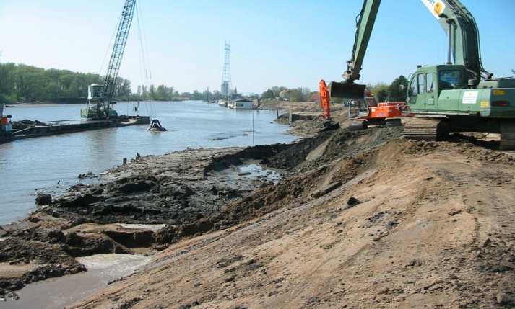
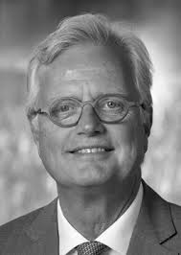
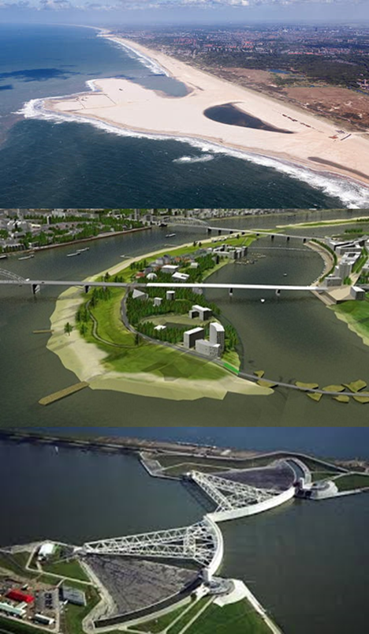

Thank you for your attention
@delta_comm
info@deltacommissaris.nl
www.deltaprogramma.nl
Peter Glas
Delta Commissioner

