Slide 1
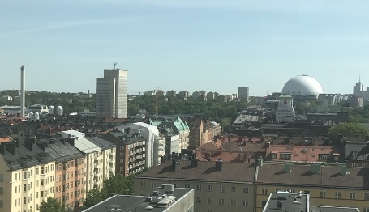

Perspectives – Sweden and France
Bodil Båvner
Swedish Association of Local Authorities and Regions

Slide 2
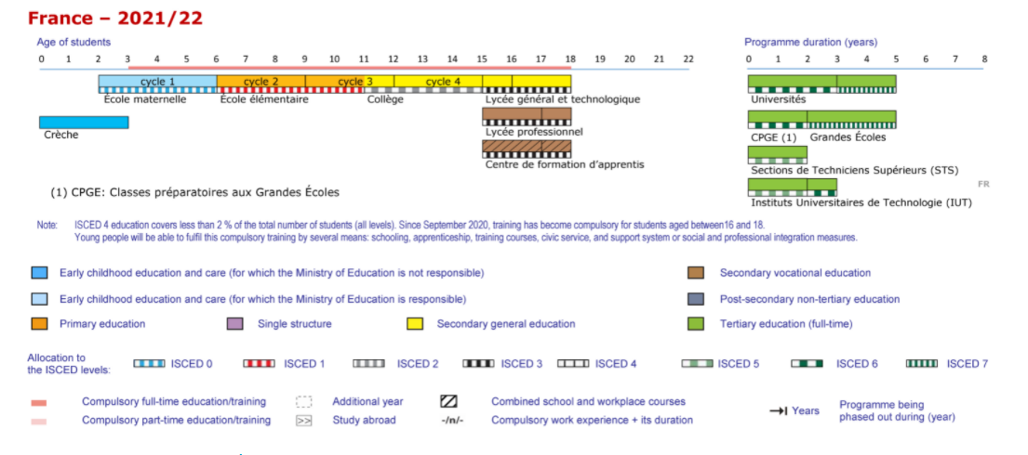
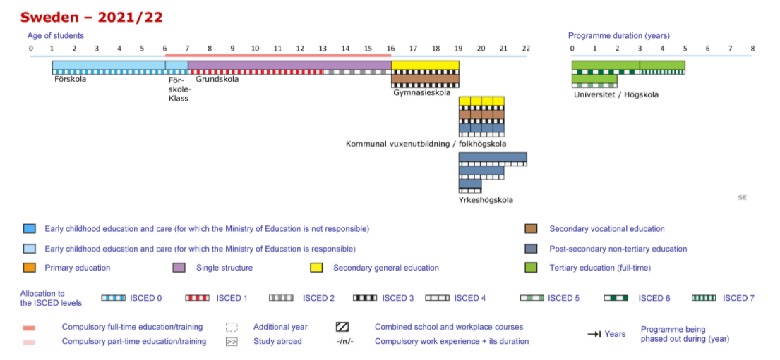

Slide 3
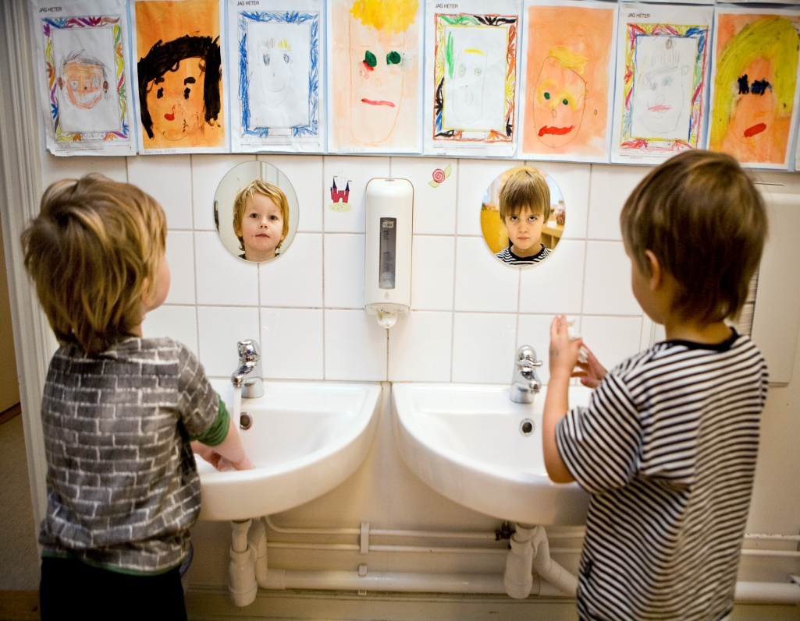
Inital observations from a decentralised education system
How teachers are employed
Time-table and teaching material decisions
Funding
Accountability
Notes:
How the system is set up – how the system works
Letting people decide at local level vs wanting to know (and value) how it is done

Slide 4
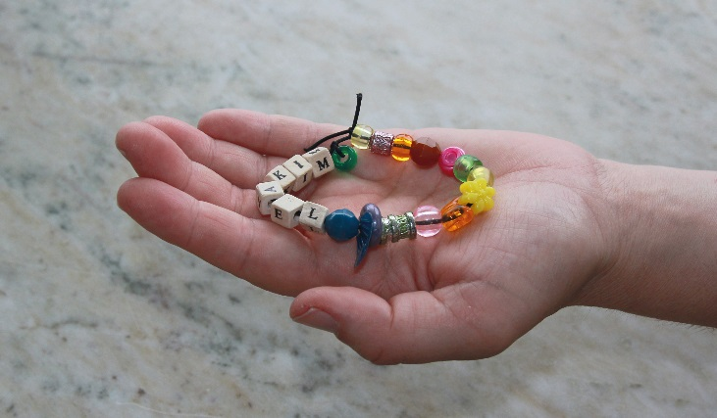
Accountability and responsibility
Definding roles and responsibilites
Consistency and long term perspective
Follow-up and evaluation – data for improvment
Leadership
Notes:
All levels have their responsibility – state; municipalities; civil servants; principals; teachers; pupils. No one can give others all the blaim only on the prerequisites. You always have some room for manouver and it is up to us all to make the most of it.
The clearer the tasks are set and described, the easier to take responsibility.
This clear cut is also necessary between the state and the municipalitities.
Steering by controlling details seldom work. Steering by dialouge, transparency and trust often works well.
However, sometimes schools or municipalities get into situations they do not control. Therefore, there needs to be support for those who need. We (and others) see that most schools and municipalities work best with full decentrlised responsibility. But around 10 % need more direct support also on ”HOW” issues, so there must be a support system in place for those who need. Just as for pupils.

Slide 5
Defining roles and responsibility
”Our communication is good, and she do not go into details. The politicians have a genuine interest in asking questions, understanding, discussing. All the time, they have our way of working and the goals in focus. Their interest makes continuing development necessary. There is no where to hide. This kind of steering works all the way. Asking questions, requiring answers but not steering details. There is clarity in each persons role and clear cuts between politicians and civil servants. She takes responsibility for her politics and the principals fell the support. The clear cuts in responsibility is based on mutual trust and really help us improve the education.”
Notes:
In any system there is a need for defining roles and responsibilities. When this is diffuse, steering is very difficult.
Responsibility and mandate must go well together. If you are responsible for an issue you need to have the means to to necessary changes.
The politicians should decide WHAT is to be done, ie set goals. The civil servant should decide HOW to do it.
Details should be decided by the ones closes to the activity. Most decisions on working methods, teaching material, time tabling etc should be decided by teachers, or principals.
Teachers need to be given the freedom to choose from a broad range of methods to support all pupils.
Resources is decided at political level. How to use them, what to spend them on is a civil servant decision. There need to be a clear discussion on how to use funding and what funding is needed. More money into a system that does not give result is not a way formward. It is how you spend the money that matters. Fund things that improve pupils’ result and to if effectively.

Slide 6
Consistency and long term perspecitve
”To constantly revise the way you do things take an enormous amount of effort. The most important factor that makes it possible for our pedagogical leadership is that we now the rules – the basic principles remain. Organizations that constantly are changing the way things are decided drains energy from the things that really matters and principals get broken by their burden.”
Notes:
Do not change overall goals to often. Schools need to be able to plan ahead and put effort into improving their work, not changing it all together. The basis for the work should be systematic, based on researach and knowledge and have a long term perspective. Although you need to follow up on a short time basis.
The formula plan – do – study – act is an aknowledge way to work.
To be able to analyse the situation, you need to have information – data – to analyse.

Slide 7
Follow up and evaluation – data for improvement
”All data you need to collect on how the pupils are doing really stresses you out . Until you have enough to see its value. That is when you realize that the pupils current results isn’t the end of it. School leaders and teachers work together to improve education on basis of the results. What we see helps us to find out how we can develop tuition and organization further.”
Notes:
Be careful so the data you collect is data that you can use to improve. You must be able to look at tha information you collect and decide what to change.
Sometimes schools are reluctant to be compared. Sometimes teachers are reluctant to work to closely together. Sometimes principals see other schools as competitors instead of companions.
To implement an attitude of openess, which is the basis for improvement, we have a motto ”sharing is caring”.
Good exempels and learning from others are a good basis for improvement.
At municipal level – we publish data on how all municipalities are doing in various aspects. In this comparisoin basic factors are also considered, so you are able to learn from those who have the same situation as yourself. We see that this publication ”Open comparision” has really put emphasis on school quality in every municipality.
To be able to improve all levels need to work together (see last slide).

Slide 8
Leadership
”Confident leaders with the goal in focus creates confident pupils. Leaders who involve others get teachers and pupils who work well together.”
”My goal is to make myself unnessecary. It usually takes three to four years to make the management team working without me. I just came from a meeting with all principals where I was at no use at all. It felt really good!”
Notes:
To improve pupils results you need to look at the whole school as a learning organisation, for both pupils and staff. And you need to have everyone working together.
Principals need to take charge and focus on their leadership. They may do differently, as they are different, but the common important factor is to focus on pupils’ results and to set a learning organisation. This means that teachers and principlas need to share good ways of working with collegagues.
Resaerch is very clear that collegiual learning it the most effective way to improve tuition, teachers and the whole school. It is not effecitve that each teacher have specific in-service training, it needs to be shared with others so the whole school can take advantage of everyones competenceies.
We see that is it not fruitful with fixed groups based on pupils abilities. It is very easy to beleive that tuition is more effective when everyone is at the same level, but evidence tell us differently. It is becase peer learning is effecitve. Pupils learn from each other and not only from the teacher. Pupils who struggle are motivated by their peers and pupils who aldreasy know things consilidate their knowledge when explaining to others. Discussing and exploring together improves understanding.
So, ”sharing is caring” at all levels.

Slide 9

Division of responsibilities – in theory and in practice
Notes:
How the system is set up – how the system works
Letting people decide at local level vs wanting to know (and value) how it is done

Slide 10
Will reforms work? How to ensure:
Factual basis? Coherent with research and experience?
Stakeholder influence / political mandate
Pilot phase. Support at different levels. Well funded.
Monitored by researchers, decision-makers, stakeholders.
Long term effect. Development, not changes. Takes courage.
Well chosen?
Well designed?
Well implemented?
Well evaluated?
Organisation / Relations
Notes:
För snabba
Dåligt underbyggda (konsekvensutredningar)
Delvis felriktade
Vi önskar
Stegvis införande efter försöksverksamheter

Slide 11
Exemple of blurred responsibilites
State actions
Teacher training
Regulating teaching profession
Professional development
National funding for salaries for individual teachers and schools
Funding for specific actions
Reforms and regulations
Municipal actions
Combining work and training
Hiring and decision on posts
Professional development
Teacher working conditions
Teacher salary
Overall funding of schools
Coping with reforms and regulations…

Slide 12
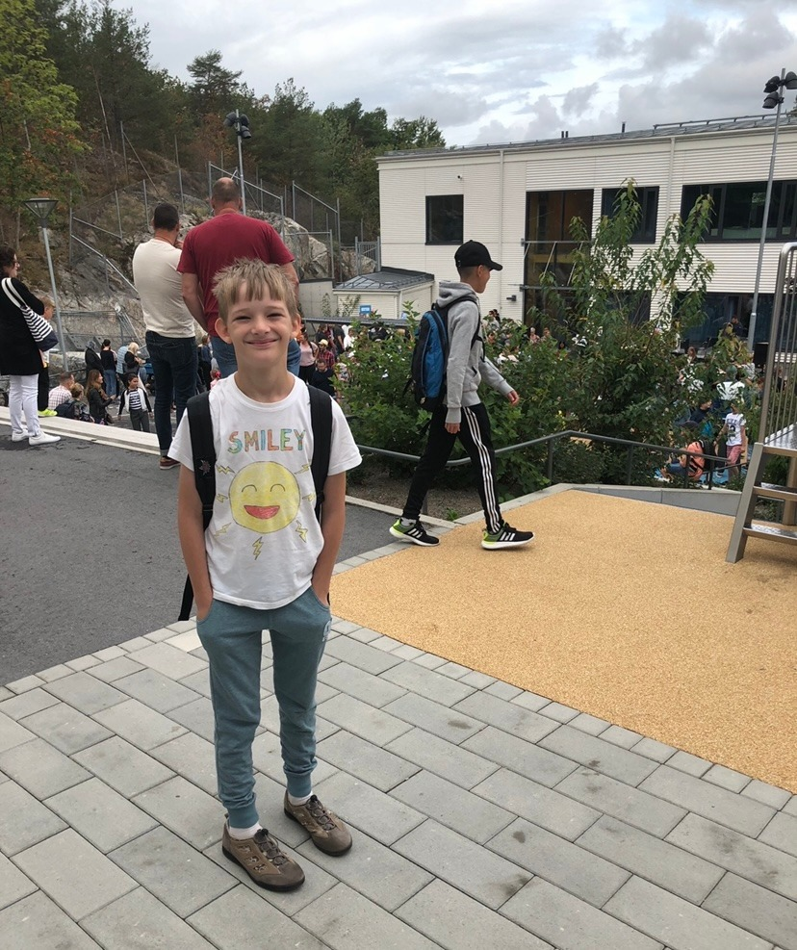
How we talk about schools matter
Notes:
Tala väl om skolan – det som man har svårt att nå ut på egen hand
Den generella debatten om skolan blir också en viktig faktor om man vill stärka läraryrkets attraktivitet. Vem vill bli lärare när man bara läser rubriker om klassrum i kaos? Den bilden kan förvisso stämma på sina håll, men jag skulle vilja säga att den inte är representativ för skolan i Sverige. Utan att blunda för de utmaningar som finns, har vi alla att vinna på att visa fördelarna med att arbeta i förskolan och skolan. Med ett valår i antågande är jag rädd för att det finns en risk för ännu större ord och svarta rubriker.
Nu går alla som arbetar i förskolan och skolan mot en välförtjänt julledighet efter ett år som på många sätt fortsatt har präglats av pandemin och ett hårt arbete för att ge barn och elever bästa möjliga utbildning. Om jag skulle önska mig en julklapp vore det nog en mer nyanserad bild av skolan – inte bara i syfte att stärka läraryrkets attraktivitet – utan också för att alla som arbetar i och med skolan ska känna självförtroende och stolthet över det fantastiska arbete de gör för barn och ungdomar varje dag.

Slide 13
School Specific Challanges
Equity – within schools and between schools.
Quality – increase results and decrease drop out rates
Shortage of teachers and other staff
Need to increase vocational training + adult education
Role of the state is debated – when trust and consensus are needed
Challenges for goal oriented system
Socio-economic issues: cluster of pupils and experienced teachers according to background
Perception of Swedish pre-schools and schools

Slide 14
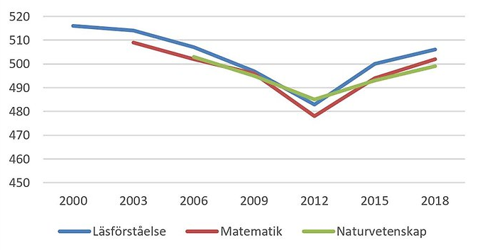
Performance PISA

Slide 15
Overall Challenges
Covid – 19: Experiences and current challenges
Globalization and a digital world
Continuously raised demand of competences in working life.
What kind of competencies will be needed?
Ageing population.
Uncertity, conflicts and migration
Decreasing interest for vocational education.
Regional differences in growth, labour market and demography
Continuously raised demand of competences in working life.

Slide 16
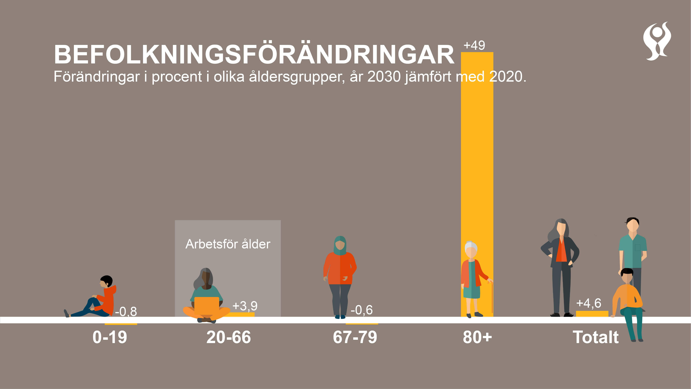
Notes:
Somia
Den här bilden visar befolkningsförändringar på nationell nivå hur de ser ut 2030 jämfört med 2020.
Nu har vi alltså bytt tidsperspektiv, och fokuserar på 10 år och på SCB:s befolkningsframskrivning.
De demografiska behoven skvallrar om behoven av välfärd och på så sätt även om behoven av personal i välfärden.
Det mest uppenbara, 40-talisterna fyller 80 år under det kommande decenniet. Befolkningen över 80 år ökar med 49 procent fram till 2030.
De kommande 10 åren beräknas ökningen av befolkningen i arbetsför ålder öka med 3,9 procent. Motsvarar en ökning på omkring 235 000. Vilket ska räcka för hela arbetsmarknadens förändrade och ökade behov. Betänk att de i arbetsför ålder 2020 är något färre en 6,1 miljoner. Det är förvisso en ökning, men sannolikt finns risk för hård konkurrens om arbetskraften då denna ska täcka hela arbetsmarknadens ökande och förändrade behov.
Stora skillnader från tidigare prognoser
Det svåraste att beräkna är hur många barn som kommer att födas och invandring/migration. Sedan några år tillbaka har prognoserna skrivits ner. Den främsta anledningen till det är förändrade antaganden om migration. Visar sig kanske främst när det gäller barn och unga och då särskilt barn mellan 0-10 år.
Utvecklingen av antalet barn går i en annan riktning än det vi vetat under senaste åren. T ex 2017 var prognosen en ökning på 17 % bland 0-19 år.
Att ökningen av barn och unga nu beräknas vara betydligt lägre påverkar såklart kompetensförsörjningen i förskola och skola. För övriga åldersgrupper är förändringar prognoserna emellan, betydligt mindre.
Viktigt att komma ihåg, att de antaganden som ligger till grund för prognosen snabbt kan omkullkastas genom politiska beslut eller stora händelser i omvärlden.
2020-2030
0-5 år: -6%
6-15 år: -3%
16-18 år: 12%
Finns mycket som gör att prognoser ändras: politiska beslut om invandring, barnafödande med mera. Det är också sådant som kan förändra läget snabbt igen, ex 2015-2016.
Den här bilden visar hur det ser ut på nationell nivå. Och i det sammanhanget är ju viktigt att påpeka att det här ser ju olika ut. Vi ska kika lite på det

Slide 17
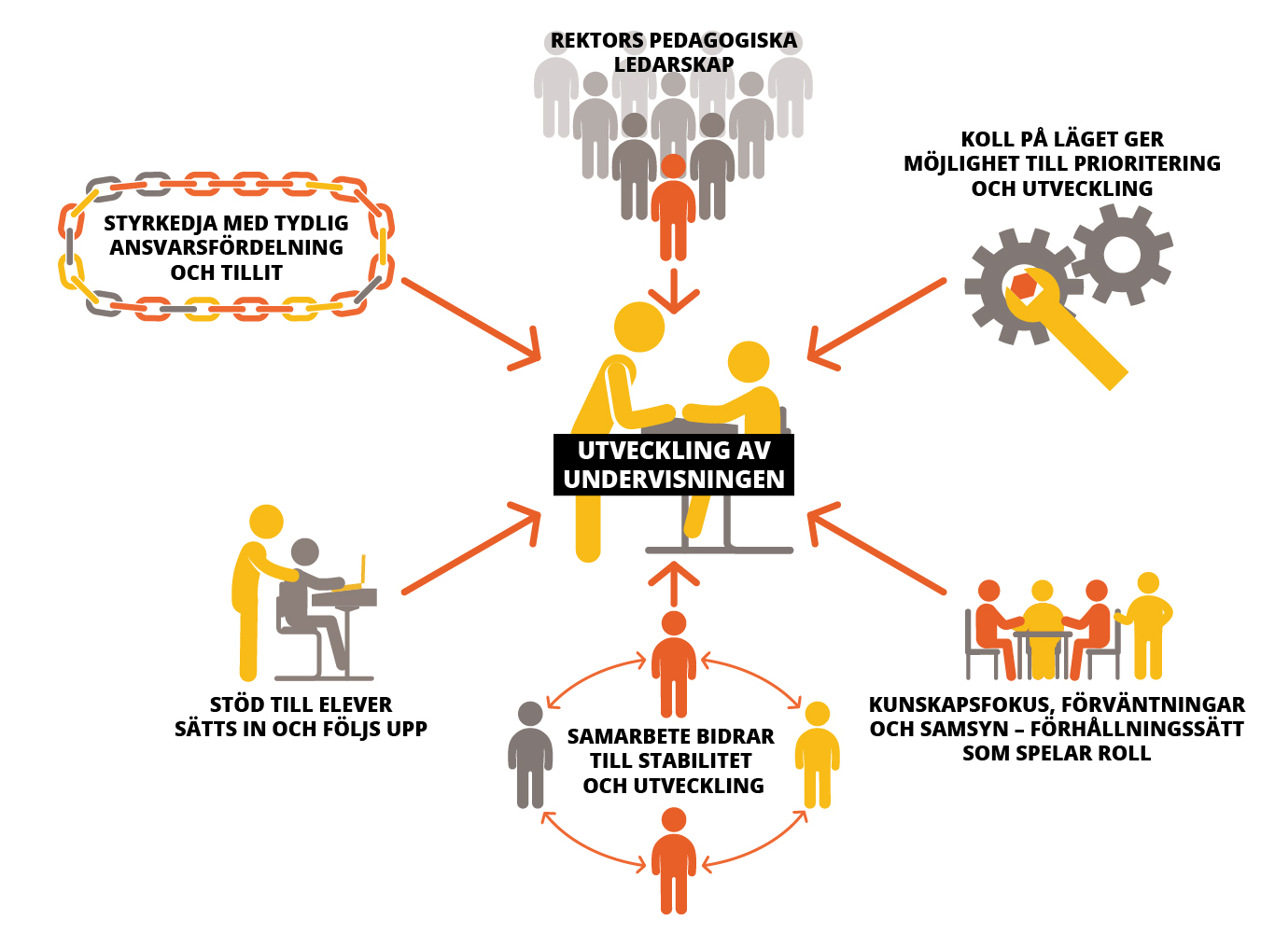
What works – school development
Notes:
Localy based
Consistency
Focus
All levels work together
Responsibilities are clear
Evidence informed
”Critical friends”
Inclusive schools

Slide 18
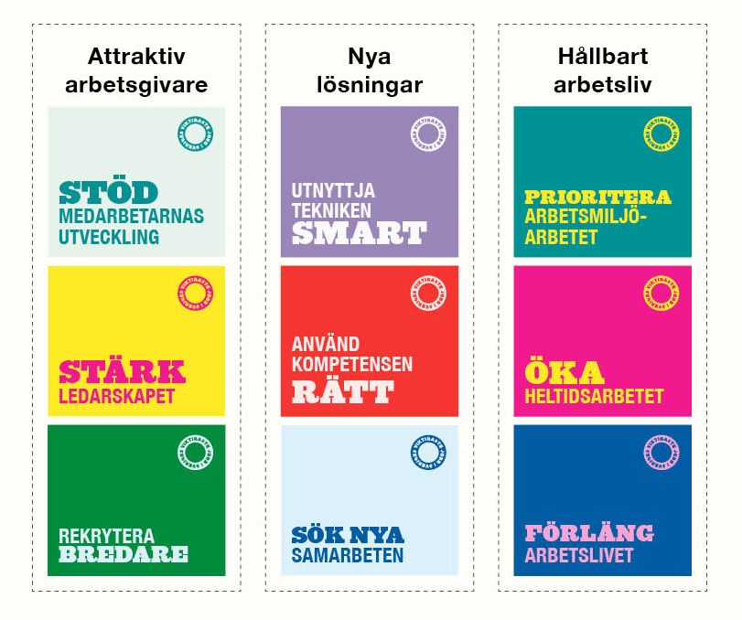
Attracting, recruiting, retaining, developing teachers and other staff
SALAR sign central collective agreements
Support members as employers
Create conditions for local solutions.

Slide 19
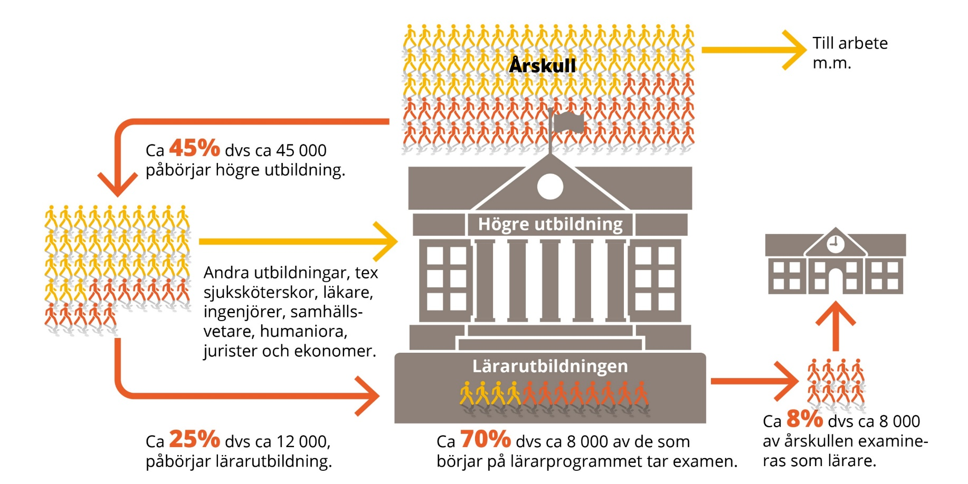
Working life
To higher education
Others
Medicin, law, arts,
engineering, business,
social science
Share of a year group
with teacher degree.
To teacher eduction and training
Teacher degree
Notes:
We also need all the others!

Slide 20
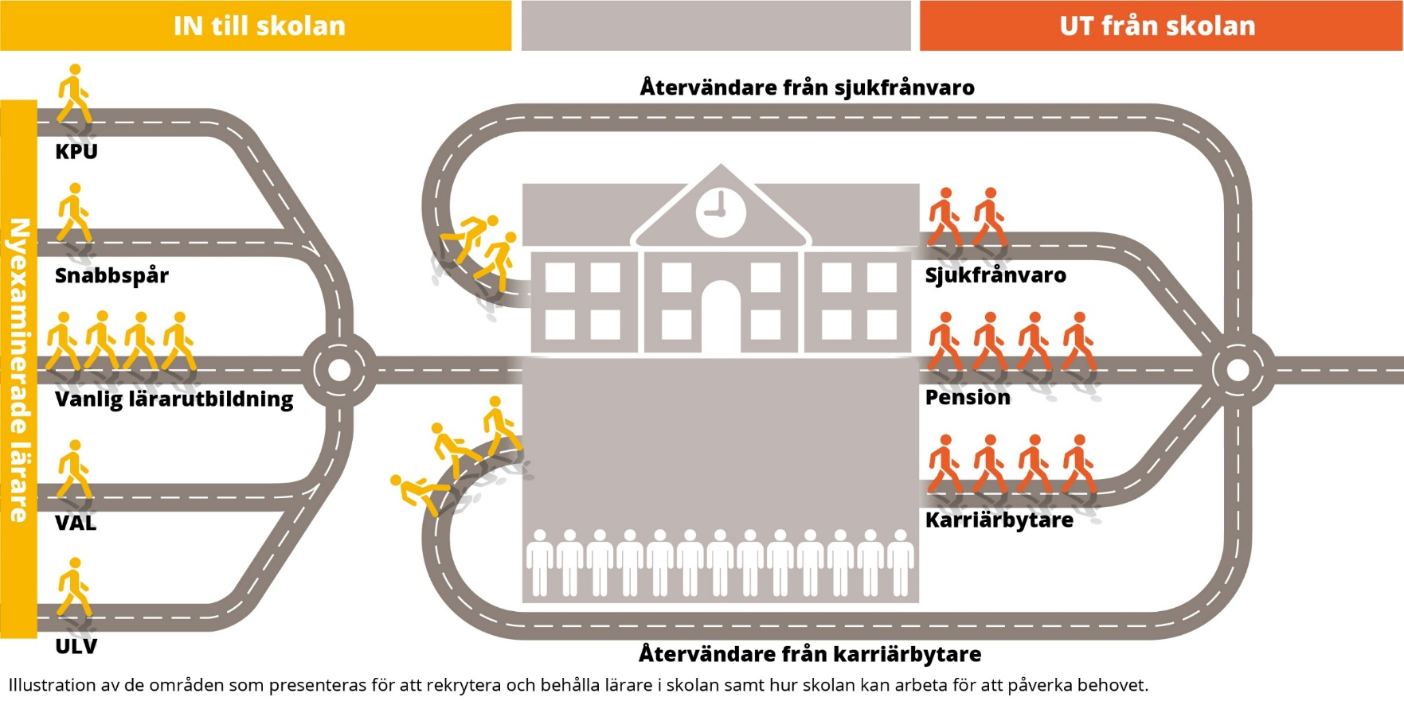
Train an retain teachers
Notes:
Helena

Slide 21
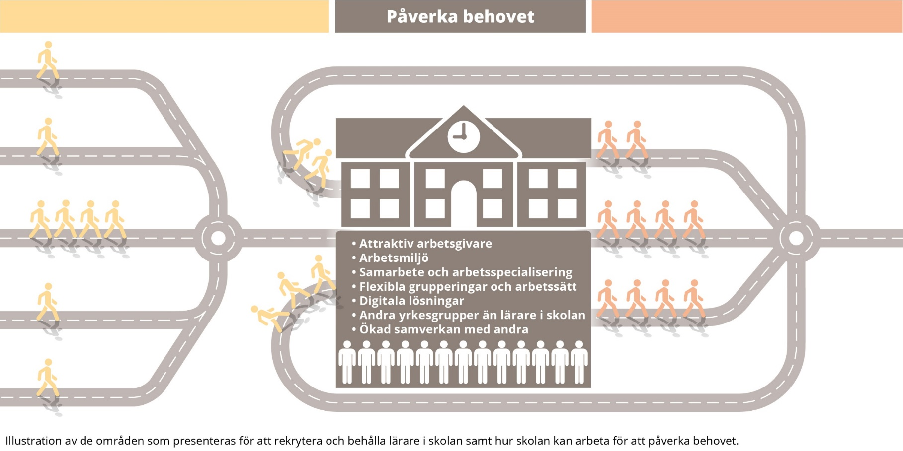
Organisation of teachers and others
Notes:
Helena
Fångat upp hos medlemmar, men färre exempel… Många står inför det - Mittköping

