Slide 1
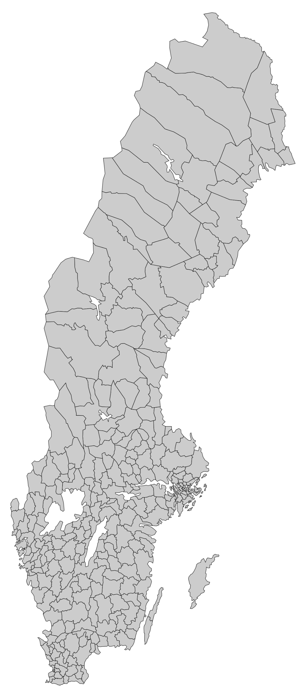
Swedens 290 municipalities
From Bjurholm with 2400 inhabitants to Stockholm with 974 000

Slide 2
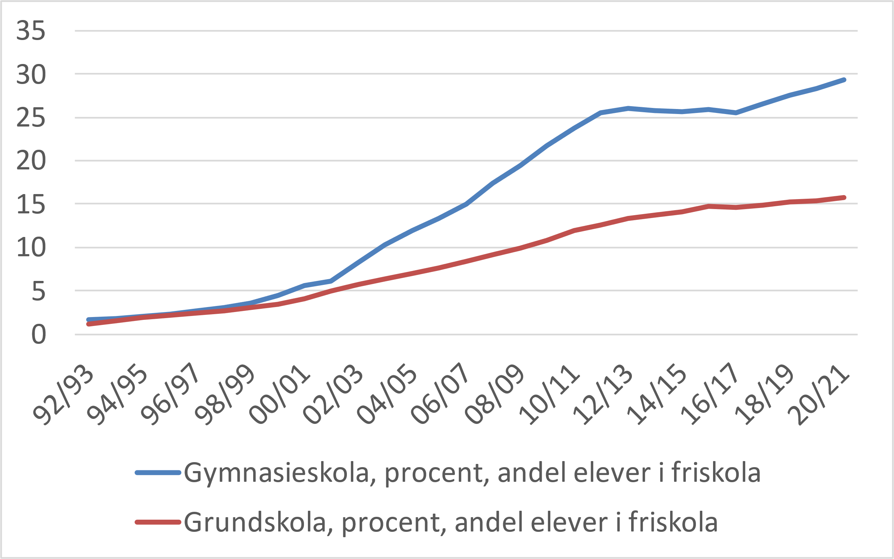
Share of students in independent schools compulsary and upper secondary

Slide 3
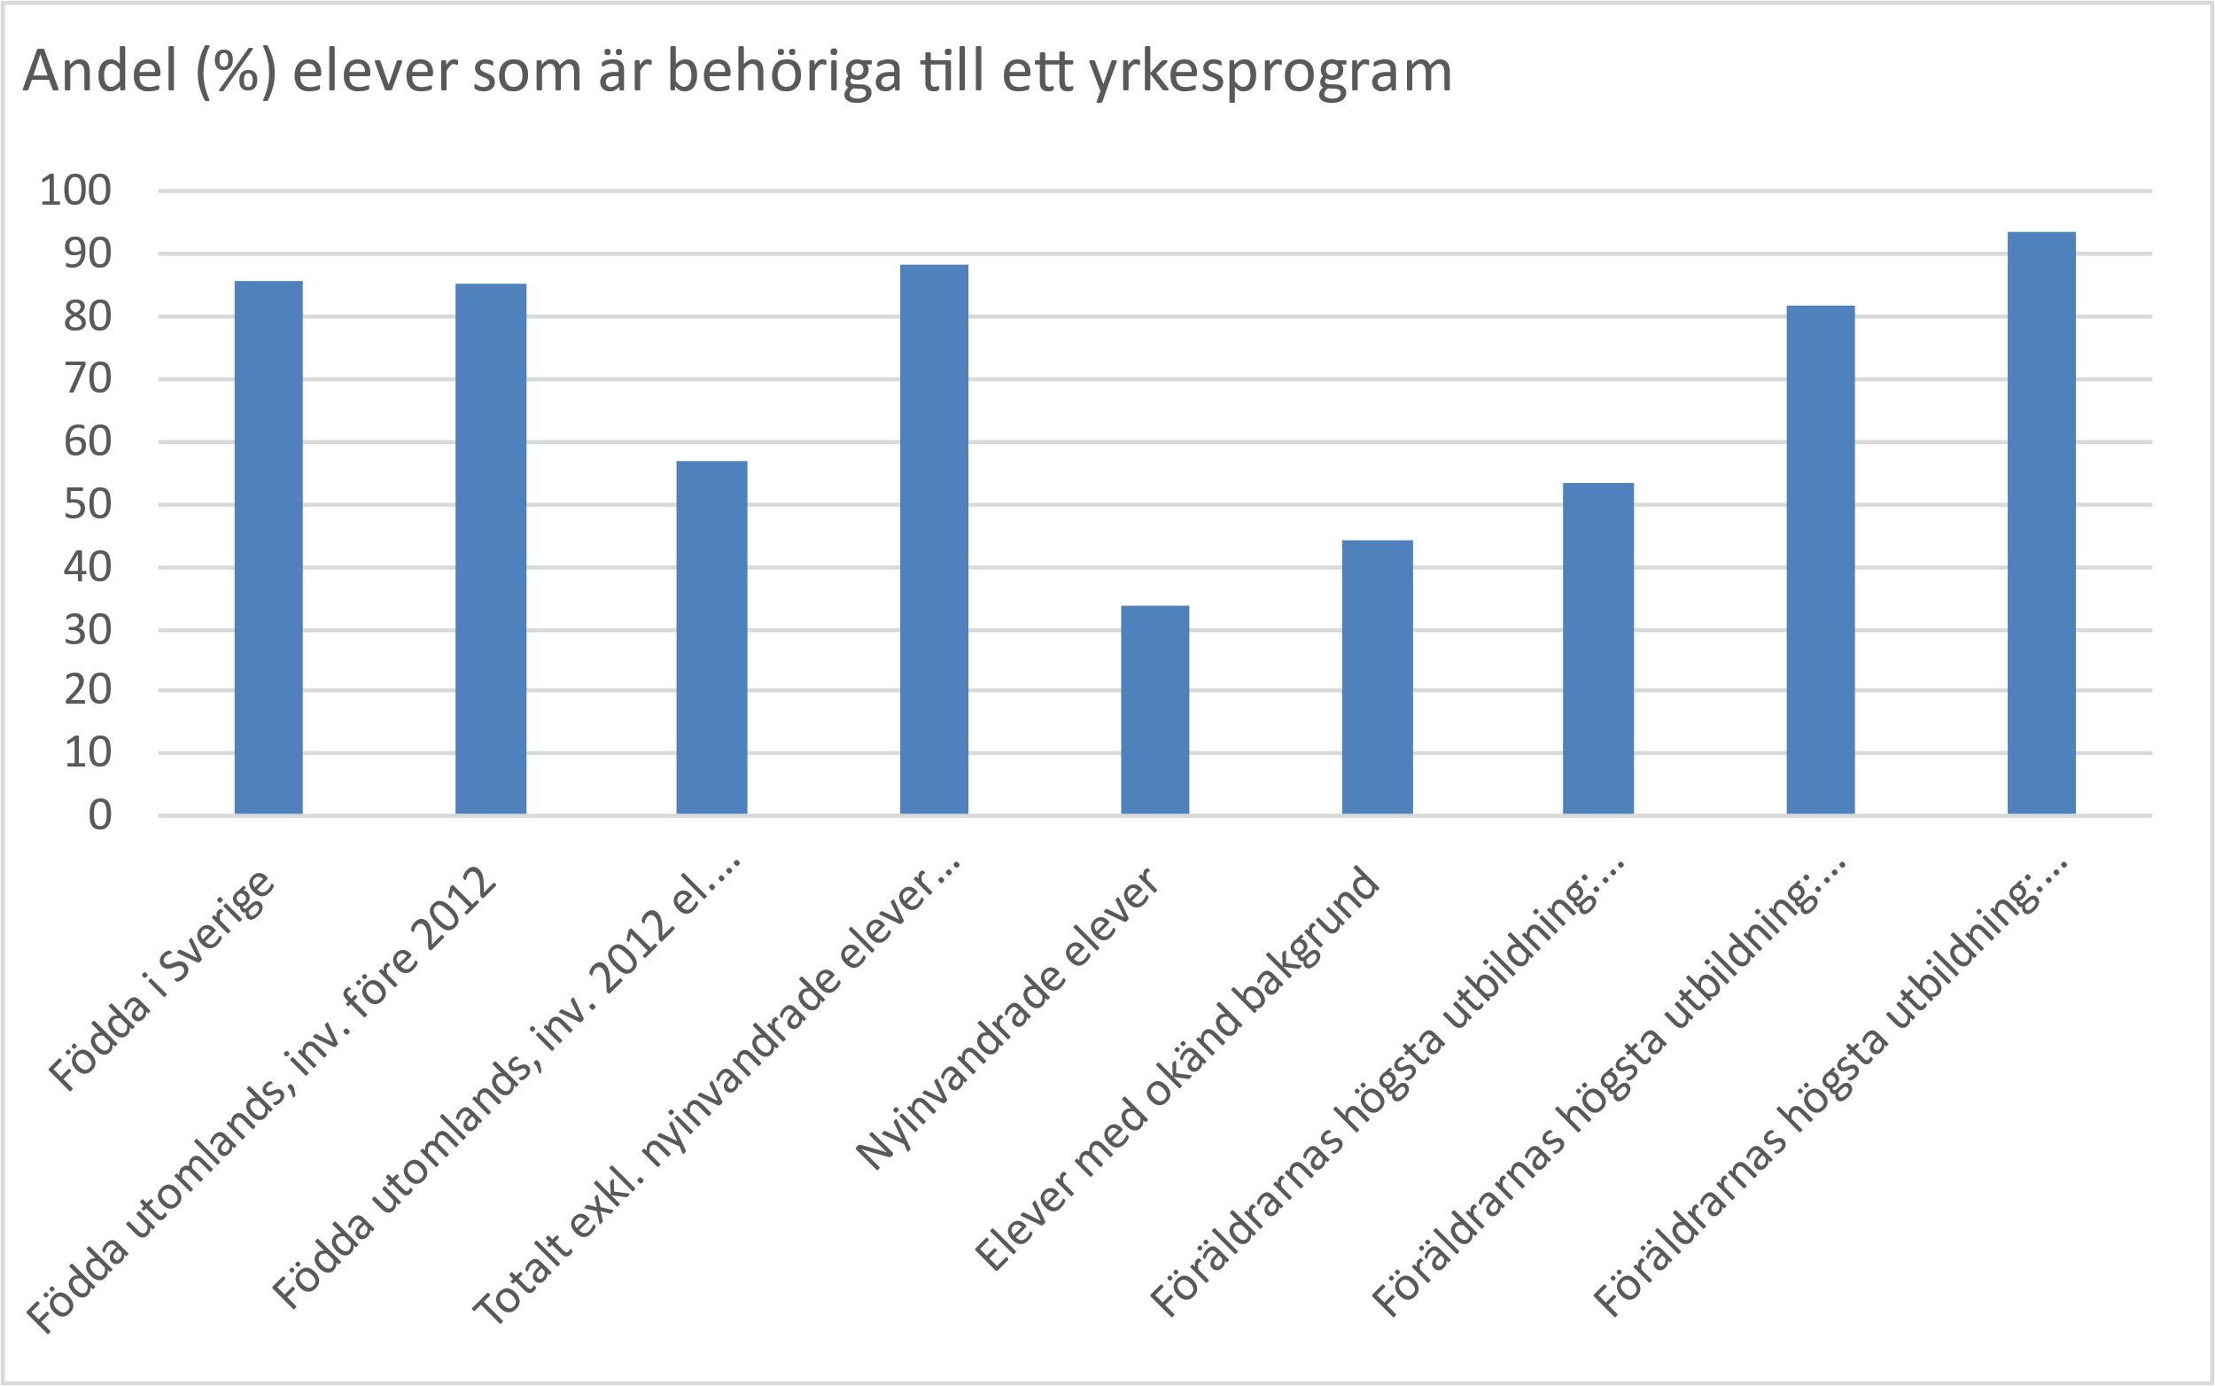
Share of students from compulsary school eligible to national programmes

Slide 4
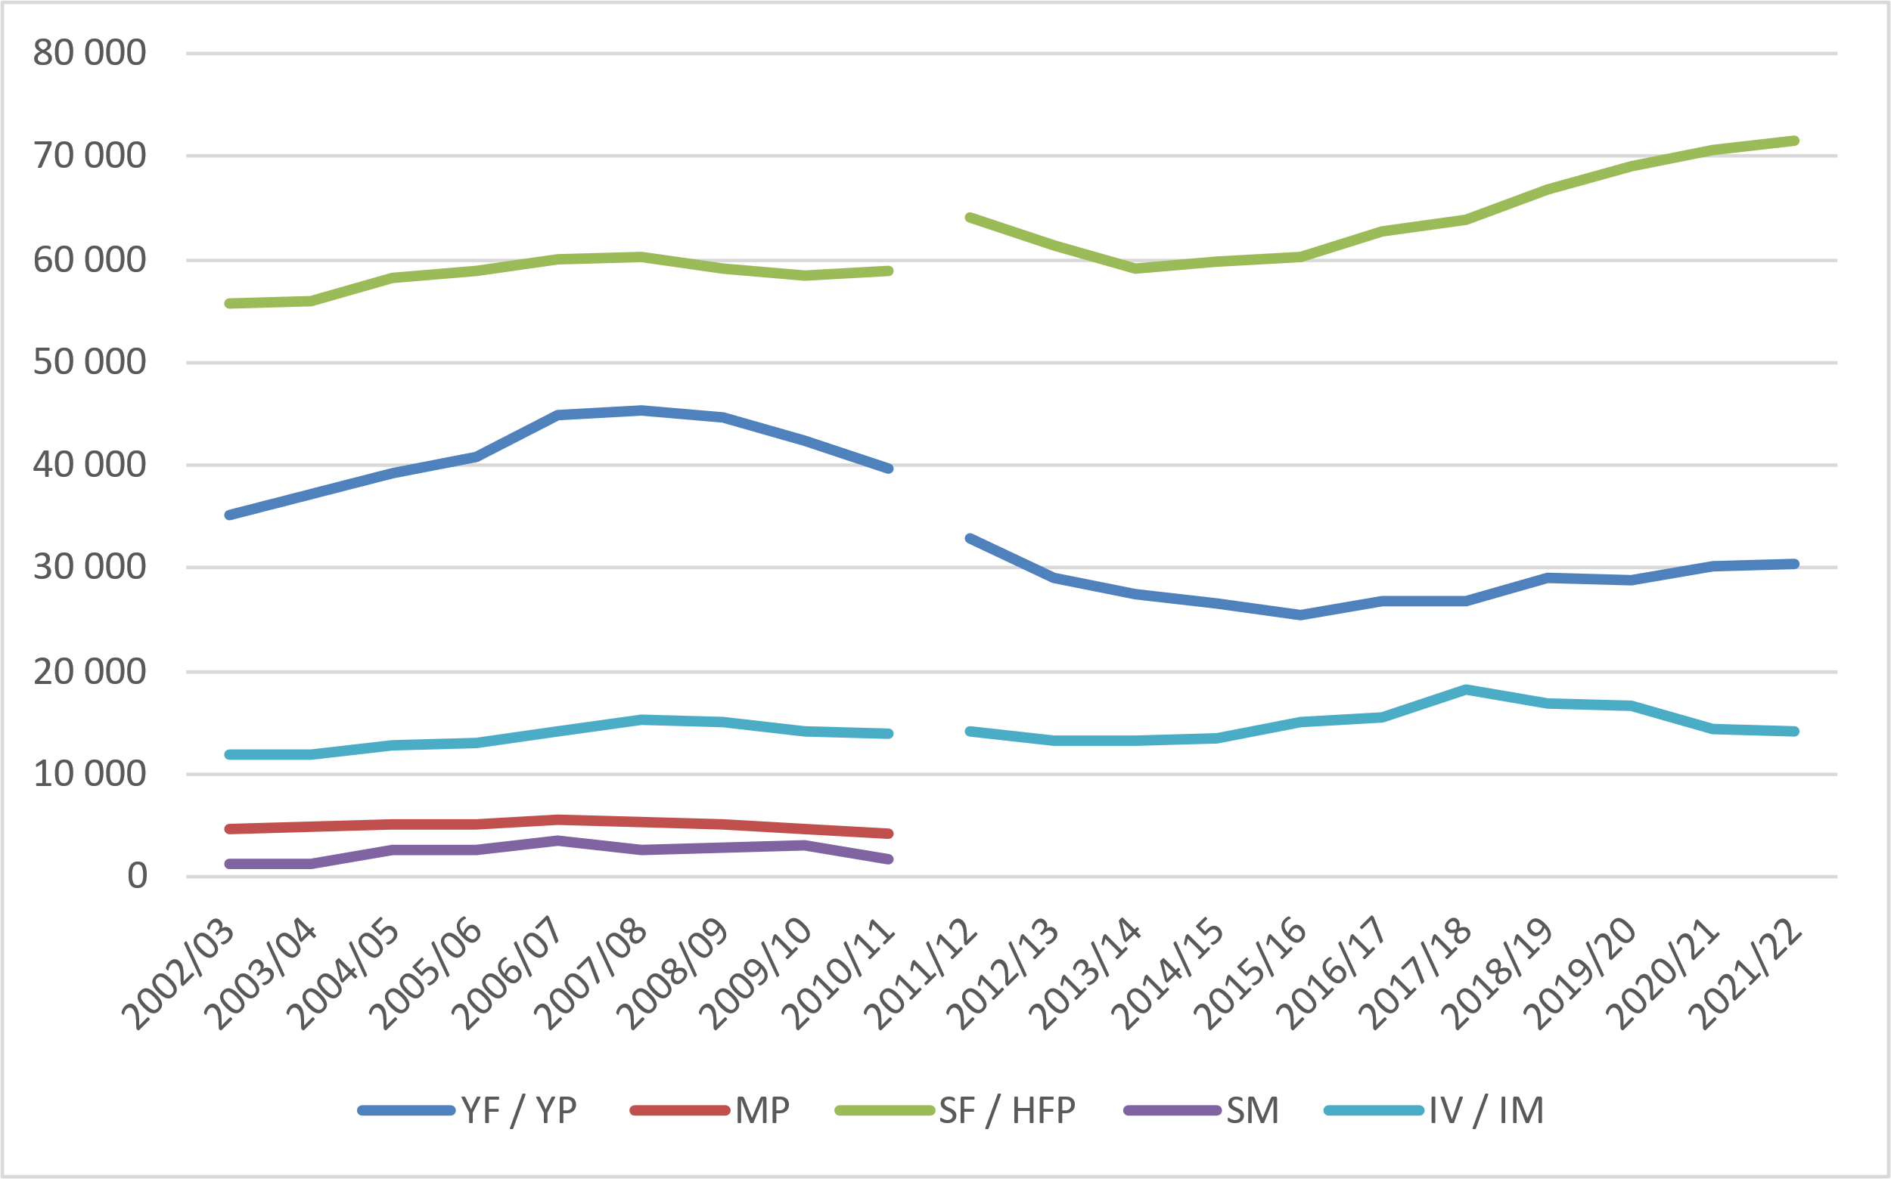
Number of students in different types of upper secondary programmes

Slide 5
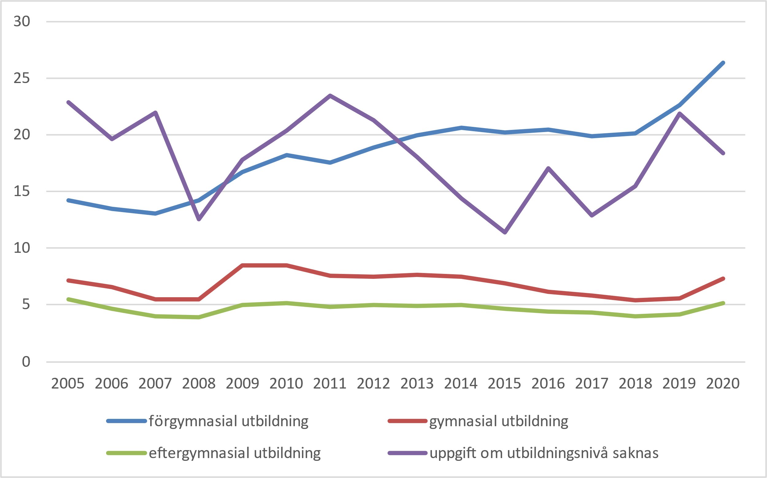
Unemployment rates after highest educational level

