Slide 1


The Swedish school system
and the National Agency for Education

Slide 2
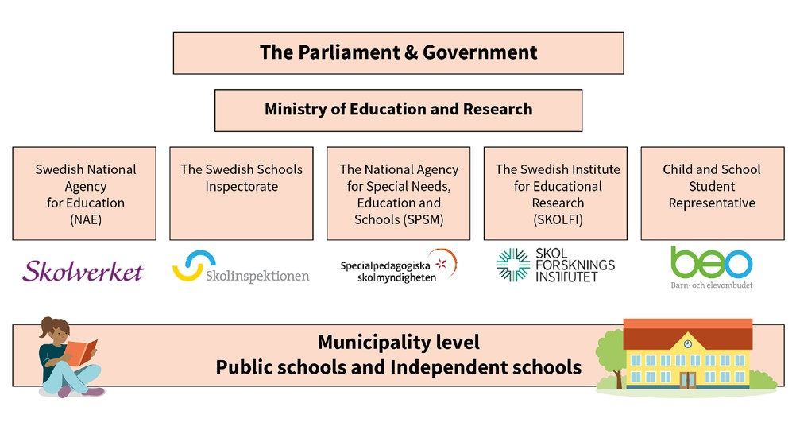


Slide 3
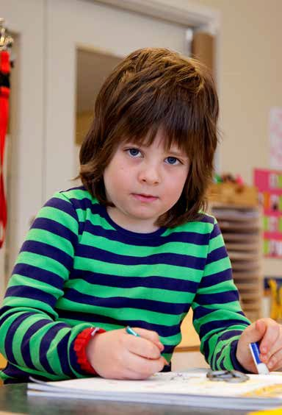
The National Agency for Education
Support, follow-up and evalutions in order to improve quality and outcomes
Steering documents
Evaluation and Official Statistics
Developement and in-service training
Teacher certification
Reference Centre for Vocational Education
Government grants
Notes:
Syftet med denna bild är att beskriva Skolverkets uppdrag och roll.
The National Agency for Education is the central administrative authority for the public school system, publicly organised preschooling, school-age childcare and for adult education.
The Swedish National Agency for Education is tasked with ensuring that all children and students have access to the same high-quality standard of education and activities in secure environments. Our mission is to create the best conditions for the children’s development and learning and to help improve the students’ learning outcomes.
SUPPORT, FOLLOW-UP AND EVALUATE
We focus on the principal organisers of the school, school heads, school leaders and teachers in the preschool, the preschool class, compulsory school , upper secondary schooling and adult education. We offer support to our target groups, follow and evaluate varoius activities and efforts at a system level in schools.
STEERING DOCUMENTS
NAE prepares knowledge requirements, syllabuses, regulations, general recommendations and national tests.
We have responsibility for issues concerning the disabled and the rights of newly arrivals in Sweden to receive the same high-quality education as everyone else.
EVALUATION AND OFFICIAL STATISTICS
NAE is also responsible for official statistics in the area of education and we conduct national follow-ups and evaluations. We also oversee Sweden’s participation in large-scale international education surveys (such as PISA and TIMSS).
DEVELOPMENT AN IN-SERVICE TRAINING
NAE also ensures that Swedish education maintains a good standard of quality. We achieve this with the help of national schools' development programs and in-service training of the staff. We distribute grants and arrange headmaster training programs.
TEACHER CERTIFICATION
NAE issues diplomas of certification to teachers and preschool teachers. The agency also has the responsibility for the Teachers’ Disciplinary Board.
REFERENCE CENTRE FOR VOCATIONAL EDUCATION
NAE’s task is to secure the national supply of competence and help young people establish a foothold on the labour market. We therefore support education providers, employers and other organizations in their efforts to improve the quality of upper-secondary vocational education.
GOVERNENMENT GRANTS
We administrate and distribute government grants to functions who are entitled to apply for grants.

Slide 4
Some characteristics of the Swedish school system
Equality of education
Equal rights to education up to university level
Same expectations on all school providers
Voucher system - no fees in independent schools
School material, school meals and transports free of charge
Teachers
Local agreements on individual salaries and working hours within a national framework
Shortage of teachers on all levels

Slide 5
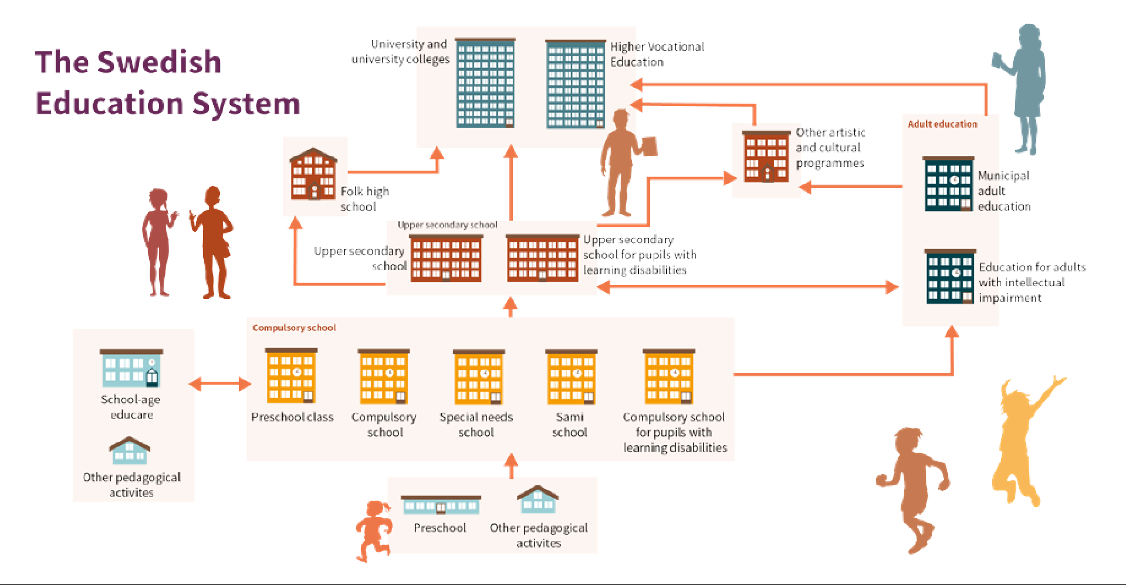
Notes:
Syftet med att visa bilden är att ge en överblick över hela utbildningsystemet och visa hur det hänger ihop.
Nedan är länk till vanlig fakta som brukar efterfrågas. Det går alltid att be att få återkomma med med fakta om det saknas någon information.
Se följande länk för aktuell statistik kring skolformerna i bilden ovan.
https://www.skolverket.se/skolutveckling/statistik/sok-statistik-om-forskola-skola-och-vuxenutbildning?sok=SokC&omrade=Skolor%20och%20elever&lasar=2020%2F21&verkform=F%C3%B6rskola

Slide 6
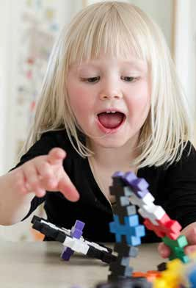
Preschool
A voluntary school form for children aged 1-5 years
Voluntary, general preschool from the age of 3, or from the age of 1 if this is needed because of parents' work or studies or the child's own needs
Should stimulate the child's development and learning, and also provide a secure care environment
Notes:
Municipalities are obliged to provide preschool for children from the age of 1 if the parents are studying or working and for older children if they do not attend school.
The preschool lays the foundations for the first part of a pupil's lifelong learning. The preschool has it’s own curriculum. Children should be provided with good pedagogical activities. The preschool should be enjoyable, secure, and rich in providing learning opportunities for all participating children. Children should have the opportunity of learning through playing, singing, creating and exploring – on their own, in groups and together with adults.
From the autumn term the year the child is 3 years old, the child is entitled to 525 free hours in preschool per year.
Children whose parents are unemployed or on parental leave must be offered a preschool place for at least 3 hours/day (or 15 hours/week) from the age of 1. Some municipalities offer more time.
Presentatören kompletterar med fakta och information som kan tänkas efterfrågas.

Slide 7
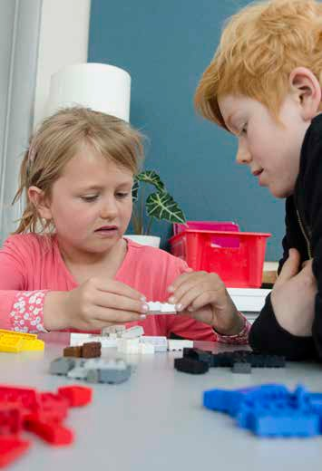
Preschool class
Compulsory school form, free of charge for children aged 6
Covers a minimum of 525 hours per academic year
Should stimulate pupils' development and learning and prepare them for further education
Combines the working approaches and methods of the preschool and school
Notes:
The preschool class is a compulsory school form in the national school system. It was previously voluntary but is since the fall semester of 2018 compulsory.
The municipalities are responsible for providing preschool classes and ensuring that pupils are offered places. Activities arranged by independent schools are an alternative to municipal activities. There are, however, significant differences around the country in how preschool classes are run. It varies from being run as a separate preschool to being fully integrated into the compulsory school.
The preschool class should function as a transition between the preschool and the compulsory school. The aim of the preschool class is that it should stimulate the development and learning of each pupil, and prepare them for further education, as well as promote their harmonious development. Play and creativity are essential components. The education should be based on an overall view of pupils and their needs.
Attendance is approximately 3 hours a day. During the rest of the day, most pupils are either in the leisure-time centre (fritids) or in pedagogical care.
Presentatören kompletterar med fakta och information som kan tänkas efterfrågas.

Slide 8
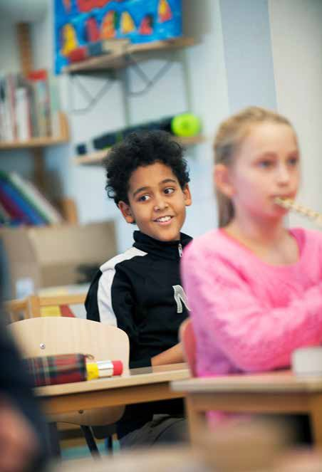
Compulsory school
School years: Preschool class to year 9 (10 years)
Grades from year 6 to year 9
School years 1-3
School years 4-6
School years 7-9
A syllabus apply for each subject. Subject syllabuses direct what pupils should learn.
Notes:
10 years including preschool class
A timetable (timplan) determines the number of instruction hours for school years 1-3, 4-6 and 7-9 respectively, but it’s the school provider who – together with the principal – decides how the hours should be divided within these school years.
Pupils recieve grades each semester from school year 6 until the end of the 9th school year.
Children are entitled to mother tongue education if one or both parents have a mother tongue other than Swedish. In order to be entitled to participate, the child also have to have basic knowledge of the language and use it at home every day.
Presentatören kompletterar med fakta och information som kan tänkas efterfrågas.

Slide 9
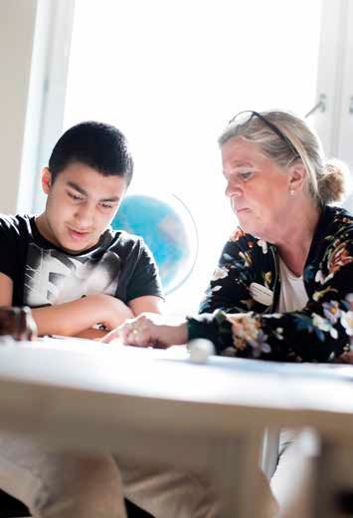
Alternative schooling
The Compulsory school for pupils with learning disabilities
The Special school
The Sami school
7 international schools, 3 national boarding schools, special youth homes and Swedish schools abroad
Notes:
There are alternatives to the compulsory school
COMPULSORY SCHOOL FOR PUPILS WITH LEARNING DISABILITIES
Sometimes together with the training school, has its own curriculum and syllabuses, for year 1 - 9 with the option of an additional year
Compulsory school for pupils with learning disabilities aims to provide an education for children with learning disabilities that is adapted to each pupil's circumstances and provides education which as far as possible corresponds to the education provided in the compulsory school. The education can also cover subjects in accordance with the compulsory school syllabuses.
Within the compulsory school for pupils with learning disabilities, there is a special orientation called the Compulsory school for children with severe learning disabilities, which is intended for pupils who have not completed their education in various subjects.
SPECIAL SCHOOL (THE NATIONAL AGENCY FOR SPECIL NEEDS EDUCATION AND SCHOOLS)
Children who due to a functional impairment or for other special reasons cannot attend the compulsory school or the compulsory school for pupils with learning disabilities, can attend the special school if they are deaf-blind, visually impaired, have other functional impairments, are deaf or hearing impaired, or have a severe speech disorder.
The special school provides 10 years of schooling.
SAMI SCHOOL
- (The Sami are an indigenous people of northern Europe) Children of Samis can attend the Sami school. Other children can also attend the Sami school if there are special reasons. Education in the Sami school covers grades 1-6. After this, pupils move on to the compulsory school.
The syllabuses of the compulsory school apply to the Sami school, but the Sami school also has its own syllabus in Sami. If the pupils wish, they can study Sami as a mother tongue in the compulsory school.
INTERNATIONAL SCHOOLS
An international school is, according to the Education Act, a school which, instead of following a Swedish curriculum, is run according to another country's curriculum or an international curriculum.
The school may receive:
• students who live in Sweden for a limited time
• students who have gone to school abroad for a long time and want to finish their education in Sweden
• students who are about to leave Sweden for a longer period of time
• students who have the school's language of instruction as a daily language of communication with at least one of the guardians and who have sufficient knowledge of the language to be able to follow the teaching.
Presentatören kompletterar med fakta och information som kan tänkas efterfrågas.

Slide 10
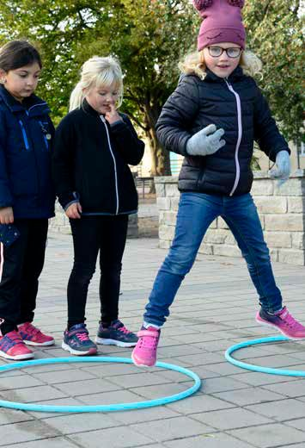
Leisure-time centre
Supplements the school for pupils aged between 6- 13 years
Voluntary
Should ”stimulate pupils' development and also provide them with meaningful recreational activities”
Municipalities must provide leisure-time centres
Notes:
LEISURE-TIME CENTRE
The leisure-time centre receives pupils during the day when they are not at school and during holidays.
Voluntary
The task of the leisure-time centre is to supplement the preschool class and the school and make it possible for parents to combine parenthood with work or studies. According to the Education Act, leisure-time centres should also stimulate pupils' development and learning and provide them with meaningful activities. Leisure-time centres have an important role in promoting social interaction and the sense of being a part of a social community.
MUNICIPALITIES MUST OFFER LEISURE-TIME CENTRES
The child’s home municipality must offer leisure-time centres to all pupils that are enrolled in the municipal preschool class, compulsory school and compulsory school for pupils with learning disabilities until the spring semester when the student turn 13.
Instead of leisure-time centre, the municipality can offer open leisure-time activities from the fall semester the year the student turn 10 IF the student due to physical or mental reasons don’t require a place at a leisure-time centre.
The child’s home municipality must also provide leisure-time centres for pupils that are enrolled in an independent school IF the independent school provider can’t offer education in a leisure-time centre.
The state should provide leisure-time centres to all pupils in the special school and in the Sami school.
The leisure-time centre should in applicable parts follow the curriculum for the compulsory school, the preschool class and the leisure-time centre
Presentatören kompletterar med fakta och information som kan tänkas efterfrågas.

Slide 11
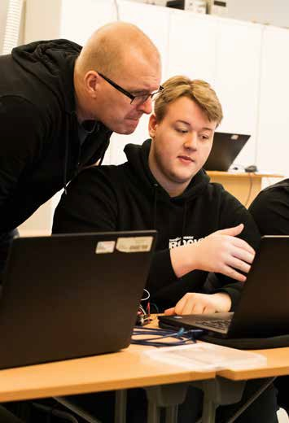
Upper secondary school
All pupils who have completed compulsory schooling are offered upper secondary school by their home municipality
The right to start an upper secondary school applies to students up to the age of 20
Free of charge and voluntary
Notes:
All youths in Sweden who have completed compulsory school are entitled to a 3-year upper secondary school
Upper secondary school aims to provide a good foundation for working life, further studies, personal development and active participation in the life of society.
All municipalities are required by law to offer upper secondary schooling to all pupils who have completed compulsory school.

Slide 12
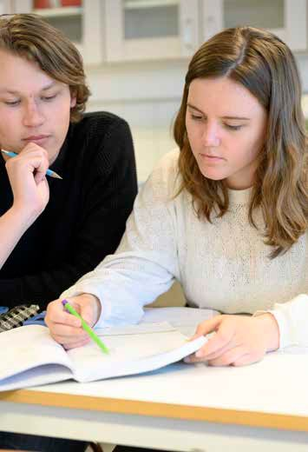
Upper secondary school
National programmes
Vocational programmes/Apprenticeship education
Higher education preparatory programmes
Upper secondary programmes with nationwide admission
Notes:
NATIONAL PROGRAMMES
The Parliament decides what programs and what standard subjects are to be offered.
There are 18 national programmes in the upper secondary school.
Each programme is 3 years long. The various upper secondary programmes can either be vocational or prepare pupils for higher education.
The total instruction time on Vocational programmes should be at least 2 430 hours of instruction (More instruction hours because of work-based learning)
The total instruction time on Higher education preparatory programmes should be at least 2 180 hours
The school provider decides how the instruction hours should be divided between different courses and through the school year(s).
There are several options to the national programmes
Upper secondary programmes with nationwide admission such as Professional dance education, Aerotechnics & Marine Technology,

Slide 13
National programmes Upper secondary school
Higher education preparatory programmes
Business Management and Economics
Arts
Humanities
Natural Science
Social Science
Technology
Vocational programmes/
Apprenticeship eduaction
Child and Recreation
Building and Construction
Electricity and Energy
Vehicle and Transport
HVAC and Property Maintenance
Health and Social care
Business and Administration
Handicrafts
Hotel and Tourism
Industrial technology
Natural Resource use
Resturant Management and Food
Notes:
Syfte med bilden är att visa på bredd och variation när det gäller gymnsieprogram. Den mer detaljerade information nedan är främst för specifikt efterfrågad info
VOCATIONAL PROGRAMMES
2 forms of Vocational programmes: School based vocational programmes & Apprentice based VET where students carry out a more than half of their education at one or several workplaces..
After completing a vocational programme, students should be well prepared for working life.
The education should be of high quality and equip students with the necessary vocational skills.
It should be possible to start working directly after completing the education.
In order to strengthen cooperation between the upper secondary school and working life, national programme councils exist to validate the vocational programmes.
Work-based learning is integrated in the Vocational programmes (minimum 15 weeks in vocational programmes and minimum 50% work-based learning in apprentice based VET)
BASIC ELIGIBILITY FOR HIGHER EDUCATION
If pupils in Vocational programmes want basic eligibility for higher education, they need to complement the standard range in English and Swedish.
Depending on which university education they want to attend after upper secondary school, they may also need to add additional courses as well.
HIGER EDUCATION PREPARATORY PROGRAMMES
The higher education preparatory programmes are intended to prepare students for studies in higher education.
The admission requirements for starting upper secondary education differ between vocational programmes and Higher education preparatory programmes
To be admitted to a national programme, students must have passing grades in Swedish or Swedish as a second language, English and Mathematics.
Studying a vocational programme requires passing grades in 5 further subjects, making a total of 8 passing grades
The higher education preparatory programmes require passing grades in a at least 9 further subjects, making a total of 12 passing grades.

Slide 14
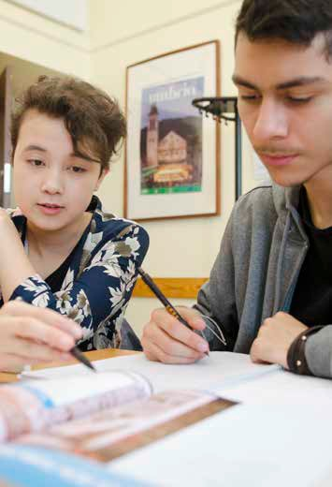
Alternatives to the National programmes
Introductory programmes
Programme oriented individual options
Vocational introduction
Individual alternative
Language introduction
Notes:
There are introductory programmes for students who are not qualified for the national programmes in upper secondary school.
The pupils’ home municipalities are responsible for offering introductory programmes to those who don’t fulfil the requirements for being accepted to the national programmes.
Education on an introductory programme has to follow a plan drawn by the principal, which must include the purpose and duration of the programme and specify its main content. An individual study plan must also be drawn up for each pupil and must take the pupil’s needs and interests into account.
PREPARATORY PROGRAMME
PROGRAMME ORIENTED INDIVIDUAL OPTIONS
Programme oriented individual options should lead to admission to a national vocational programme. To be admitted, students must have passing grades in Swedish or Swedish as a second language. In addition, passing grades are required in English or mathematics and in at least four other subjects, or passing grades in English and mathematics and at least three other subjects. Students can follow a number of courses in a national programme at the same time as they study courses needed to achieve eligibility.
VOCATIONAL INTRODUCTION
The vocational introduction is intended for students who lack passing grades for admission to a vocational programme. Students should receive a vocationally oriented education which improve their chances to establish themselves on the labour market or that leads to studies in a vocational programme.
INDIVIDUAL ALTERNATIVE
The individual alternative prepares students for the vocational introduction, other forms of further education or the labour market. The education is designed for students on an individual level and is intended for students with profound lack of knowledge, weak motivation and that aren’t qualified for a national vocational programme.
LANGUAGE INTRODUCTION
The language introduction aims to provide newly arrived immigrant youths with an education in Swedish enabling them to progress to the upper secondary school or other forms of education. The students can also get tuition in other compulsory and secondary subjects that the student needs for further education.

Slide 15
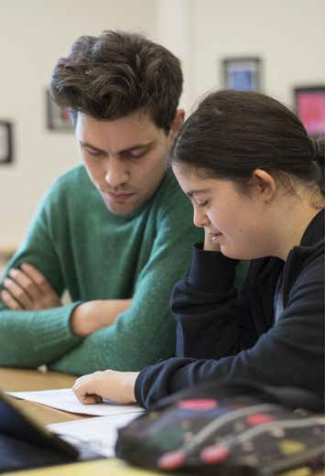
Alternative upper secondary schooling
Upper secondary school for pupils with learning disabilities
Swedish schools abroad
Special institutions (state)
Distance education at upper secondary level in Torsås
International schools
IB education
Notes:
Upper secondary school for pupils with learning disabilities
Upper secondary school for individuals with learning disabilities is a voluntary type of school which young people with learning disabilities can choose to attend. There are nine national upper secondary school programmes, largely mirroring the programmes of upper secondary school but adjusted to provide optimal learning for the target group. The national programmes are primarily vocational. The duration of each programme is four years. In all national programmes, a minimum of 22 weeks of work-based learning should be included.
A national programme may also be undertaken as an upper secondary school apprenticeship. All students should complete a diploma project at the end of the education. This should be in line with the programme’s objectives and the student’s education. The project aims to show that students can manage normal tasks at work in a vocational area. There are also individual programmes for learners with severe learning disabilities. These programmes are tailored to the needs of the individual students. In 2020/21 6 580 students were enrolled in one of the programmes in upper secondary school for individuals with learning disabilities. 3 780 students were enrolled in a national programme and 2 800 were enrolled in an individual programme.
Swedish schools abroad
The Swedish schools abroad are entitled to state subsidies for education in pre-school classes and in grades 1-6. In some cases also for upper secondary school grades 7-9 and upper secondary school 1-3. There are currently 18 schools abroad that receive government grants.
Teaching at foreign schools corresponds as far as possible to that which student receive in Sweden. The schools follow the Swedish curricula, and the teaching is in Swedish. Swedish schools abroad that receive government grants have the right to set grades. The Swedish Schools Inspectorate supervises the activities that receive government grants. The National Agency for Education is responsible for follow-up and evaluation of the activities.
Special institutions
The education within special institutions (SIS) shall correspond to the education in the compulsory, upper secondary and upper secondary special school, respectively. Relevant provisions in the Education Act shall be applied with the necessary deviations that follow from the child or young person staying in a special youth home. Furthermore, certain specified provisions in the Education Act do not need to be applied. In light of the regulation in the Education Act, all special youth homes have school activities. Each school has a principal and a focus for the school (and the department) on compulsory and / or non-compulsory students.
There is also national recruitment training for young people who are deaf and hard of hearing, deafblind or young people with severe mobility impairments.
Distance education at upper secondary level in Torsås
The municipality of Torsås may, within the framework of a pilot project, organize national programs in upper secondary school through distance education for students from all over the country. The education, which is given via Korrespondensgymnasiet, may be arranged as distance learning with study guidance and regulated in a special ordinance.
International schools and IB education
Schools providing education at upper secondary level that follows the curriculum of another country or that of IB. They are not part of the Swedish school system.

Slide 16
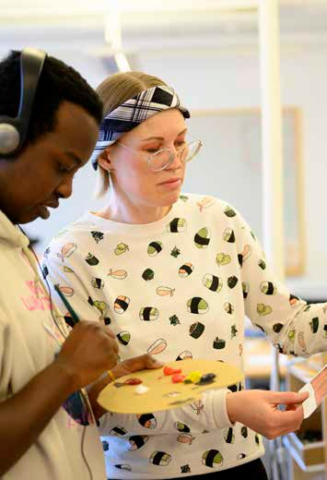
National Agency for Education priorities
Local school governance, leadership and development
School segregation
Supply of teachers
Digitalization
Curricula, course and subject plans
The benefit of state grants
Notes:
Valbar bild med syfte att lyfta blicken och kunna presentera tre av Skolverkets prioriterade områden samt aktuella frågor i svensk utbildningskontext. Nedan presenteras Skolverkest mål för några av de prioriterade områdena samt önskvärda lägen. Presentatören tar själv fram fördjupad information vid behov.
The National Agency for Education has set up six prioritised areas based on some of the challenges within the educational system. There are six prioritised areas for the school sector and the Agency has a variety of actions to fulfil the goals of each area. Below we presents the objectives for each of the six prioritised areas.
Governance and leadership
Objective: School are developed systematically based on the national objectives with the support of science and proven experience.
School segregation
Objective: In the school system, compensatory measures are taken to counteract the negative effects of school segregation.
Supply of teachers
Objective: In the school system, teaching is carried out by competent and certified preschool teachers and teachers.
Digitization
Objective: Digitization strengthens the quality of teaching in the school system.
Curricula, course and subject plans
Objective: Curricula, course and subject plans provide conditions for one good and equivalent teaching in the school system.
The benefit of state grants
Objective: Government grants contribute to increased quality in the school system.

