Slide 1
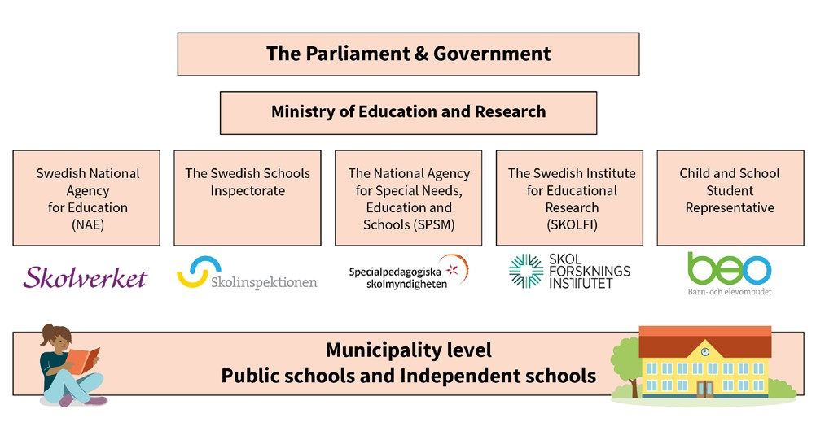


Slide 2

The National Agency for Education
Support, follow-up and evalutions in order to improve quality and outcomes
Steering documents
Evaluation and Official Statistics
Developement and in-service training
Teacher certification
Reference Centre for Vocational Education
Government grants
Notes:
Syftet med denna bild är att beskriva Skolverkets uppdrag och roll.
The National Agency for Education is the central administrative authority for the public school system, publicly organised preschooling, school-age childcare and for adult education.
The Swedish National Agency for Education is tasked with ensuring that all children and students have access to the same high-quality standard of education and activities in secure environments. Our mission is to create the best conditions for the children’s development and learning and to help improve the students’ learning outcomes.
SUPPORT, FOLLOW-UP AND EVALUATE
We focus on the principal organisers of the school, school heads, school leaders and teachers in the preschool, the preschool class, compulsory school , upper secondary schooling and adult education. We offer support to our target groups, follow and evaluate varoius activities and efforts at a system level in schools.
STEERING DOCUMENTS
NAE prepares knowledge requirements, syllabuses, regulations, general recommendations and national tests.
We have responsibility for issues concerning the disabled and the rights of newly arrivals in Sweden to receive the same high-quality education as everyone else.
EVALUATION AND OFFICIAL STATISTICS
NAE is also responsible for official statistics in the area of education and we conduct national follow-ups and evaluations. We also oversee Sweden’s participation in large-scale international education surveys (such as PISA and TIMSS).
DEVELOPMENT AN IN-SERVICE TRAINING
NAE also ensures that Swedish education maintains a good standard of quality. We achieve this with the help of national schools' development programs and in-service training of the staff. We distribute grants and arrange headmaster training programs.
TEACHER CERTIFICATION
NAE issues diplomas of certification to teachers and preschool teachers. The agency also has the responsibility for the Teachers’ Disciplinary Board.
REFERENCE CENTRE FOR VOCATIONAL EDUCATION
NAE’s task is to secure the national supply of competence and help young people establish a foothold on the labour market. We therefore support education providers, employers and other organizations in their efforts to improve the quality of upper-secondary vocational education.
GOVERNENMENT GRANTS
We administrate and distribute government grants to functions who are entitled to apply for grants.

Slide 3

National Agency for Education priorities
Local school governance, leadership and development
School segregation
Supply of teachers
Digitalization
Curricula, course and subject plans
Skills supply
Notes:
Valbar bild med syfte att lyfta blicken och kunna presentera tre av Skolverkets prioriterade områden samt aktuella frågor i svensk utbildningskontext. Nedan presenteras Skolverkest mål för några av de prioriterade områdena samt önskvärda lägen. Presentatören tar själv fram fördjupad information vid behov.
The National Agency for Education has set up six prioritised areas based on some of the challenges within the educational system. There are six prioritised areas for the school sector and the Agency has a variety of actions to fulfil the goals of each area. Below we presents the objectives for each of the six prioritised areas.
Governance and leadership
Objective: School are developed systematically based on the national objectives with the support of science and proven experience.
School segregation
Objective: In the school system, compensatory measures are taken to counteract the negative effects of school segregation.
Supply of teachers
Objective: In the school system, teaching is carried out by competent and certified preschool teachers and teachers.
Digitization
Objective: Digitization strengthens the quality of teaching in the school system.
Curricula, course and subject plans
Objective: Curricula, course and subject plans provide conditions for one good and equivalent teaching in the school system.
The benefit of state grants
Objective: Government grants contribute to increased quality in the school system.

